Slide 1
Hiding Secrecy Leakage in Leaky Helper Data
Matthias Hiller¹ and Aysun Gurur Önalan²
¹Fraunhofer AISEC; ²Technical University of Munich
Conference on Cryptographic Hardware and Embedded Systems (CHES)
28/09/2017, Taipei, Taiwan

Slide 2
Agenda
Key generation with biased PUFs
Motivation
State of the Art
Wiretap Coset Coding for PUFs
Example
Trade-offs
Practical Results

Slide 3
Problem: Biased PUFs
Wish / Promise
PUF responses independent and uniform
Reality
PUF responses often biased
► Leakage e.g. Delvaux et al. CHES 2016
Leakage mitigation required with debiasing step

Slide 4
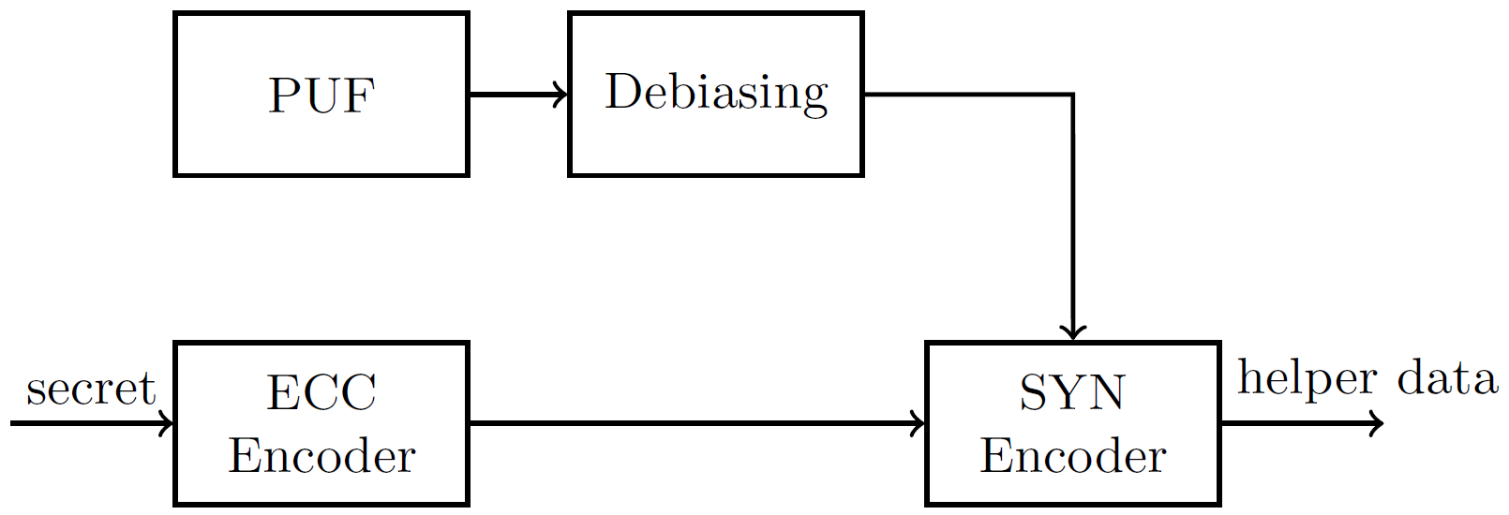
System View: Helper Data Generation with PUFs

Slide 5
Debiasing: State of the Art
Index-Based Syndrome Coding
Stores pointers to most reliable
0 or 1 in a block
Yu and Devadas, IEEE S&T 2010

Slide 6
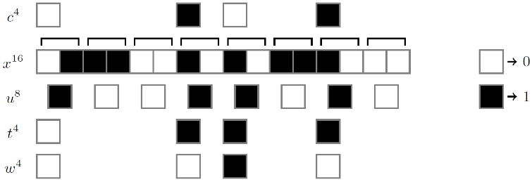
Debiasing: State of the Art
Von-Neumann Corrector
Evaluates the order of bits in pairs
Occuring with the same probability
Maes et al., CHES 2015

Slide 7
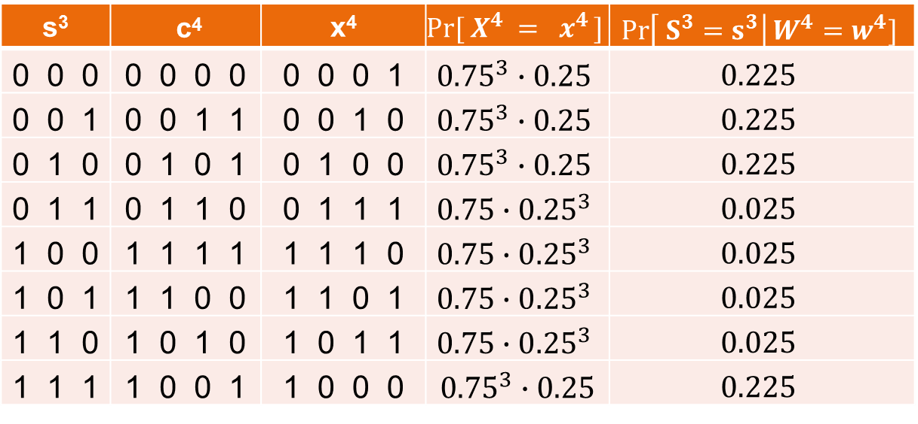
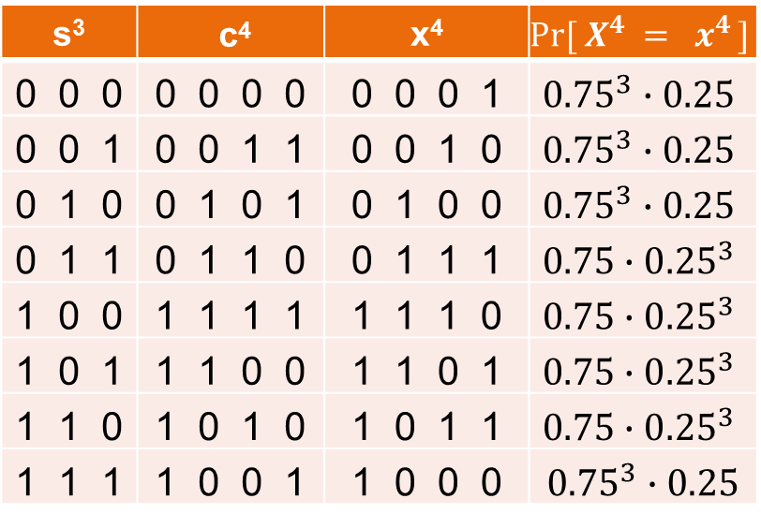
Wiretap Coset Codes for PUFs
$\text{Reed} \text{Muller} \text{Code}\text{:}$ $RM\left(1,2\right)≜\left[4,3,2\right]$
Helper data: w⁴ ⁼ c⁴ + x⁴ = 0001
s³ | c⁴
0 0 0 | 0 0 0 0
0 0 1 | 0 0 1 1
0 1 0 | 0 1 0 1
0 1 1 | 0 1 1 0
1 0 0 | 1 1 1 1
1 0 1 | 1 1 0 0
1 1 0 | 1 0 1 0
1 1 1 | 1 0 0 1
s³ | c⁴ | x⁴
0 0 0 | 0 0 0 0 | 0 0 0 1
0 0 1 | 0 0 1 1 | 0 0 1 0
0 1 0 | 0 1 0 1 | 0 1 0 0
0 1 1 | 0 1 1 0 | 0 1 1 1
1 0 0 | 1 1 1 1 | 1 1 1 0
1 0 1 | 1 1 0 0 | 1 1 0 1
1 1 0 | 1 0 1 0 | 1 0 1 1
1 1 1 | 1 0 0 1 | 1 0 0 0
s³ | c⁴ | x⁴ | $$Pr[ X^{4} = x^{4} ]$$
0 0 0 | 0 0 0 0 | 0 0 0 1 | $${0.75}^{3}∙0.25$$
0 0 1 | 0 0 1 1 | 0 0 1 0 | $${0.75}^{3}∙0.25$$
0 1 0 | 0 1 0 1 | 0 1 0 0 | $${0.75}^{3}∙0.25$$
0 1 1 | 0 1 1 0 | 0 1 1 1 | $$0.75∙{0.25}^{3}$$
1 0 0 | 1 1 1 1 | 1 1 1 0 | $$0.75∙{0.25}^{3}$$
1 0 1 | 1 1 0 0 | 1 1 0 1 | $$0.75∙{0.25}^{3}$$
1 1 0 | 1 0 1 0 | 1 0 1 1 | $$0.75∙{0.25}^{3}$$
1 1 1 | 1 0 0 1 | 1 0 0 0 | ${0.75}^{3}∙0.25$
s³ | c⁴ | x⁴ | $$Pr[ X^{4} = x^{4} ]$$ | $$\operatorname{Pr}\left[ S^{3}=s^{3}\right|W^{4}=w^{4}]$$
0 0 0 | 0 0 0 0 | 0 0 0 1 | $${0.75}^{3}∙0.25$$ | $$0.225$$
0 0 1 | 0 0 1 1 | 0 0 1 0 | $${0.75}^{3}∙0.25$$ | $$0.225$$
0 1 0 | 0 1 0 1 | 0 1 0 0 | $${0.75}^{3}∙0.25$$ | $$0.225$$
0 1 1 | 0 1 1 0 | 0 1 1 1 | $$0.75∙{0.25}^{3}$$ | $$0.025$$
1 0 0 | 1 1 1 1 | 1 1 1 0 | $$0.75∙{0.25}^{3}$$ | $$0.025$$
1 0 1 | 1 1 0 0 | 1 1 0 1 | $$0.75∙{0.25}^{3}$$ | $$0.025$$
1 1 0 | 1 0 1 0 | 1 0 1 1 | $$0.75∙{0.25}^{3}$$ | $$0.025$$
1 1 1 | 1 0 0 1 | 1 0 0 0 | ${0.75}^{3}∙0.25$ | $$0.225$$
Biased distribution: $Pr\left(1\right)=b=0.25$

Slide 8
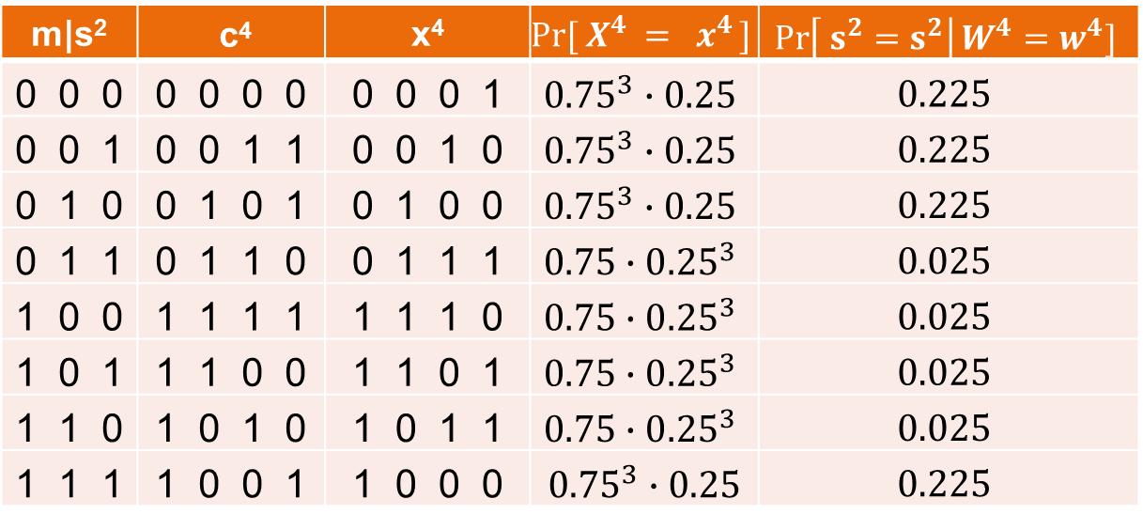
Wiretap Coset Codes for PUFs
m|s² | c⁴ | x⁴ | $$Pr[ X^{4} = x^{4} ]$$ | $$\operatorname{Pr}\left[ s^{2}=s^{2}\right|W^{4}=w^{4}]$$
0 0 0 | 0 0 0 0 | 0 0 0 1 | $${0.75}^{3}∙0.25$$ | $$0.225$$
0 0 1 | 0 0 1 1 | 0 0 1 0 | $${0.75}^{3}∙0.25$$ | $$0.225$$
0 1 0 | 0 1 0 1 | 0 1 0 0 | $${0.75}^{3}∙0.25$$ | $$0.225$$
0 1 1 | 0 1 1 0 | 0 1 1 1 | $$0.75∙{0.25}^{3}$$ | $$0.025$$
1 0 0 | 1 1 1 1 | 1 1 1 0 | $$0.75∙{0.25}^{3}$$ | $$0.025$$
1 0 1 | 1 1 0 0 | 1 1 0 1 | $$0.75∙{0.25}^{3}$$ | $$0.025$$
1 1 0 | 1 0 1 0 | 1 0 1 1 | $$0.75∙{0.25}^{3}$$ | $$0.025$$
1 1 1 | 1 0 0 1 | 1 0 0 0 | ${0.75}^{3}∙0.25$ | $$0.225$$
$$\operatorname{Pr}\left[ S^{2}=s^{2}\right|W^{4}=w^{4}]=$$
$$0.225+0.025=0.25$$

Slide 9
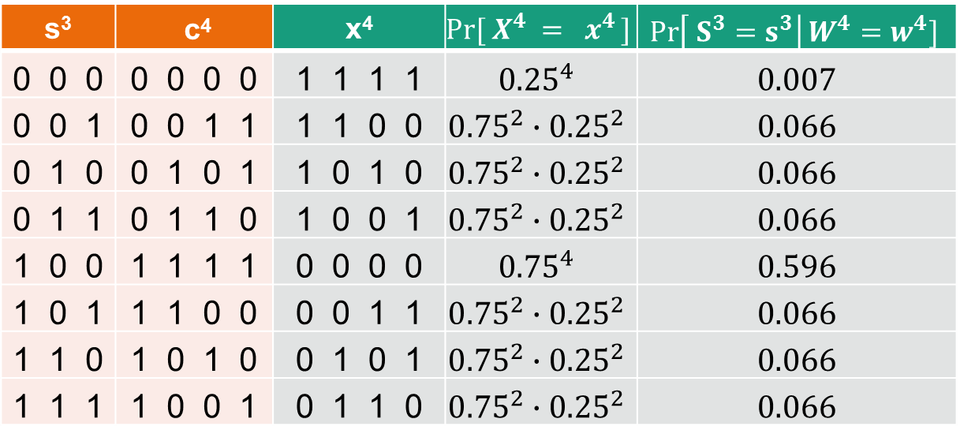
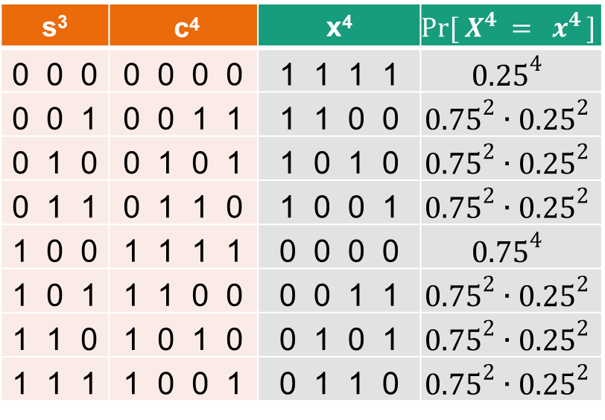
Wiretap Coset Codes for PUFs
$\text{Reed} \text{Muller} \text{Code}\text{:}$ $RM\left(1,2\right)≜\left[4,3,2\right]$
Helper data: w⁴ ⁼ c⁴ + x⁴ = 1111
s³ | c⁴ | x⁴
0 0 0 | 0 0 0 0 | 1 1 1 1
0 0 1 | 0 0 1 1 | 1 1 0 0
0 1 0 | 0 1 0 1 | 1 0 1 0
0 1 1 | 0 1 1 0 | 1 0 0 1
1 0 0 | 1 1 1 1 | 0 0 0 0
1 0 1 | 1 1 0 0 | 0 0 1 1
1 1 0 | 1 0 1 0 | 0 1 0 1
1 1 1 | 1 0 0 1 | 0 1 1 0
s³ | c⁴ | x⁴ | $$Pr[ X^{4} = x^{4} ]$$
0 0 0 | 0 0 0 0 | 1 1 1 1 | $${0.25}^{4}$$
0 0 1 | 0 0 1 1 | 1 1 0 0 | $${0.75}^{2}∙{0.25}^{2}$$
0 1 0 | 0 1 0 1 | 1 0 1 0 | $${0.75}^{2}∙{0.25}^{2}$$
0 1 1 | 0 1 1 0 | 1 0 0 1 | $${0.75}^{2}∙{0.25}^{2}$$
1 0 0 | 1 1 1 1 | 0 0 0 0 | $${0.75}^{4}$$
1 0 1 | 1 1 0 0 | 0 0 1 1 | $${0.75}^{2}∙{0.25}^{2}$$
1 1 0 | 1 0 1 0 | 0 1 0 1 | $${0.75}^{2}∙{0.25}^{2}$$
1 1 1 | 1 0 0 1 | 0 1 1 0 | $${0.75}^{2}∙{0.25}^{2}$$
s³ | c⁴ | x⁴ | $$Pr[ X^{4} = x^{4} ]$$ | $$\operatorname{Pr}\left[ S^{3}=s^{3}\right|W^{4}=w^{4}]$$
0 0 0 | 0 0 0 0 | 1 1 1 1 | $${0.25}^{4}$$ | 0.007
0 0 1 | 0 0 1 1 | 1 1 0 0 | $${0.75}^{2}∙{0.25}^{2}$$ | 0.066
0 1 0 | 0 1 0 1 | 1 0 1 0 | $${0.75}^{2}∙{0.25}^{2}$$ | 0.066
0 1 1 | 0 1 1 0 | 1 0 0 1 | $${0.75}^{2}∙{0.25}^{2}$$ | 0.066
1 0 0 | 1 1 1 1 | 0 0 0 0 | $${0.75}^{4}$$ | 0.596
1 0 1 | 1 1 0 0 | 0 0 1 1 | $${0.75}^{2}∙{0.25}^{2}$$ | 0.066
1 1 0 | 1 0 1 0 | 0 1 0 1 | $${0.75}^{2}∙{0.25}^{2}$$ | 0.066
1 1 1 | 1 0 0 1 | 0 1 1 0 | $${0.75}^{2}∙{0.25}^{2}$$ | 0.066
Biased distribution: $Pr\left(1\right)=b=0.25$

Slide 10
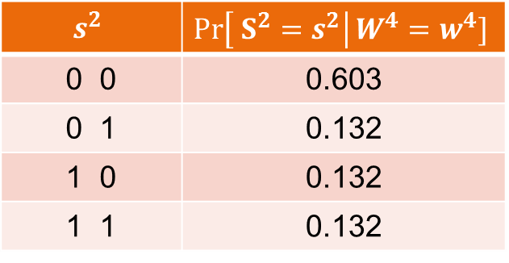
Result after Masking for w⁴ = 1111
One mask bit
$$s^{2}$$ | $$\operatorname{Pr}\left[ S^{2}=s^{2}\right|W^{4}=w^{4}]$$
0 0 | 0.603
0 1 | 0.132
1 0 | 0.132
1 1 | 0.132
Two mask bits
$$s^{1}$$ | $$\operatorname{Pr}\left[ S^{1}=s^{1}\right|W^{4}=w^{4}]$$
0 | 0.735
1 | 0.264

Slide 11
Wiretap Coset Coding for PUFs
Idea: Interpret parts of the information bits as mask
Assign more mask bits ► better debiasing properties
Decreasing marginal benefit due to code structure

Slide 12
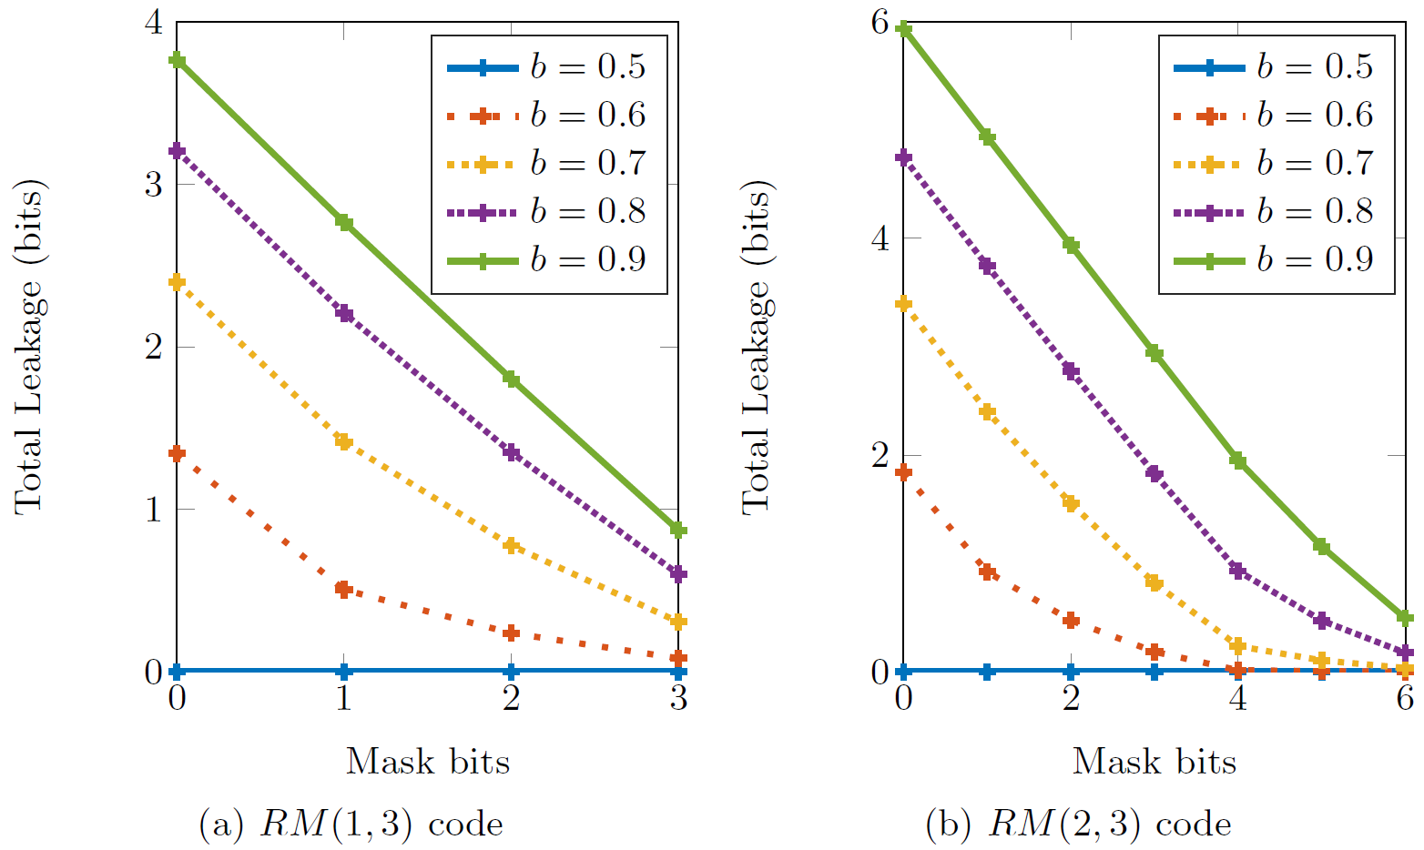
8-Bit Small-Scale Example: Exact Leakage

Slide 13
Comparison of Debiasing Schemes, Bias 0.54 128 Bit Key, 15% avg. Input Err, Key Err Prob < 10⁻⁶
Design | Fuzzy Extr. | DSC
Mask Bits
Secret Size | 198 | 168
PUF Size | 1,530 | 640
Leakage | ≤ 65.5 | ≤ 37.1
Design | Fuzzy Extr. | DSC | IBS | VN
Mask Bits
Secret Size | 198 | 168 | 128 | 144
PUF Size | 1,530 | 640 | 1,778 | 2,471
Leakage | ≤ 65.5 | ≤ 37.1 | 0 | 0
Design | Fuzzy Extr. | DSC | IBS | VN | CC + DSC
Mask Bits |  |  |  |  | 30
Secret Size | 198 | 168 | 128 | 144 | 138
PUF Size | 1,530 | 640 | 1,778 | 2,471 | 704
Leakage | ≤ 65.5 | ≤ 37.1 | 0 | 0 | ≤ 0.06
Design | Fuzzy Extr. | DSC | IBS | VN | CC + DSC | CC + DSC
Mask Bits |  |  |  |  | 30 | 25
Secret Size | 198 | 168 | 128 | 144 | 138 | 128
PUF Size | 1,530 | 640 | 1,778 | 2,471 | 704 | 1,472
Leakage | ≤ 65.5 | ≤ 37.1 | 0 | 0 | ≤ 0.06 | ≤ 0.01

Slide 14
Conclusion
Wiretap coset coding allows to bring leakage to zero
Efficient practical results for popular reference scenario
For theory, see paper

Slide 15
Contact Information
Matthias Hiller
Head of Research Group
Physical Security Technologies
Fraunhofer Institute for
Applied and Integrated Security AISEC
Parkring 4, 85748 Garching, Germany
www.aisec.fraunhofer.de
Phone +49 (0)89 3229986-162
matthias.hiller@aisec.fraunhofer.de

Slide 16
Comparison of Debiasing Schemes, bias 0.54 128 Bit key, 15% avg. Input error, Key err Prob < 10⁻⁶
Design | Fuz Ext | DSC | IBS | VN | CC + DSC | CC + DSC
Codes | REP + BCH | RM | REP + BCH | REP + BCH | RM | RM
Parameters |  |  | 7 bits per block | 3 passes | 30 mask bits | 25 mask bits
Num Blocks | 2 | 4 | 2 | 4 | 2 | 4
Inner Code | (3,1,3) | (2.5,1) | (5,1,5) | (8,1,8) | (2.75,1) | (5.75,1)
Outer Code | (255,99,47) | (64,42,8) | (127,64,21) | (63,36,11) | (128,99,8) | (64,57,4)
Secret Size | 198 | 168 | 128 | 144 | 138 | 128
PUF Size | 1,530 | 640 | 1,778 | 2,471 | 704 | 1,472
Err Prob | 5.4 x 10⁻⁷ | 3.5 x 10⁻⁷ | 4.6 x 10⁻⁷ | 9.7 x 10⁻⁸ | 2.5 x 10⁻⁷ | 6.6 x 10⁻⁷
Leakage | <= 65.5 | <=37.1 | 0 | 0 | <= 0.06 | <= 0.01

Slide 17
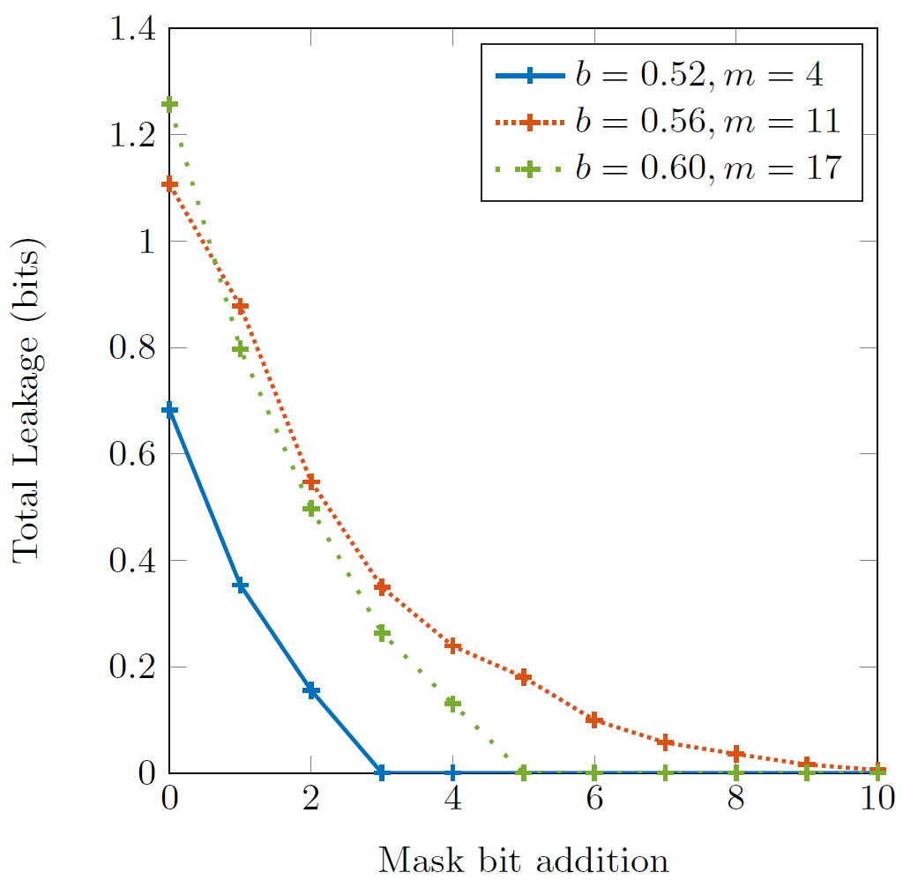
64-Bit Large-Scale Example: Upper Bounded Leakage
RM(2,6) code with 22 information bits

