Slide 1
CacheZoom: How SGX Amplifies The Power of Cache Attacks
Ahmad Moghimi, Gorka Irazoqui, Thomas Eisenbarth
September 26, 2017
CHES 2017 - Taipei

Slide 2
Intel Software Guard Extensions (SGX)
Trusted Execution Environment
Enclave: Hardware protected user-level software module
Loaded by the user program
Mapped by the Operating System
Authenticated and Encrypted by CPU
Protects against system level adversary
“no protection against access pattern leakages”
New Attacker Model:
Attacker gets full control over OS
Hardware
Hypervisor
OS
App
App
App
blocked
blocked

Slide 3
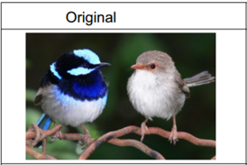
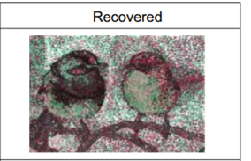
Side Channel Attacks on SGX
OS initiated attacks are powerful:
Page Accesses [XCP15, vBWK+17]
Branch Shadowing [LSG+17]
Cache Attacks
Classic [GESM17, BMD+17]
Enclave to Enclave [SWG+17]
SGX Enclave
[XCP15] Yuanzhong Xu, Weidong Cui, Marcus Peinado. Controlled-channel attacks: Deterministic side channels for untrusted operating systems. IEEE S&P, 2015.
[vBWK+17] J. Van Bulck, N. Weichbrodt, R. Kapitza et al. Telling Your Secrets without Page Faults: Stealthy Page Table-Based Attacks on Enclaved Execution. Usenix Security 17.
[LSG+17] Sangho Lee, Ming-Wei Shih, Prasun Gera, et al. Inferring Fine-grained Control Flow Inside SGX Enclaves with Branch Shadowing. Usenix Security 17.
[GESM17] Götzfried, J., Eckert, M., Schinzel, S., Müller, T.: Cache Attacks on Intel SGX. EUROSEC 17
[BMD+17] Ferdinand Brasser,, Urs Müller, Alexandra Dmitrienko et al. Software Grand Exposure: SGX Cache Attacks Are Practical. WOOT 17
[SWG+17] Schwarz, M., Weiser, S., Gruss, D., Maurice, C., Mangard, S: Malware guard extension: Using SGX to conceal cache attacks. DIMVA 2017

Slide 4
Why CacheZoom?
Cache Attacks
Versatile and well-studied
Most libraries have some level of protection by now
High resolution attack:
spatial resolution: 64b
page faults: 4kb
CacheZoom
maximizes temporal and spatial resolution on SGX
Breaks implementations and “countermeasures”
Unless cache accesses profile is constant

Slide 5
How To CacheZoom

Slide 6
CacheZoom: Cache Isolation
Manipulate OS to reduce noise:
Fix CPU Frequency → stable access times
Kernel task scheduler isolates cores → L1 Cache attack
Other Task 0
Other Task 1
Attacker task
Victim Enclave
Other Task 0
Other Task 1
Core 0
Core 1
L1$
L1$
Last Level Cache (shared)

Slide 7
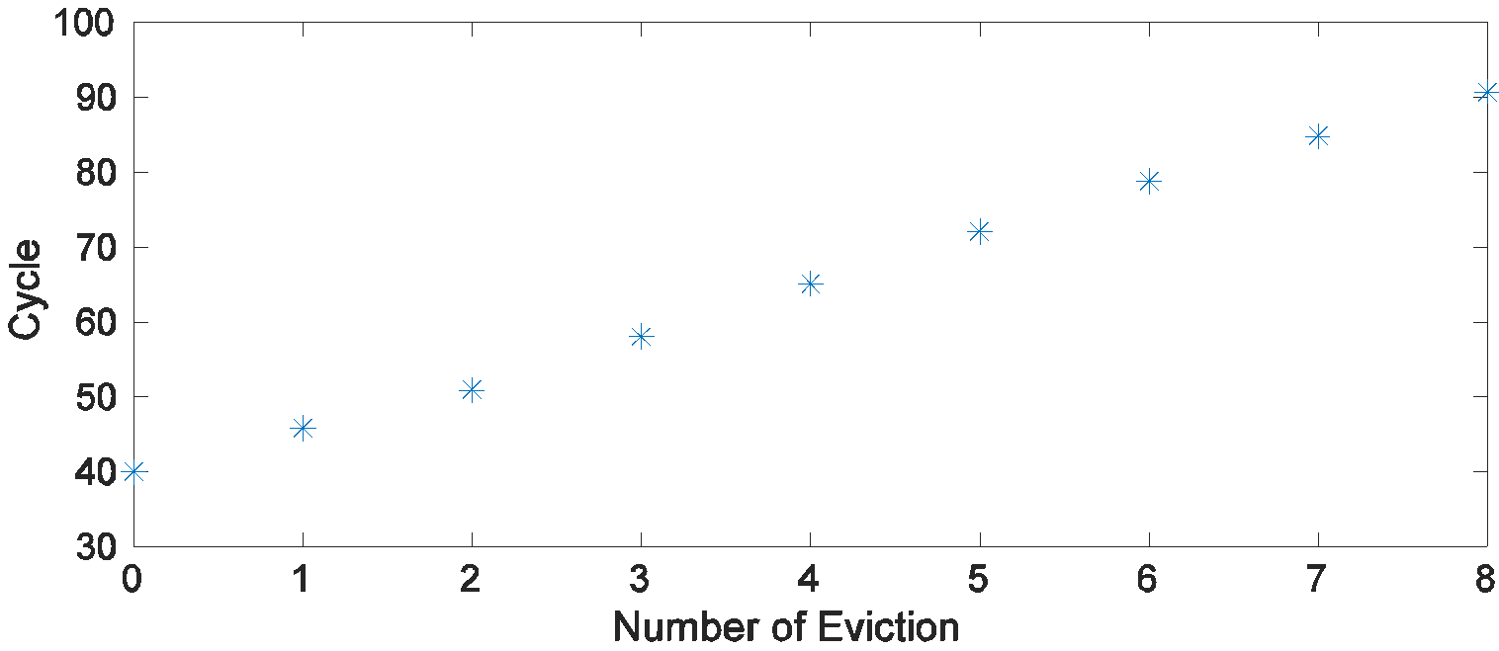
CacheZoom:Maximize Resolution
Prime+Probe entire L1D
Interleaved Execution
L1D Cache 4-way s-a.
Set 0
Steps:
Prime entire L1D
Interrupt execution
Probe reload time
re-prime
1
2
Execute enclave
Resume execution
3
4
63
Clean detection of number of set accesses

Slide 8
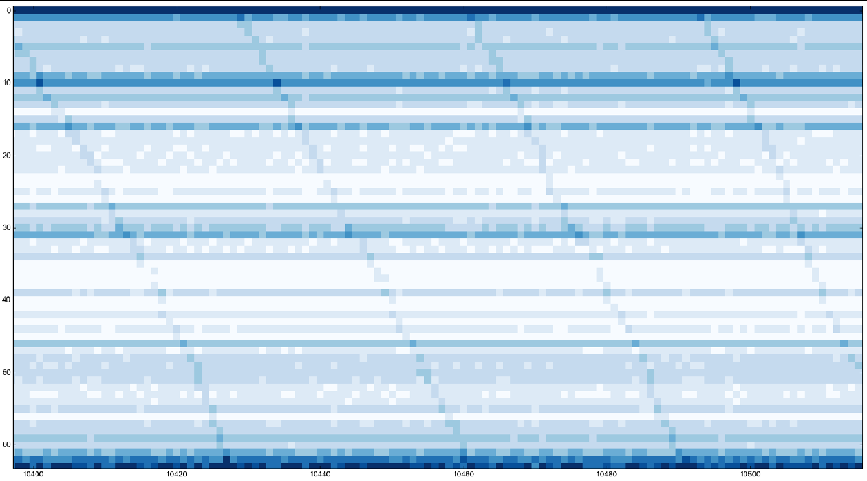
CacheZoom: Raw Measurement

Slide 9
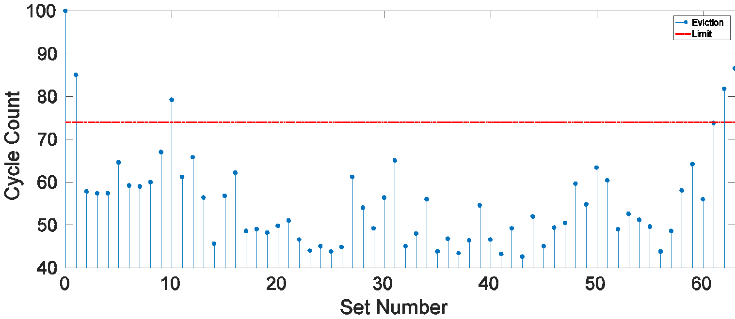
CacheZoom: Noise Filtering
Probe cycles based on the number of evictions
Context-switch noise:
unavoidable but predictable
evictions/set caused by an empty enclave

Slide 10
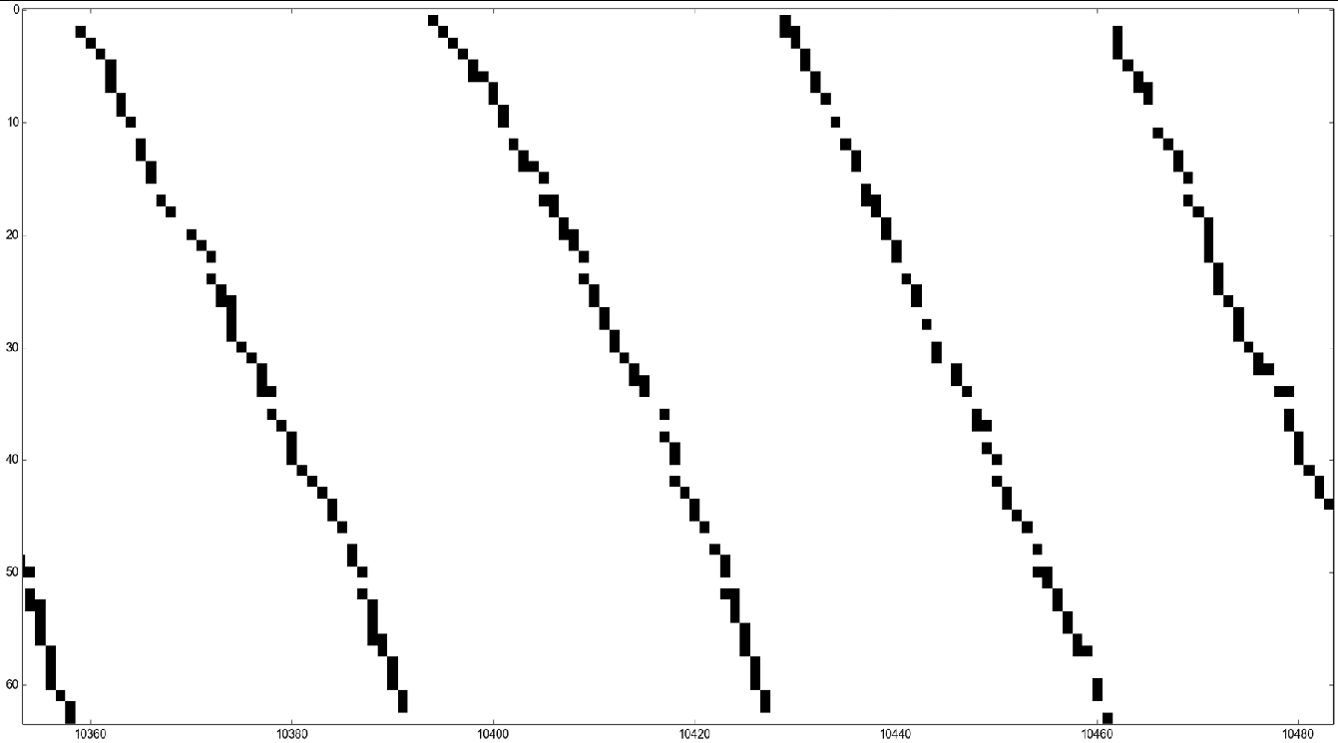
CacheZoom: Noise Filtering
Probe cycles based on the number of evictions
Context-switch noise:
unavoidable but predictable
evictions/set caused by an empty enclave
Filtering the predicted eviction noise

Slide 11
CacheZooming AES

Slide 12
Attack Scenario
Attack on AES encryption/decryption:
4 T-Tables: 4x1kB: fills 1 way of entire L1D cache
Huge T-Table: 1x2kB: 64-bit entries w/read offset
S-Box 256 byte table
only 4 cache lines: 40 accesses each
Assumptions:
Full access to OS resources
AES code & key protected by SGX Enclave
Cipher input or output known

Slide 13
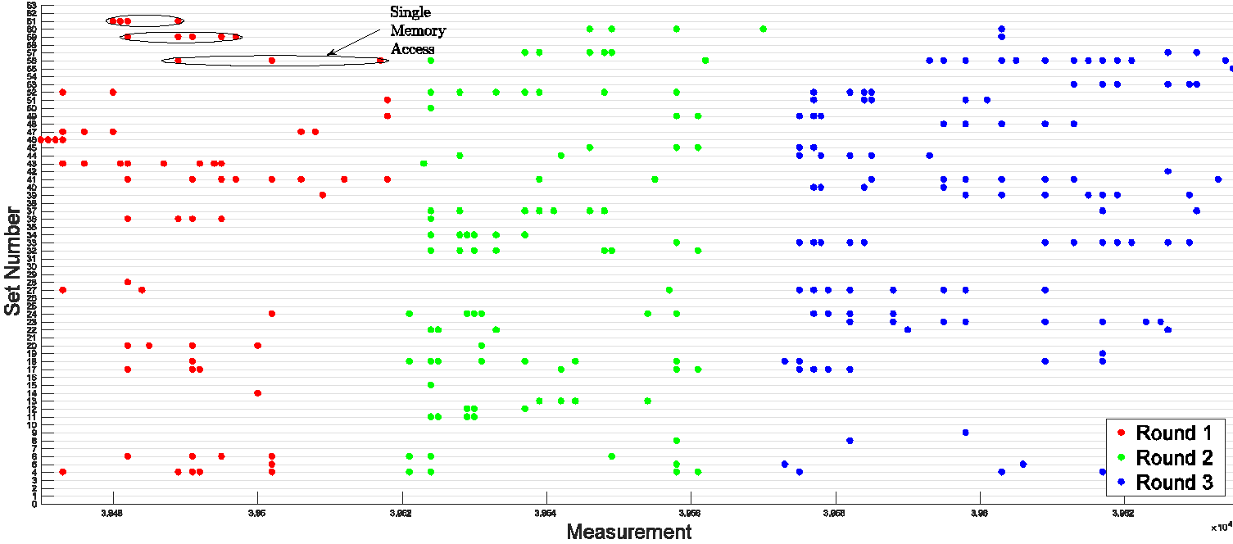
CacheZoom on AES T-Table
Out of order Execution:
Repeat accesses to same set
blind sets

Slide 14
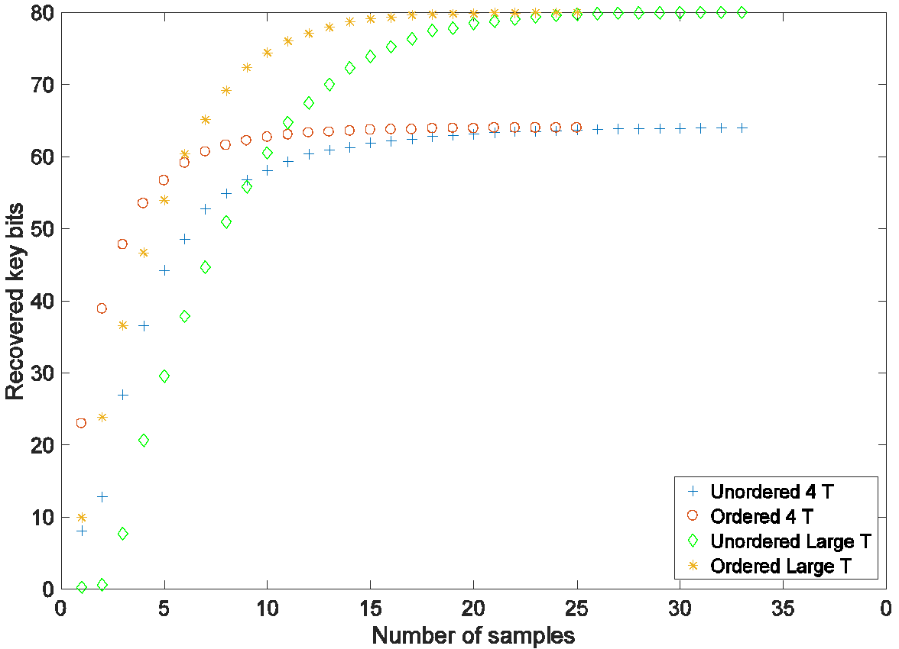
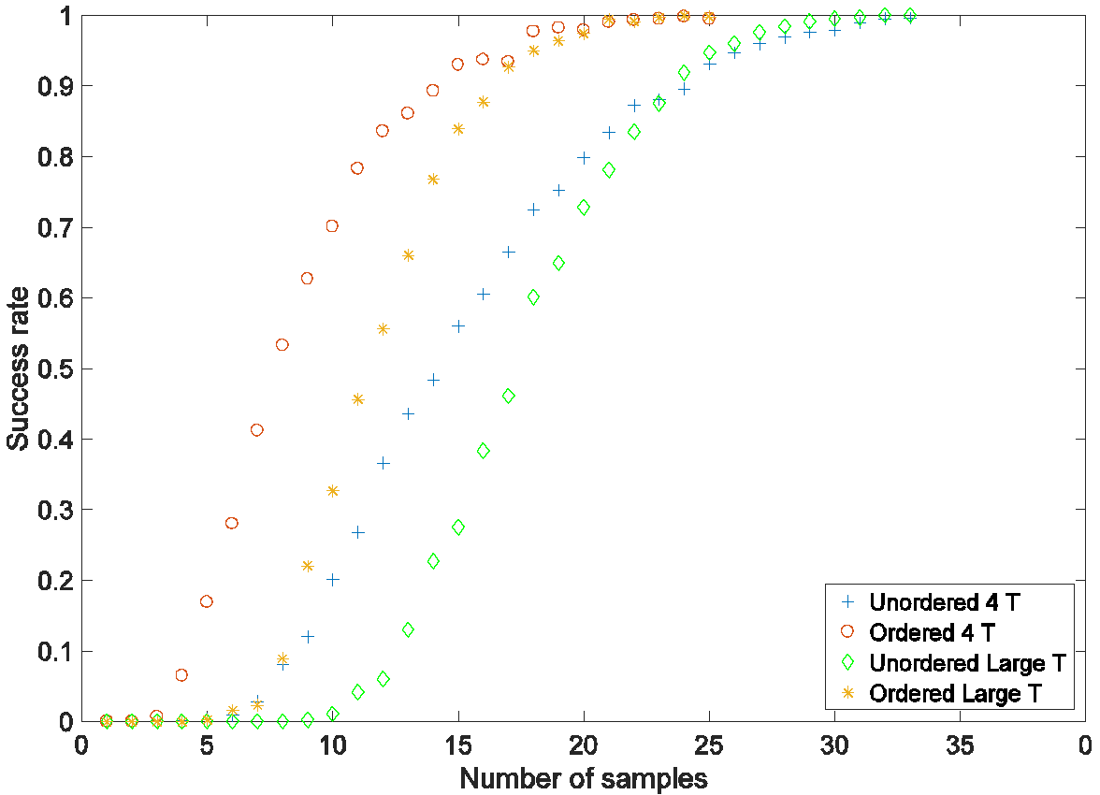
Key Recovery
Known Plaintext attack on first round [TOS10,AGM16]
Reveals 64-80 key bits
Reconstruct access order
Difficult due to out-of-order execution
Arithmetic mean of accesses is reasonable approximation
[TOS10] Eran Tromer, Dag Arne Osvik, Adi Shamir. Efficient Cache Attacks on AES, and Countermeasures. Journal of Cryptology, 2010.
[AGM16] Ashokkumar, C., Giri, R.P., Menezes, B.: Highly efficient algorithms for aes key retrieval in cache access attacks. Euro S&P 2016.

Slide 15
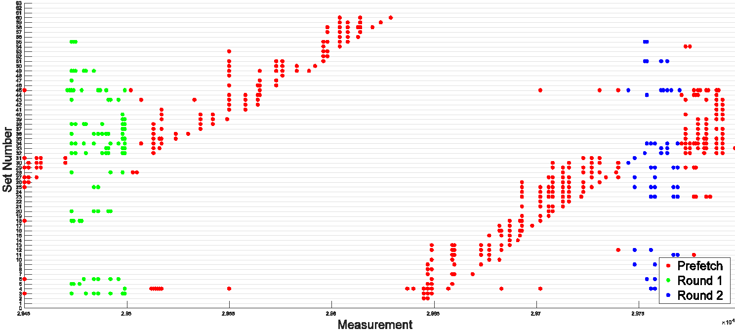
Prefetching to prevent cache attacks?
Cache warming:
Prefetch or postfetch entire T-table
Once or every round
Works if attacker cannot interrupt AES
Resistant to previous cache side-channels
Vulnerable to our attack

Slide 16
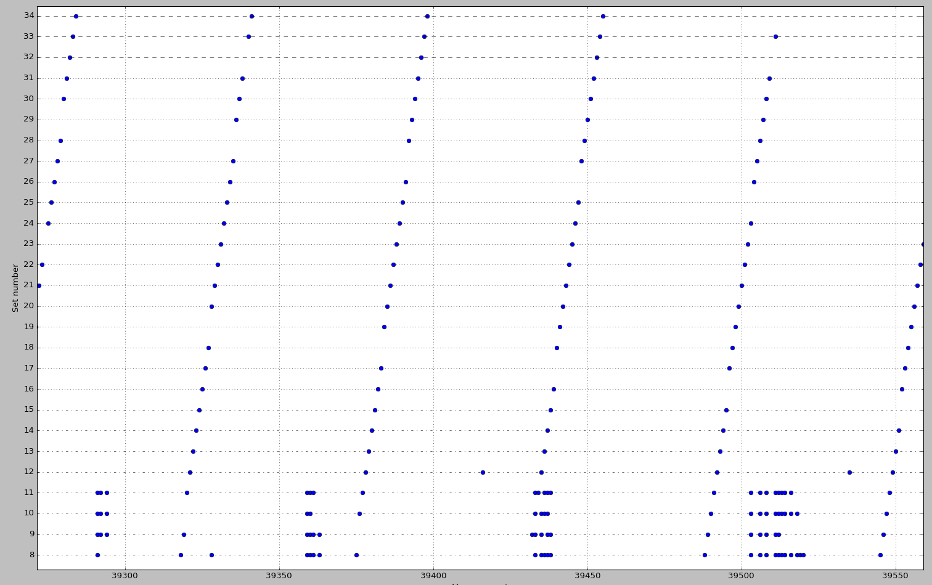
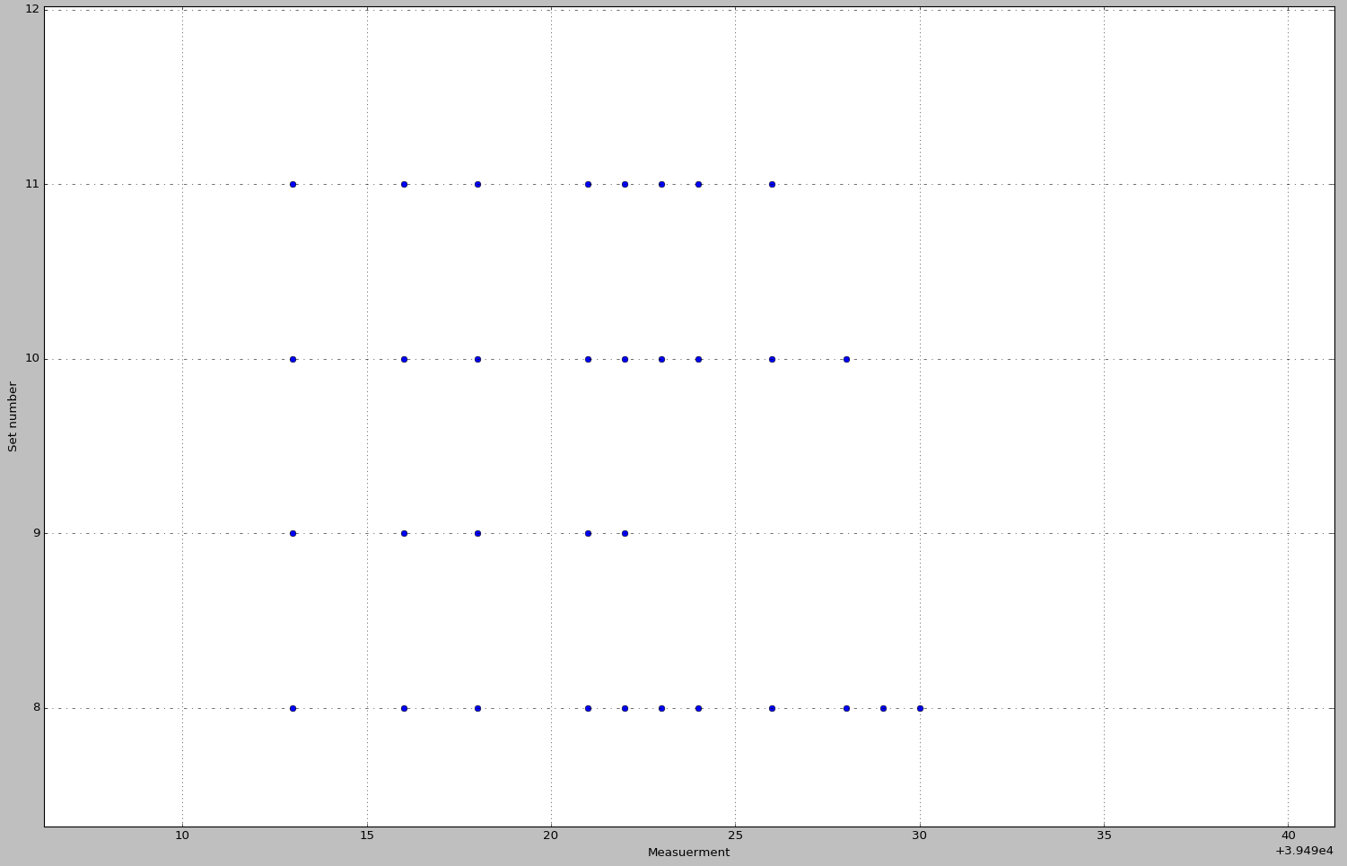
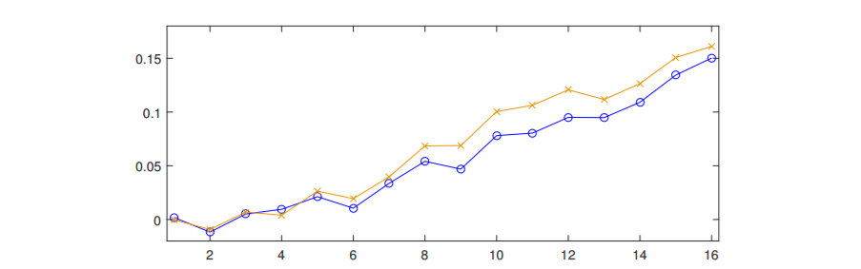
AES S-Box Implementation
256 bytes S-Box table→difficult
spans 4 cache lines: 16 access per round
order? Out of order execution and repeat accesses
“Secure” if not able to interrupt
Observed # of accesses/set correlated to expected

Slide 17
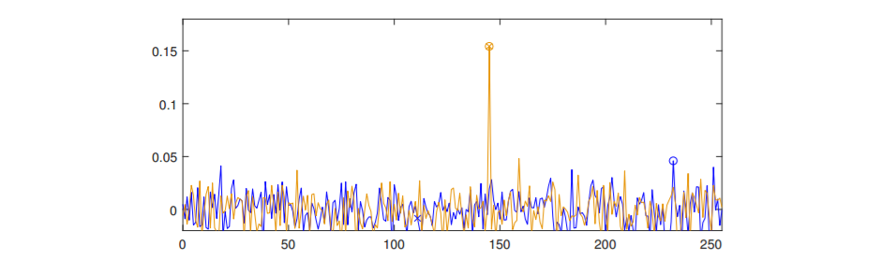
AES S-Box Implementation
Correlate accesses/set to observation
Using 1500 traces:
$$k_{15}$$
$$k_{0}$$

Slide 18
Where to find them?
Library | Vulnerable Implementations
OpenSSL 1.1.0f | aes_core.c T-table, aes_x86core.c Large T-table; S-box and prefetching configurable
WolfCrypt 3.11.0 | aes.c: T-Table; prefetching before 1st round.
Nettle Mozilla 3.3 | rijndael.c T-Table and S-box configurable
NSS 3.30.2 | aes-encrypt-internal.asm T-table
Libtomcrypt 1.17 | aes.c: T-Table
Libgcrypt 1.7.7 | rjindael.c: T-Table; S-box for last round w/ prefetching
MbedTLS 2.4.2 | aes.c: T-Table; S-box for last round
Implementations configurable through compile or runtime settings

Slide 19
CacheZoom: High Resolution Cache Attack on SGX
Prime+Probe on L1D w/ interrupted execution
Full Cache image every few instructions
Sample Target: AES
All table-based implementations vulnerable even with cache warming countermeasure
Key after <20 traces because of resolution
Side-channels are devastating in SGX
Constant execution flow+data accesses are essential when processing secrets

Slide 20
Download CacheZoom at:
https://github.com/vernamlab/CacheZoom
Thank you!
thomas.eisenbarth@uni-luebeck.de
its.uni-luebeck.de vernam.wpi.edu
@vernamgroup

Slide 21
How to AES?
T-Tables:
Fast in SW
Data-dependent
vulnerable
S-Box:
Slow
Attack difficult but possible
Fix: always access all (4) cache lines
No Tables:
SIMD [Ham09]
AES-NI or AES co-processor
Other Cryptosystems:
Only secure if data accesses and execution flow constant (or secret-independent)
[Ham09] Mike Hamburg: Accelerating AES with Vector Permute Instructions. CHES, 2009

Slide 22
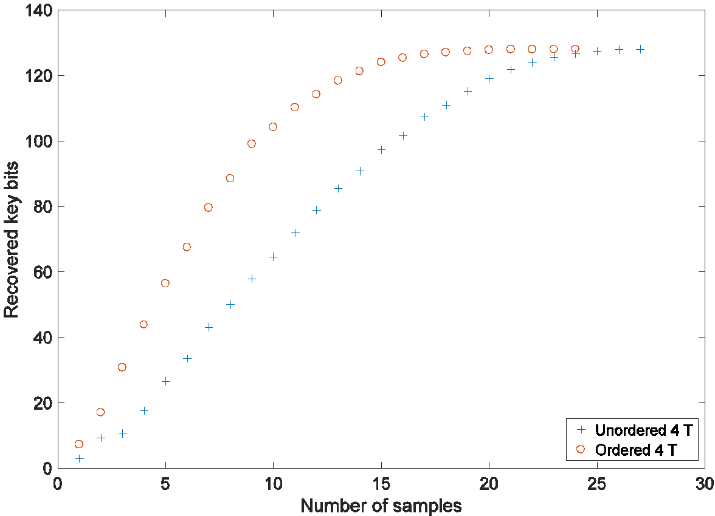
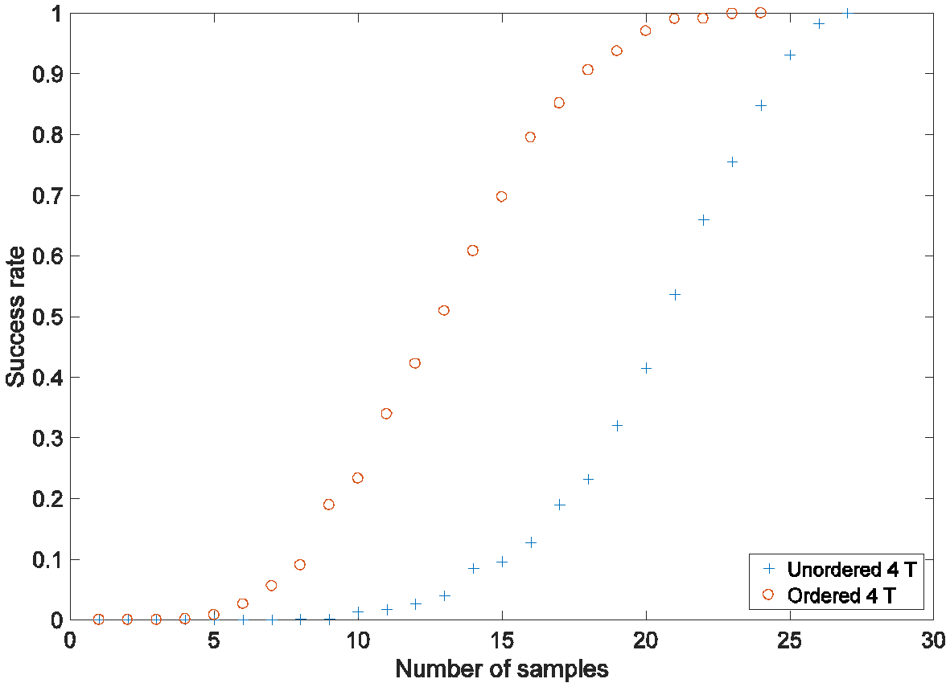
Key Recovery
Known Ciphertext attack on last round
Reveals all key bits after few observations
Attack on 2 last rounds:
Fewer observations (1 with ideal leakage; 2-3 is practical)
Increased computational load (2h with python as of now)

