Slide 1
FPGA-based Key Generator for the Niederreiter Cryptosystem using Binary Goppa Codes
Wen Wang¹, Jakub Szefer¹, and Ruben Niederhagen²
Yale University, USA
Fraunhofer Institute SIT, Germany
Sep 26, 2017

Slide 2
Code-based cryptography
Public-key cryptography
Classic
Post-quantum
Lattice-based
Code-based
...
McEliece
Niederreiter
...
GRS code
Binary Goppa code
…
Notes:
Add …

Slide 3
Modules in a code-based cryptosystem
Code-based cryptosystem
Key generator
Encryption
Decryption
(sk, pk)
pk
sk
Key generator
  no existing hardware work with 266-bit security
  complex in logic and cycles
  hardware implementation needed: HSM, smart cards and etc.
Encryption
  cheap in hardware
Decryption
  a few related works: Shoufan’10, Heyse’12, Ghosh’14, and etc.

Slide 4
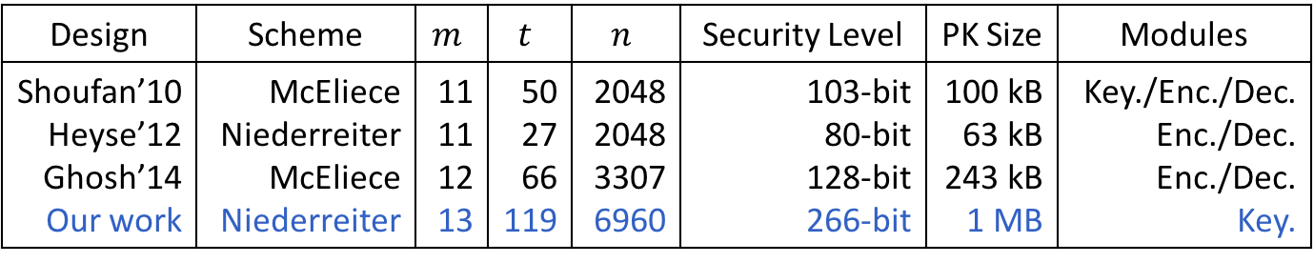
Parameters for code-based cryptosystem
PQCRYPTO project recommendation in 2015
  266-bit security
  system parameters
    field size m = 13
    number of correctable errors t = 119
    code length n = 6960
  public key ~ 1MB
  secret key ~ 13kB
Design | Scheme | $$m$$ | $$t$$ | $$n$$ | Security Level | PK Size | Modules
Shoufan’10 Heyse’12 Ghosh’14 Our work | McEliece Niederreiter McEliece Niederreiter | 11 11 12 13 | 50 27 66 119 | 2048 2048 3307 6960 | 103-bit 80-bit 128-bit 266-bit | 100 kB 63 kB 243 kB 1 MB | Key./Enc./Dec. Enc./Dec. Enc./Dec. Key.

Slide 5
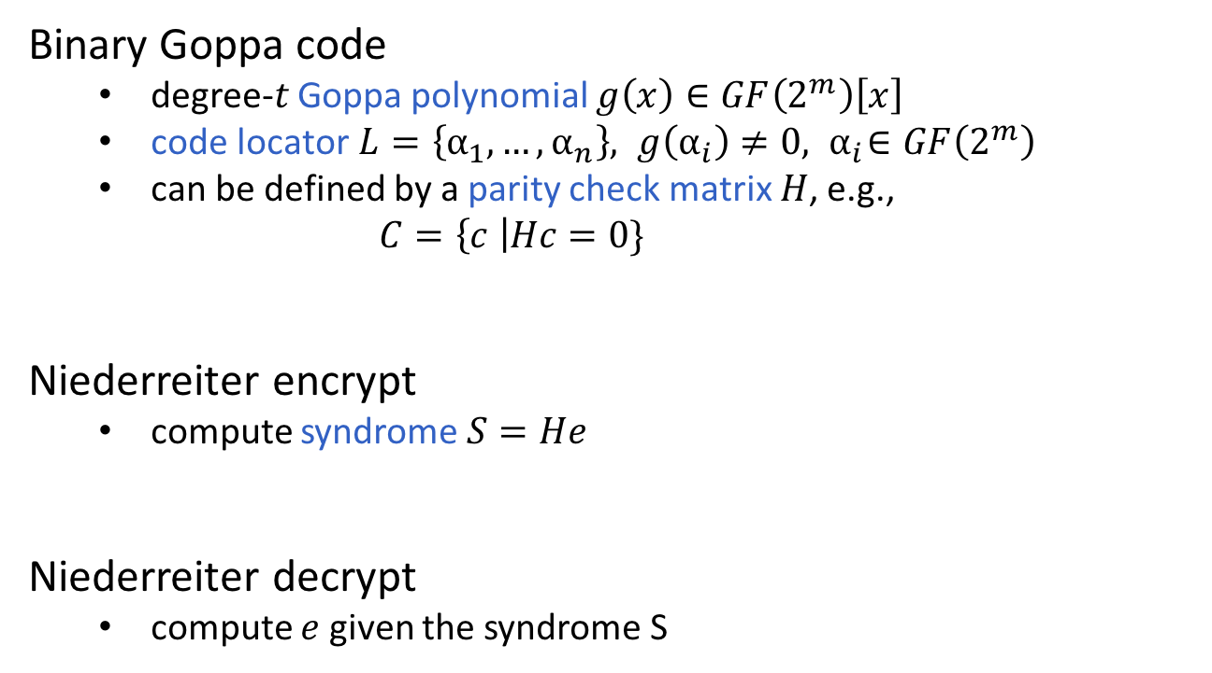
Coding theory
Binary Goppa code
  degree-$t$ Goppa polynomial $g\left(x\right)∈GF\left(2^{m}\right)\left[x\right]$
  code locator$L=\left\{α_{1},…, α_{n}\right\}, { g\left(α_{i}\right)≠0, α}_{i}∈GF\left(2^{m}\right)$
  can be defined by a parity check matrix $H$, e.g.,
          $$C=\left\{c \right|Hc=0\}$$
Niederreiter encrypt
  compute syndrome $S=He$
Niederreiter decrypt
  compute $e$ given the syndrome S
Notes:
point out in this slide which is secret key and which is public key

Slide 6
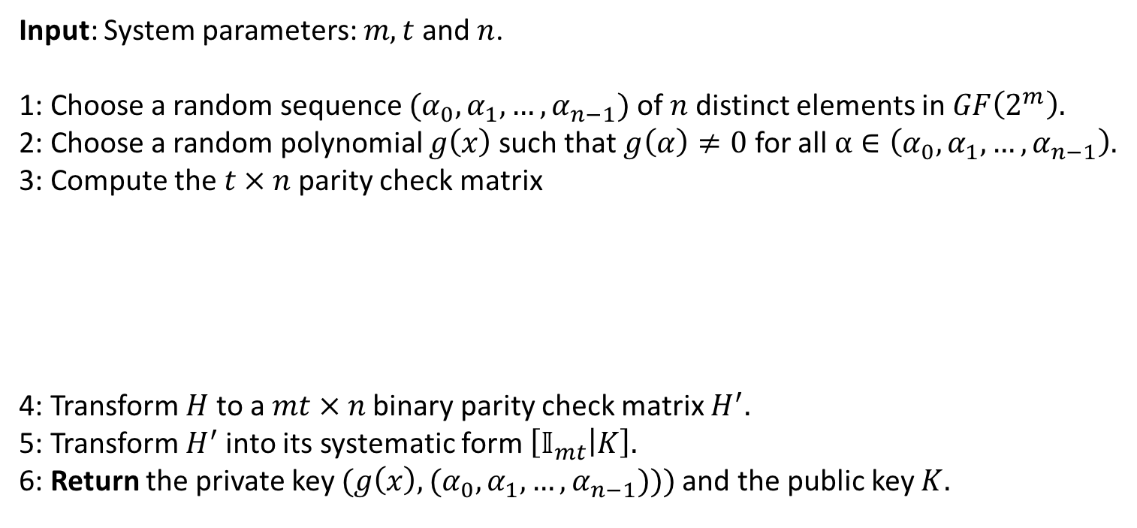
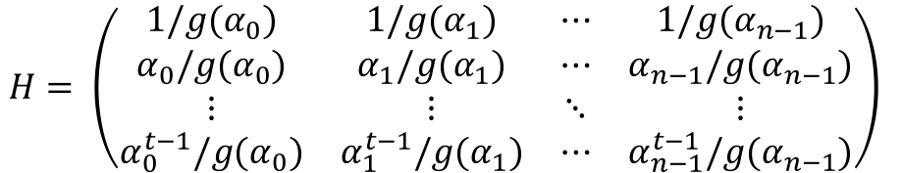
Key generator algorithm
Input: System parameters: $m, t$ and $n$.
1: Choose a random sequence $(α_{0}, α_{1}, …, α_{n−1})$ of $n$ distinct elements in $GF\left(2^{m}\right).$
2: Choose a random polynomial $g\left(x\right)$ such that $g\left(α\right)≠0$ for all $α∈\left(α_{0}, α_{1}, …, α_{n−1}\right).$
3: Compute the $t × n$ parity check matrix
4: Transform $H$ to a $mt × n$ binary parity check matrix $H^{′}.$
5: Transform $H^{′}$into its systematic form $\left[𝕀_{mt} | K\right].$
6: Return the private key $(g\left(x\right), (α_{0}, α_{1}, …, α_{n−1})))$ and the public key $K.$
$$H= \left(\begin{matrix}1/g(α_{0}) & 1/g(α_{1}) & ⋯ & 1/g(α_{n−1}) \\ α_{0}/g(α_{0}) & α_{1}/g(α_{1}) & ⋯ & α_{n−1}/g(α_{n−1}) \\ ⋮ & ⋮ & ⋱ & ⋮ \\ α_{0}^{t−1}/g(α_{0}) & α_{1}^{t−1}/g(α_{1}) & ⋯ & α_{n−1}^{t−1}/g(α_{n−1})\end{matrix}\right)$$
Notes:
Move diagram over to the end

Slide 7
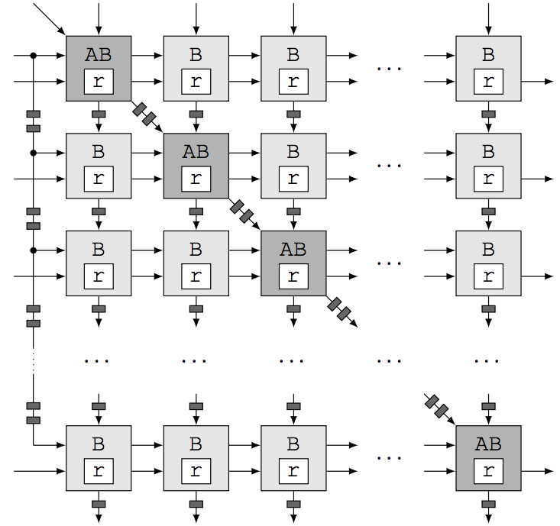
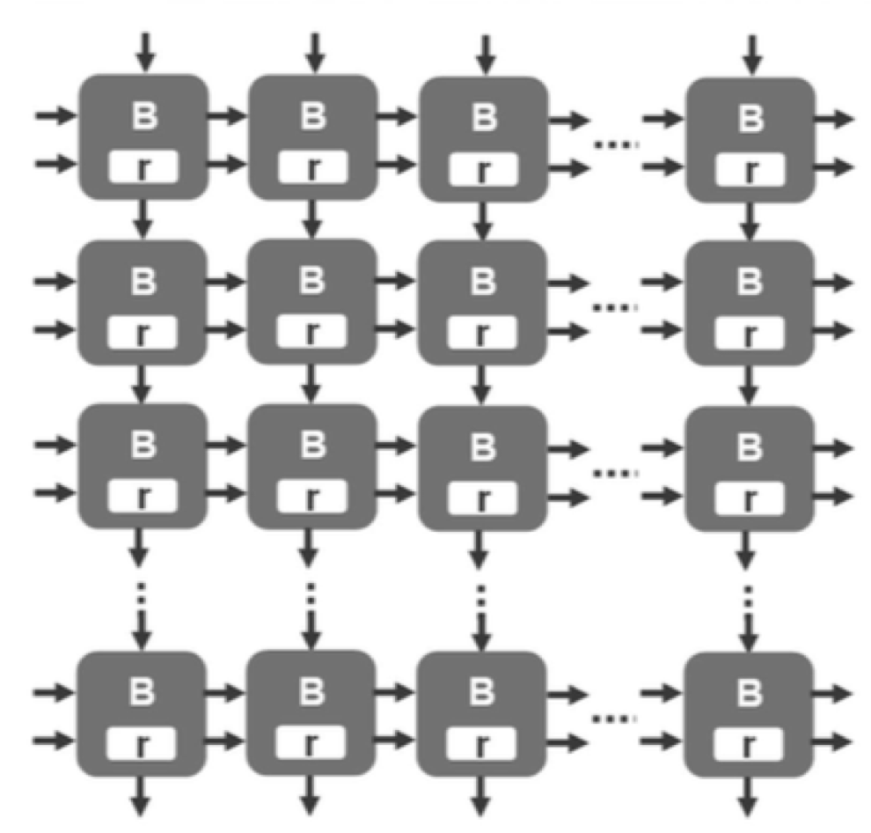
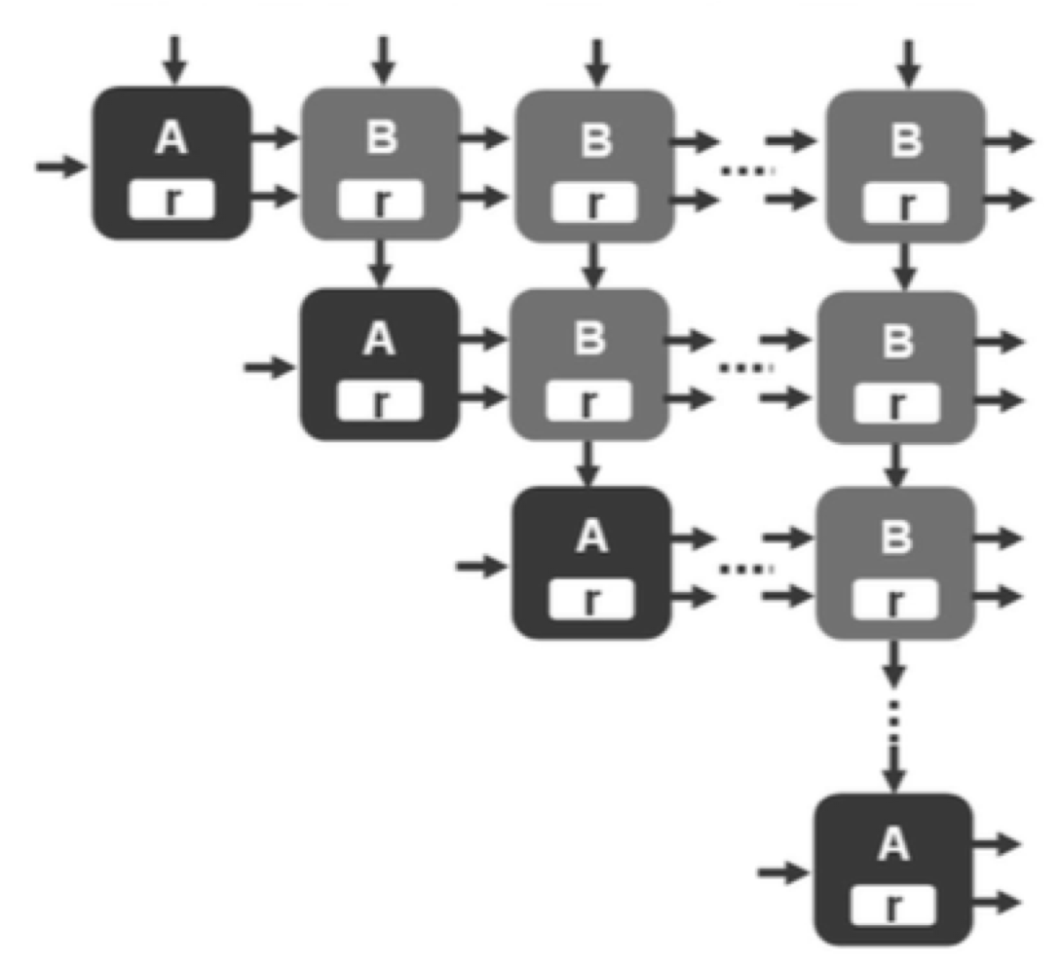
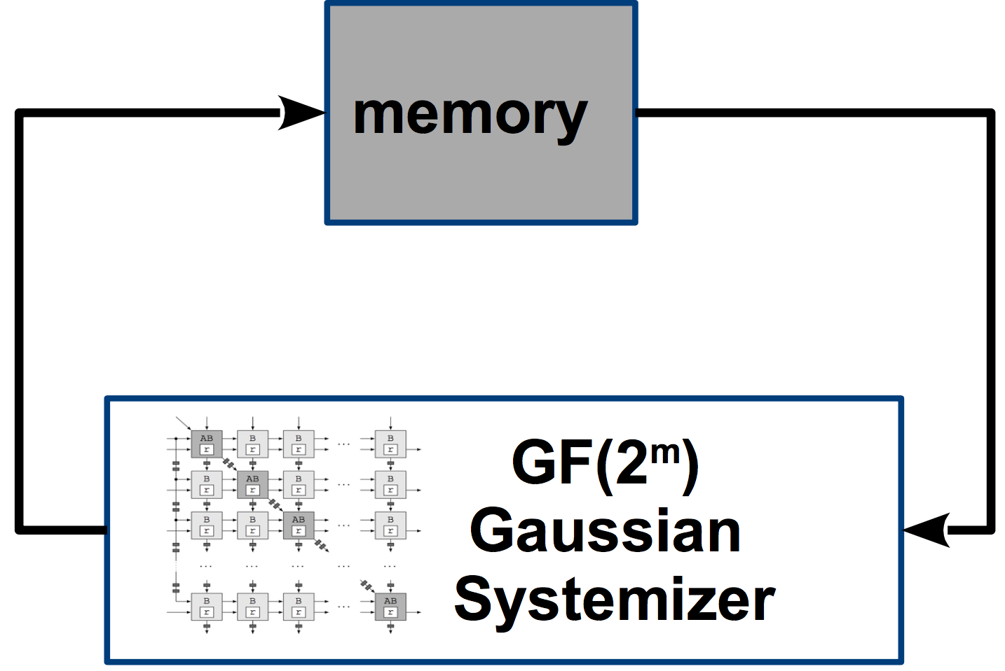
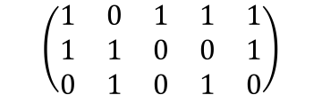
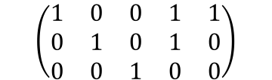
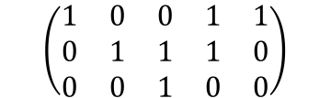
Gaussian systemizer
Solving systems of linear equations; Matrix systemization
Gaussian elimination
Systolic architecture
forward & backward
backward
$$\left(\begin{matrix}1 & 0 & 0 & 1 & 1 \\ 0 & 1 & 1 & 1 & 0 \\ 0 & 0 & 1 & 0 & 0\end{matrix}\right)$$
$$\left(\begin{matrix}1 & 0 & 1 & 1 & 1 \\ 1 & 1 & 0 & 0 & 1 \\ 0 & 1 & 0 & 1 & 0\end{matrix}\right)$$
forward
$$\left(\begin{matrix}1 & 0 & 0 & 1 & 1 \\ 0 & 1 & 0 & 1 & 0 \\ 0 & 0 & 1 & 0 & 0\end{matrix}\right)$$
Notes:
add 2010-paper old figures

Slide 8
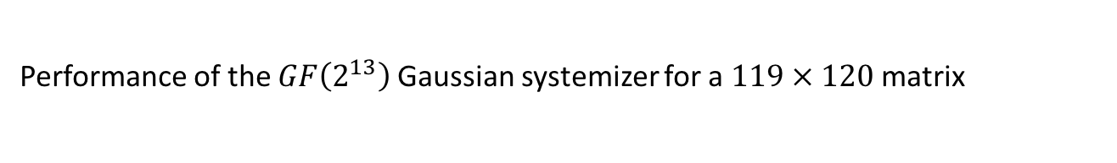
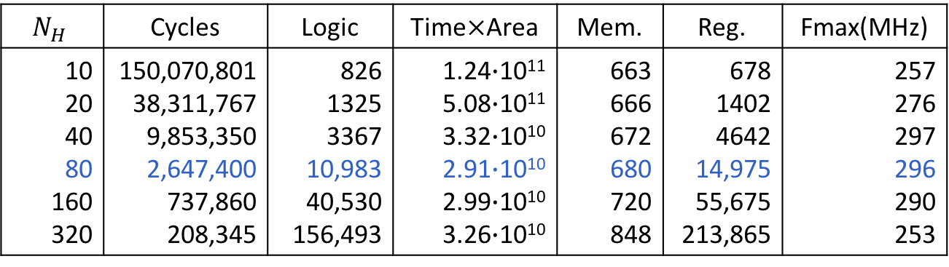
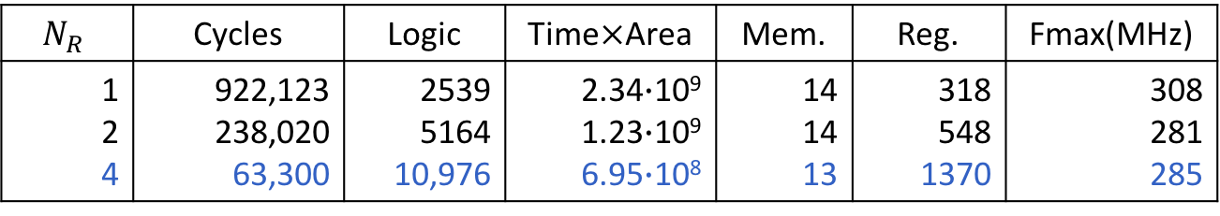
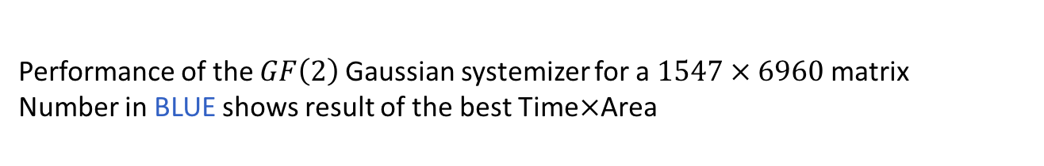
Performance
$$N_{H}$$ | Cycles | Logic | Time$×$Area | Mem. | Reg. | Fmax(MHz)
10 20 40 80 160 320 | 150,070,801 38,311,767 9,853,350 2,647,400 737,860 208,345 | 826 1325 3367 10,983 40,530 156,493 | 1.24$∙$10¹¹ 5.08$∙$10¹¹ 3.32$∙$10¹⁰ 2.91$∙$10¹⁰ 2.99$∙$10¹⁰ 3.26$∙$10¹⁰ | 663 666 672 680 720 848 | 678 1402 4642 14,975 55,675 213,865 | 257 276 297 296 290 253
Performance of the $GF\left(2\right)$Gaussian systemizer for a $1547 × 6960$ matrix
Number in BLUE shows result of the best Time$×$Area
$$N_{R}$$ | Cycles | Logic | Time$×$Area | Mem. | Reg. | Fmax(MHz)
1 2 4 | 922,123 238,020 63,300 | 2539 5164 10,976 | 2.34$∙$10⁹ 1.23$∙$10⁹ 6.95$∙$10⁸ | 14 14 13 | 318 548 1370 | 308 281 285
Performance of the $GF\left(2^{13}\right)$Gaussian systemizer for a $119 × 120$matrix

Slide 9
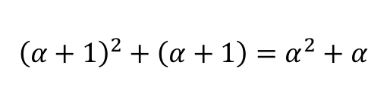
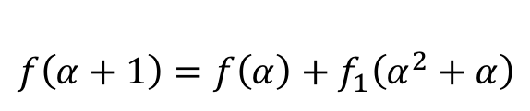

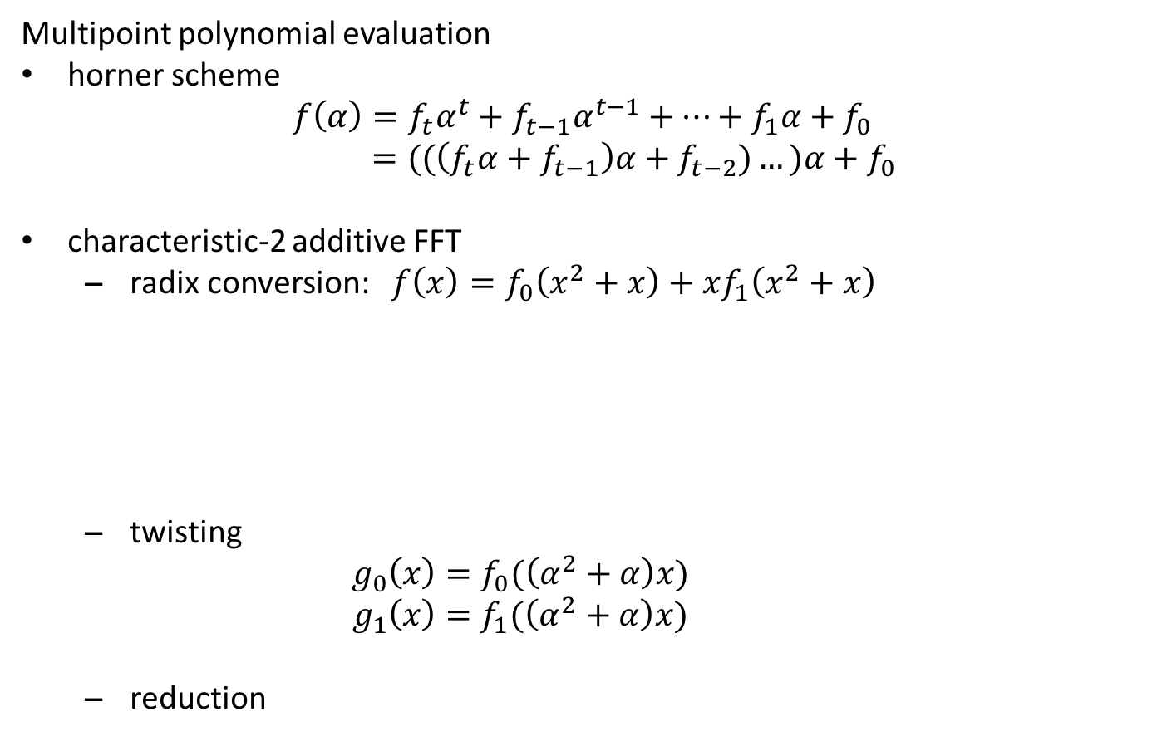
Gao-Mateer additive FFT
Multipoint polynomial evaluation
horner scheme
$$f\left(α\right)=f_{t}α^{t}+f_{t−1}α^{t−1}+…+f_{1}α+f_{0}$$
  $=((\left(f_{t}α+f_{t−1}\right)α+f_{t−2})…)α+f_{0}$
characteristic-2 additive FFT
  radix conversion: $f\left(x\right)=f_{0}\left(x^{2}+x\right)+xf_{1}\left(x^{2}+x\right)$
  twisting
    $$g_{0}\left(x\right)=f_{0}(\left(α^{2}+α\right)x)$$
    $$g_{1}\left(x\right)=f_{1}(\left(α^{2}+α\right)x)$$
  reduction
$$f\left(α\right)=f_{0}\left(α^{2}+α\right)+αf_{1}\left(α^{2}+α\right)$$
$${\left(α+1\right)}^{2}+\left(α+1\right)=α^{2}+α$$
$$f\left(α+1\right)=f\left(α\right)+f_{1}\left(α^{2}+α\right)$$

Slide 10


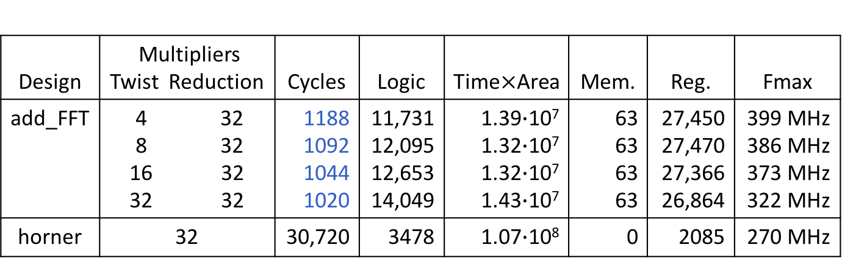
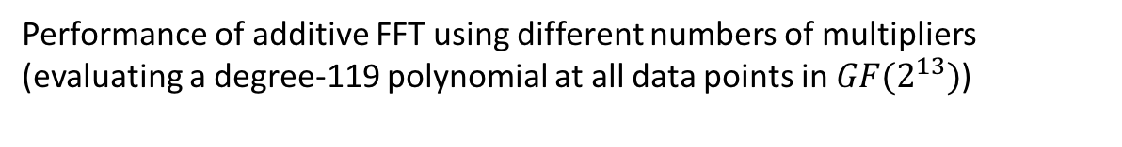
Non-recursive hardware implementation
Reduction
g(x)
f(βx)
(f₀, f₁ )
= f(x)
Radix
Conversion
Twisting
data memory
const. memory
$$f′\left(x\right)=f(βx)$$
$$f′\left(x\right)={f′}_{0}\left(x^{2}+x\right)+x{f′}_{1}\left(x^{2}+x\right)$$
Design | Multipliers Twist Reduction | Cycles | Logic | Time$×$Area | Mem. | Reg. | Fmax
add_FFT | 4 32 8 32 16 32 32 32 | 1188 1092 1044 1020 | 11,731 12,095 12,653 14,049 | 1.39$∙$10⁷ 1.32$∙$10⁷ 1.32$∙$10⁷ 1.43$∙$10⁷ | 63 63 63 63 | 27,450 27,470 27,366 26,864 | 399 MHz 386 MHz 373 MHz 322 MHz
horner | 32 | 30,720 | 3478 | 1.07$∙$10⁸ | 0 | 2085 | 270 MHz
Performance of additive FFT using different numbers of multipliers
(evaluating a degree-119 polynomial at all data points in $GF(2^{13})$)

Slide 11

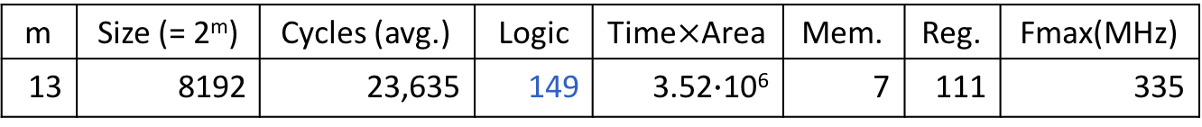
Fisher-Yates Shuffle
Random, uniform permutation
Algorithm
Hardware implementation
Initialize: A = {0, 1, …, n-1}
for i from n-1 downto 0 do
Generate j uniformly from range[0, i]
Swap A[i] and A[j]
Output: Shuffled array A
PRNG
Fisher-Yates
Shuffle
dual-port
memory
m | Size (= 2^{m}) | Cycles (avg.) | Logic | Time$×$Area | Mem. | Reg. | Fmax(MHz)
13 | 8192 | 23,635 | 149 | 3.52$∙$10⁶ | 7 | 111 | 335
Performance for shuffling $2^{13}$elements

Slide 12
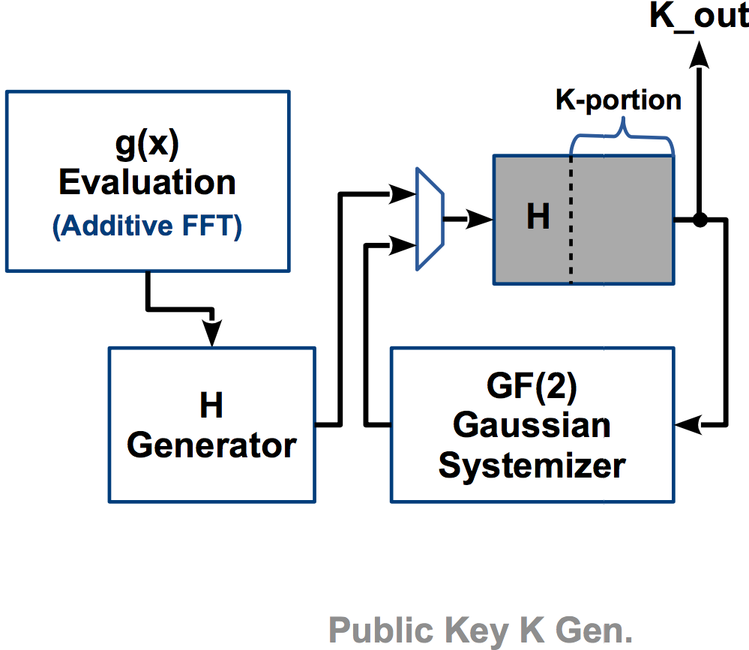
Key generator

Slide 13
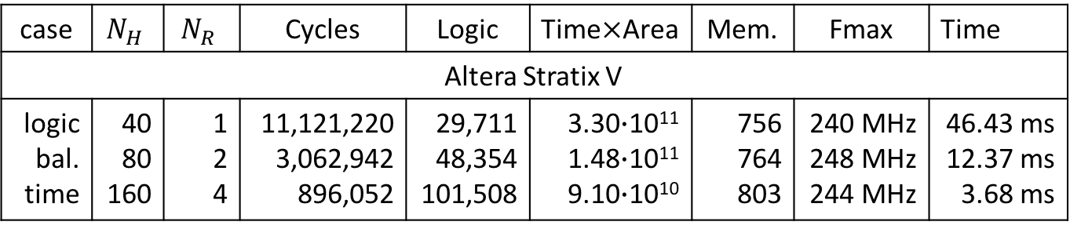
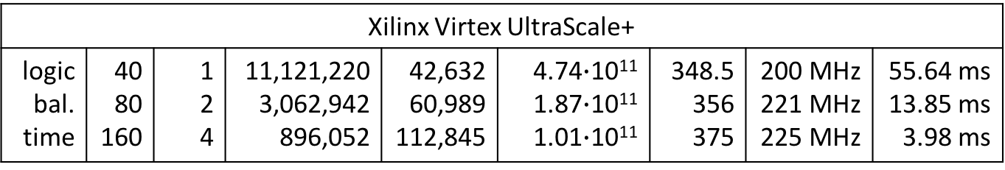
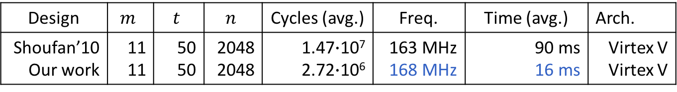
Performance results
case | $$N_{H}$$ | $$N_{R}$$ | Cycles | Logic | Time$×$Area | Mem. | Fmax | Time
Altera Stratix V
logic bal. time | 40 80 160 | 1 2 4 | 11,121,220 3,062,942 896,052 | 29,711 48,354 101,508 | 3.30$∙$10¹¹ 1.48$∙$10¹¹ 9.10$∙$10¹⁰ | 756 764 803 | 240 MHz 248 MHz 244 MHz | 46.43 ms 12.37 ms 3.68 ms
Xilinx Virtex UltraScale+
logic bal. time | 40 80 160 | 1 2 4 | 11,121,220 3,062,942 896,052 | 42,632 60,989 112,845 | 4.74$∙$10¹¹ 1.87$∙$10¹¹ 1.01$∙$10¹¹ | 348.5 356 375 | 200 MHz 221 MHz 225 MHz | 55.64 ms 13.85 ms 3.98 ms
(m = 13, t = 119, n = 6960)
Design | $$m$$ | $$t$$ | $$n$$ | Cycles (avg.) | Freq. | Time (avg.) | Arch.
Shoufan’10 Our work | 11 11 | 50 50 | 2048 2048 | 1.47$∙$10⁷ 2.72$∙$10⁶ | 163 MHz 168 MHz | 90 ms 16 ms | Virtex V Virtex V
Chou’17 Our work | 13 13 | 128 128 | 8192 8192 | 1.24$∙$10⁹ 4.30$∙$10⁶ | 1-4 GHz 215 MHz | 1236-309 ms 20 ms | Haswell Stratix V

Slide 14
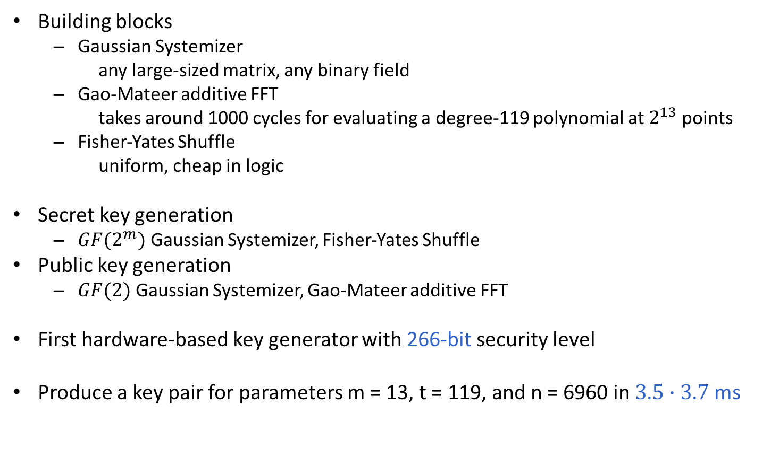
Conclusions
Building blocks
  Gaussian Systemizer
  any large-sized matrix, any binary field
  Gao-Mateer additive FFT
  takes around 1000 cycles for evaluating a degree-119 polynomial at $2^{13}$ points
  Fisher-Yates Shuffle
  uniform, cheap in logic
Secret key generation
  $GF(2^{m})$ Gaussian Systemizer, Fisher-Yates Shuffle
Public key generation
  $GF(2)$ Gaussian Systemizer, Gao-Mateer additive FFT
First hardware-based key generator with 266-bit security level
Produce a key pair for parameters m = 13, t = 119, and n = 6960 in $3.5∙3.7$ ms
Notes:
Change all 128 -> 266, all **-security

Slide 15
Thanks!
http://caslab.csl.yale.edu/code/keygen/

