Slide 1
Novel Bypass Attack and BDD-based Trade-off Analysis Against all Known Logic Locking Attacks
Xiaolin Xu, Bicky Shakya, Mark Tehranipoor, Domenic Forte
University of Florida, Gainesville, FL
September 26, 2017

Slide 2





Outline
Logic Obfuscation
Attacks on Logic Obfuscation and Countermeasures
Bypass Attack on SAT-resistant Locking
BDD-based Functional Locking
Conclusion and Future Work
Notes:
25 min total

Slide 3
Vertical Business Model
Specification
  All steps in IC production performed in-house or on-shore
  No longer prevalent
    Complex designs
    Market time pressure
    Exploding costs of top-end fabs
RTL Design, DFT
Synthesis, Verification
Design House
Physical Design
Signoff
Fabrication
Packaging
Assembly
Notes:
Make arr

Slide 4
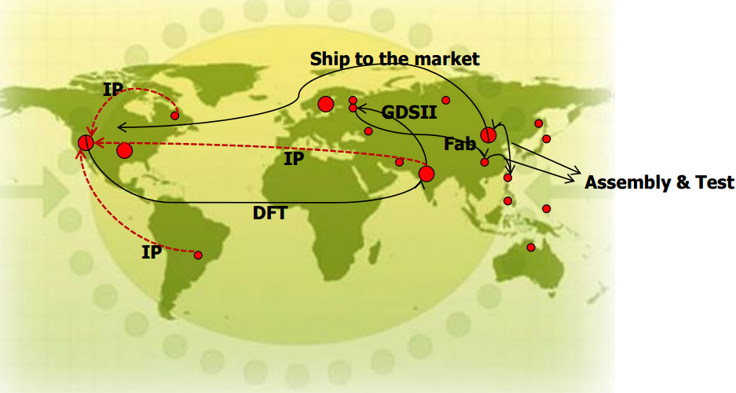
Horizontal Business Model
On-shore design house
(Fabless SoC integrator)
Off-shore fabrication, test ,
packaging and assembly
Specs, RTL Design
Synthesis, Verification, DFT
Physical Design, Signoff
Fab
Test
Package,
Assembly
Supply Chain
  Top-end fabs moving off-shore
  Reduced cost, quicker turn-around times
  Focus more on product development

Slide 5


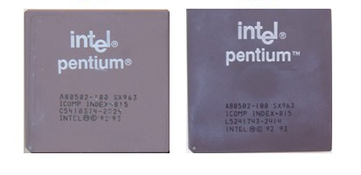
Threats
Foundry
Receives entire design along with test vectors. Design house has little to no control
Trojan insertion Overproduction IP/IC piracy Out-of-spec Defective Cloning | Supply Chain
 | Reverse engineering Cloning IP piracy
Real
Fake
Notes:
Added mechanical

Slide 6
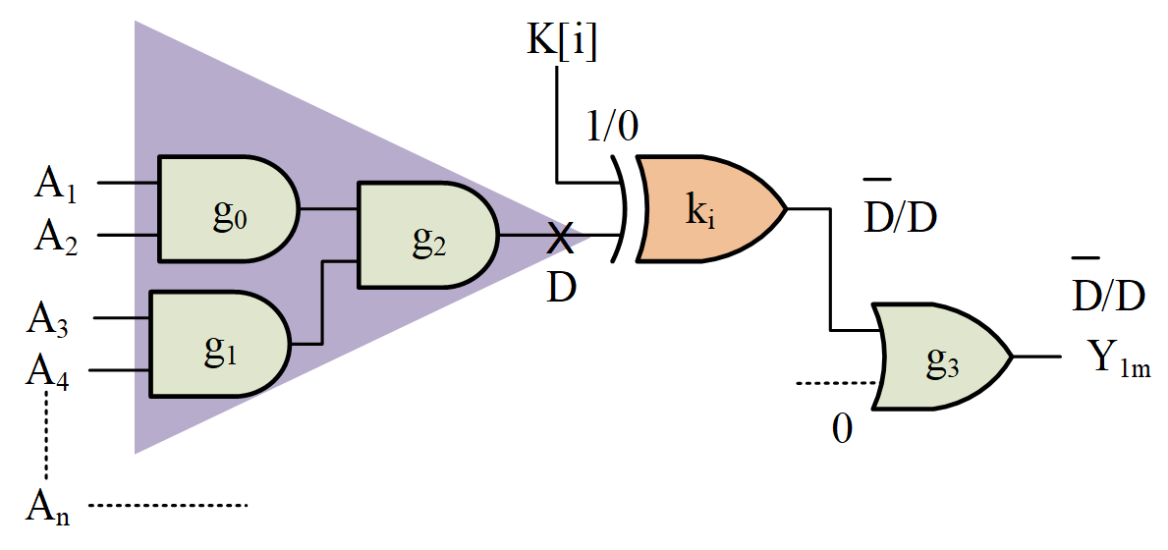
Logic Obfuscation
Original Netlist
Locked Netlist
Key gates inserted into netlist (XOR, XNOR, MUX etc.)
Incorrect I/O behavior unless correct key provided
Protects against untrusted foundry
  IP/IC piracy
  IC overproduction

Slide 7
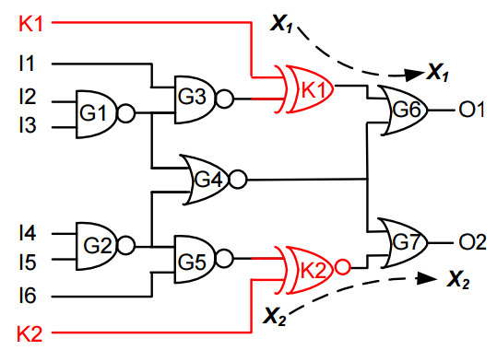
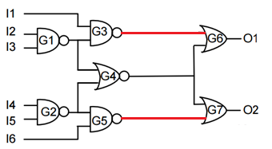
Attack on Logic Obfuscation
Key sensitization
  Apply inputs to propagate correct key value to observable output
  Prevent with interference-based logic locking (SLL)
Removal
  Identify and simply ‘remove’ components belonging to logic obfuscation
  Prevent by resynthesis
Propagating key to output(s)
[Rajendran, DAC ‘12]
Removing key logic

Slide 8

SAT-based Attack [HOST ’15]
Locked
Netlist
SAT Solver
Golden I/O
Patterns
Key
Unlocked
Chip
Unlocked
Netlist
Adversarial Model

Slide 9




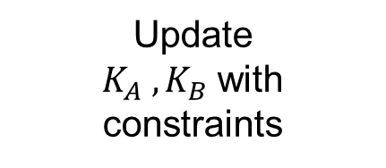
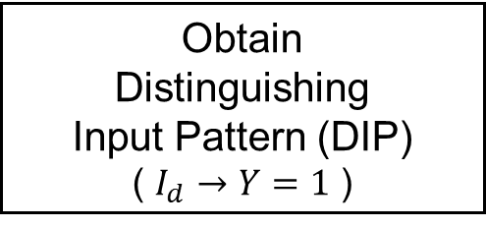


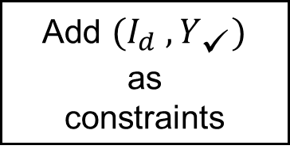



SAT-based Attack Methodology
Combinational Miter
1
2
Wrong Key $K_{A}$
Locked Netlist
(Copy A)
$$Y_{A}$$
Obtain
Distinguishing
Input Pattern (DIP)
( $I_{d}$ $→$ $Y=1$ )
Input $I$
⊕
$$Y$$
Locked Netlist
(Copy B)
$$Y_{B}$$
Wrong Key $K_{B}$
$$I_{d}$$
Update
$K_{A} , K_{B}$with
constraints
Add $(I_{d} ,Y_{✓})$
as
constraints
5
4
3
$$Y_{✓}$$

Slide 10


Basic Idea for SAT Attack
DIP # | Input | Y | K1 | K2 | K3 | K4 | K5 | K6
1. | {0,0,1,0} | 0 | 1 | 1 | 1 | 1 | 0 | 0
2. | {0,0,1,1} | 1 | 1 | 0 | 1 | 0 | 1 | 0
CNF Constraint Size
Initial Keyspace
size $2^{\left|K\right|}$
#
SAT
Iterations
Correct key(s)

Slide 11
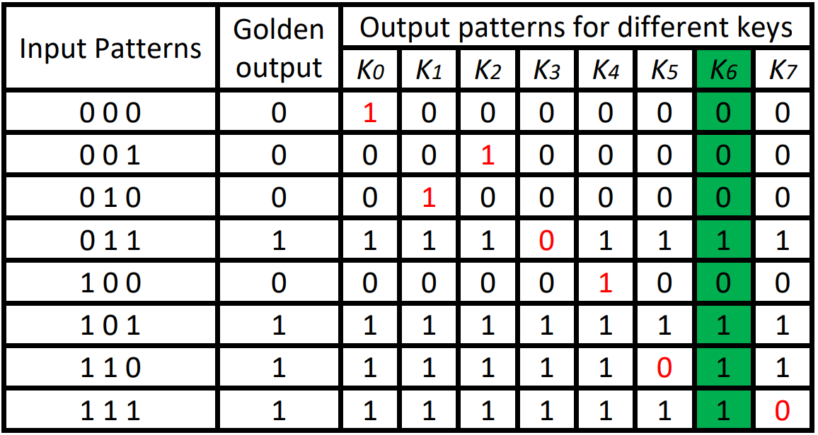




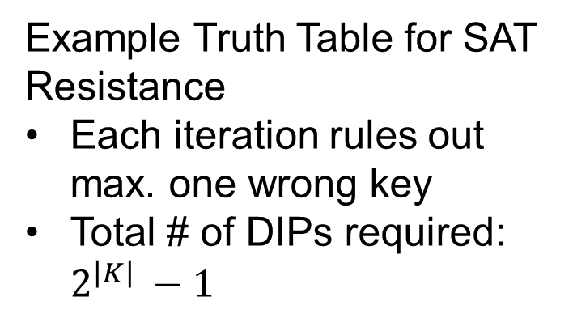





SAT-Resistant Countermeasures
$$K_{SLL}$$
Example Truth Table for SAT Resistance
Each iteration rules out max. one wrong key
Total # of DIPs required: $2^{\left|K\right|} −1$
Y
IN
Logic Cone
Y
SAT Resistant
Block
$$K_{SR}$$
$$∙$$
SLL
SR
Keys ruled out
$$∙$$
$$∙$$
$$∙$$
$$∙$$
$$λ$$
$$2^{|IN|}$$
No. inputs applied

Slide 12
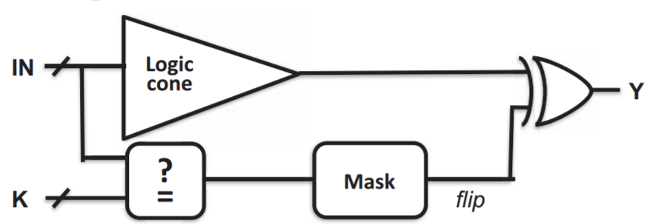
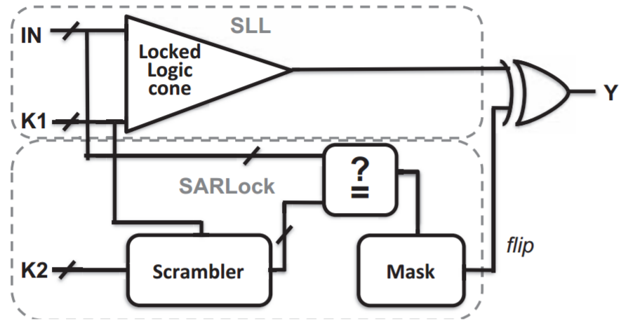
SAT-Resistant Countermeasures
SARLock
SARLock + SLL
SARLock to achieve maximum # DIPs [Yasin, HOST’15]

Slide 13
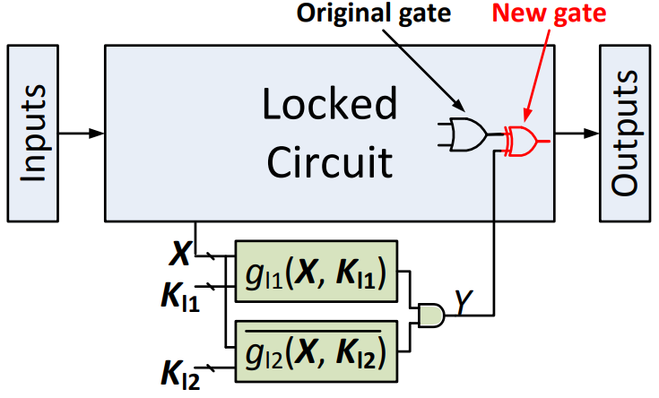
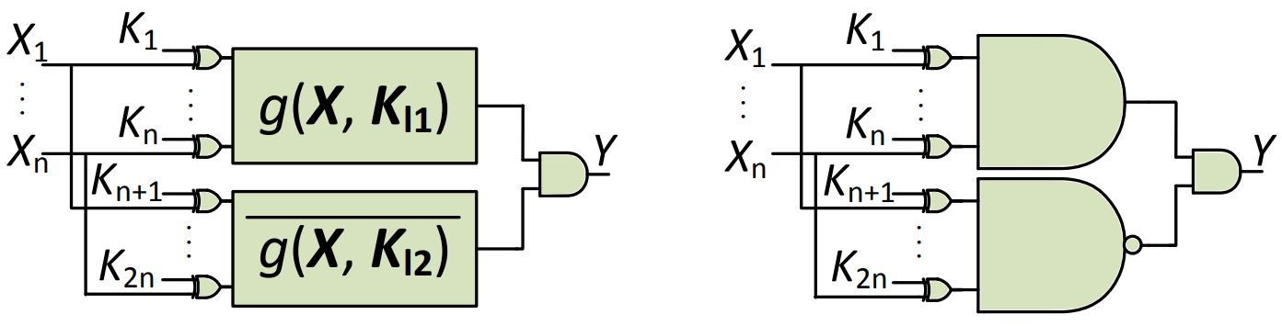
SAT-Resistant Countermeasures
Anti-SAT Integration
[Xie, CHES’16]
Secure: Use PI +
Observable Wires
Random: Use
random internal
nets
Anti-SAT Block
[Xie, CHES’16]
One Possible
Implementation

Slide 14
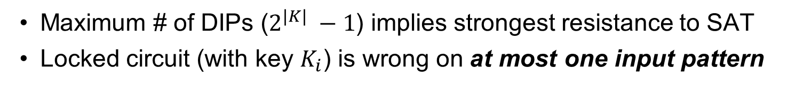
Observations on Countermeasures
Maximum # of DIPs ($2^{\left|K\right|} −1$) implies strongest resistance to SAT
Locked circuit (with key $K_{i}$) is wrong on at most one input pattern

Slide 15
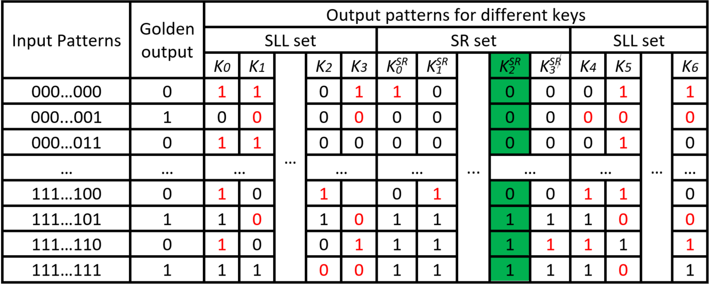

Observations on Hybrid Construction
For $|K|$ SLL keys and $|K^{SR}|$ keys, total key space is $2^{|K+K^{SR}|}$
$$2^{|K+K^{SAR}|}$$
SLL ✗
SR ✗
SLL ✗
SR ✓
SLL ✓
SR ✗
SLL ✓
SR ✓
SAT resistance is only guaranteed in {SLL ✓ SR ✗}
Incorrect Keys
Correct Key(s)

Slide 16

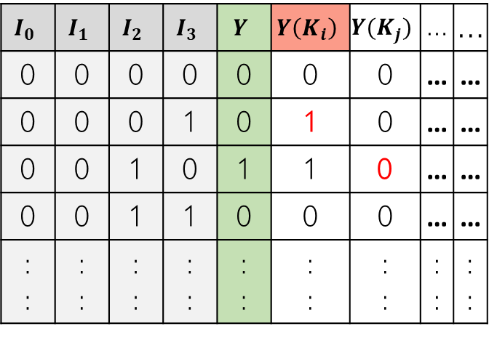
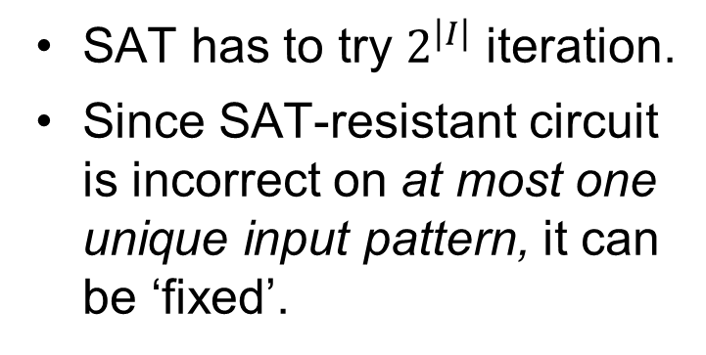








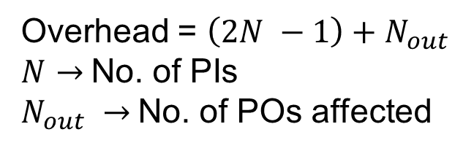
Proposed Bypass Attack
SAT has to try $2^{\left|I\right|}$ iteration.
Since SAT-resistant circuit is incorrect on at most one unique input pattern, it can be ‘fixed’.
$$K_{i}$$
Locked
Netlist
$$∙$$
$$∙$$
$$I_{0}$$
$$Y$$
$$∙$$
$$∙$$
$$I_{N}$$
$$\{0,0,0,1\}$$
$$I_{0}$$ | $$I_{1}$$ | $$I_{2}$$ | $$I_{3}$$ | $$Y$$ | $$Y\left(K_{i}\right)$$ | $$Y(K_{j})$$ | … | …
0 | 0 | 0 | 0 | 0 | 0 | 0 | … | …
0 | 0 | 0 | 1 | 0 | 1 | 0 | … | …
0 | 0 | 1 | 0 | 1 | 1 | 0 | … | …
0 | 0 | 1 | 1 | 0 | 0 | 0 | … | …
: : | : : | : : | : : | : : | : : | : : | : : | : :
Comparator
    Overhead = $\left(2N −1\right)+N_{out}$
    $N$ $→$No. of PIs
    $N_{out} →$No. of POs affected

Slide 17

Bypass on Hybrid Versions
$$2^{|K^{SLL}+K^{SAR}|}$$
SLL ✗
SR ✗
SLL ✗
SR ✓
SLL ✓
SR ✗
SLL ✓
SR ✓
Incorrect Keys
Correct Key
1
Fast elimination of wrong SLL keys
2
Keys for bypass (Algorithm terminates)
3
Correct key(s)

Slide 18






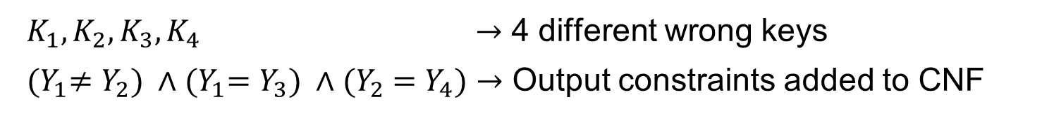

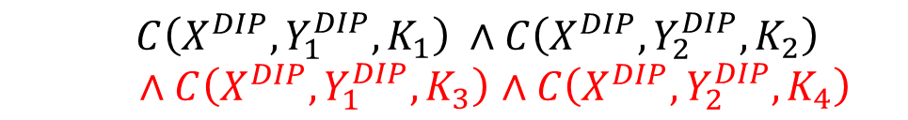



Bypass on Hybrid Versions
Miter helps to eliminate at least two wrong keys in each iteration
  Only weeds out incorrect SLL keys
$$K_{3}$$
$$Y_{3}$$
Original SAT CNF
⊕
$$K_{1}$$
$$Y_{1}$$
$C\left(X^{DIP}, Y_{1}^{DIP}, K_{1}\right) ∧C\left(X^{DIP}, Y_{2}^{DIP}, K_{2}\right)$
  $∧C\left(X^{DIP}, Y_{1}^{DIP}, K_{3}\right)$ $∧C\left(X^{DIP}, Y_{2}^{DIP}, K_{4}\right)$
$$X^{DIP}$$
⊕
∧
$$1$$
$$K_{2}$$
$$Y_{2}$$
⊕
$$K_{4}$$
$$Y_{4}$$
Added SAT CNF
$K_{1}, K_{2}, K_{3}, K_{4}$ $→$ 4 different wrong keys
${(Y}_{1}≠Y_{2}) ∧{(Y}_{1}=Y_{3}) ∧{(Y}_{2} =Y_{4})$ $→$ Output constraints added to CNF
Notes:
Y Y1 Y2 Y3
----------------
0 1 0 0 -> Entirely in antiSAT keyspace (don’t want to be here)
1 0 1 1 -> Only one key eliminated (not ideal)

Slide 19
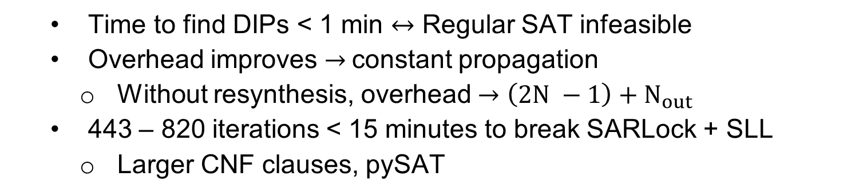
Attack Execution
 |  | SARLock |  |  |  | AntiSAT
 |  | Locked Cone |  | Bypass |  | Locked Cone |  | Bypass
Benchmark | Gate Count | Area % | Delay % | Area % | Delay % | Area % | Delay % | Area % | Delay %
C432 | 160 | 83.13 | 29.03 | 3.13 | -12.9 | 394.74 | 29.03 | 48.75 | 9.68
C880 | 383 | 44.19 | 110.53 | 0.78 | 0.00 | 50.50 | 111.11 | 26.11 | 88.89
C1908 | 880 | 15.36 | 37.04 | 0.11 | 0.00 | 18.11 | 37.04 | 9.55 | 7.41
C3540 | 1669 | 7.02 | 178.57 | 0.84 | -7.14 | 8.26 | 178.57 | 2.22 | 92.86
C5315 | 2297 | 6.60 | 166.67 | 0.00 | 0.00 | 7.38 | 166.67 | 0.00 | 0.00
C7552 | 3512 | 10.08 | 476.47 | -0.20 | 29.41 | 11.68 | 476.47 | -0.20 | 29.41
apex2 | 1522 | 11.04 | 11.76 | -0.33 | 0.00 | 11.67 | 11.76 | -0.33 | 0.00
sqrt | 16998 | 0.63 | 0.86 | -0.01 | -0.86 | 0.70 | 0.86 | 0.33 | 1.29
  Time to find DIPs < 1 min $↔$ Regular SAT infeasible
  Overhead improves $→$constant propagation
    Without resynthesis, overhead $→$ $\left(2N −1\right)+N_{out}$
  443 – 820 iterations < 15 minutes to break SARLock + SLL
    Larger CNF clauses, pySAT
Notes:
(2 SAT calls w/ blocking clause),
Write down no. of inputs

Slide 20
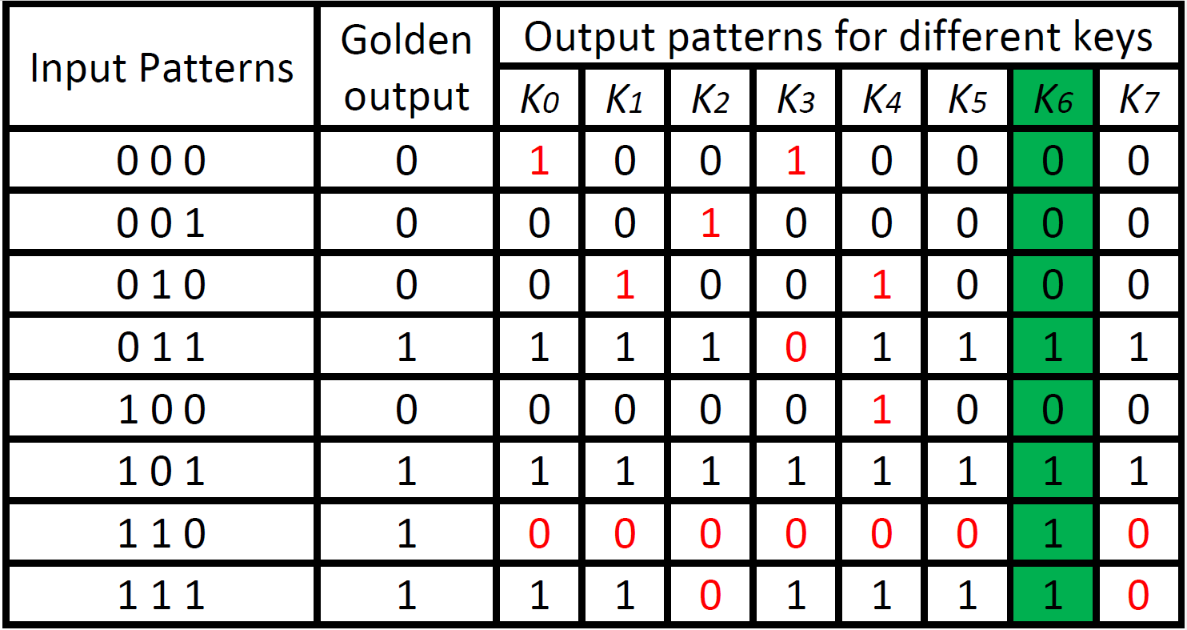
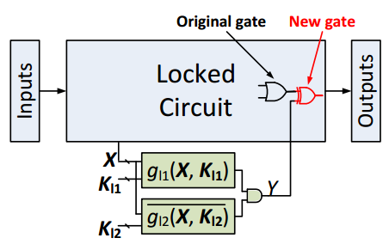
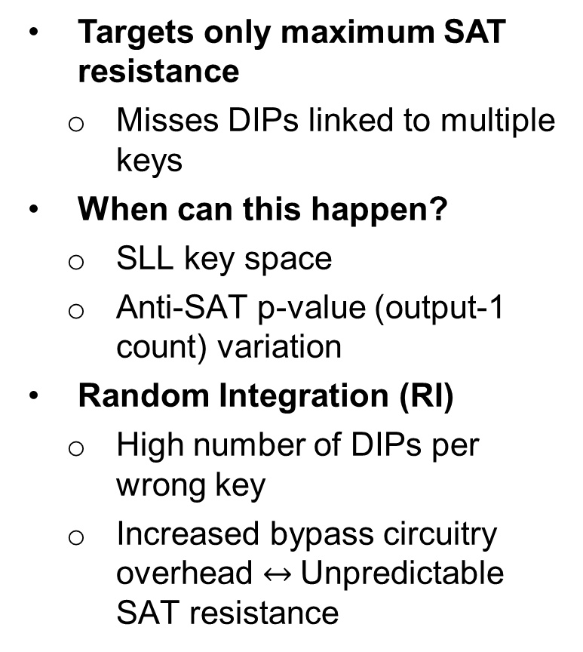
Limitations
Targets only maximum SAT resistance
  Misses DIPs linked to multiple keys
When can this happen?
  SLL key space
  Anti-SAT p-value (output-1 count) variation
Random Integration (RI)
  High number of DIPs per wrong key
  Increased bypass circuitry overhead $↔$Unpredictable SAT resistance
Internal nodes as antiSAT inputs
Notes:
Note that the figure is not experimental. Its just

Slide 21
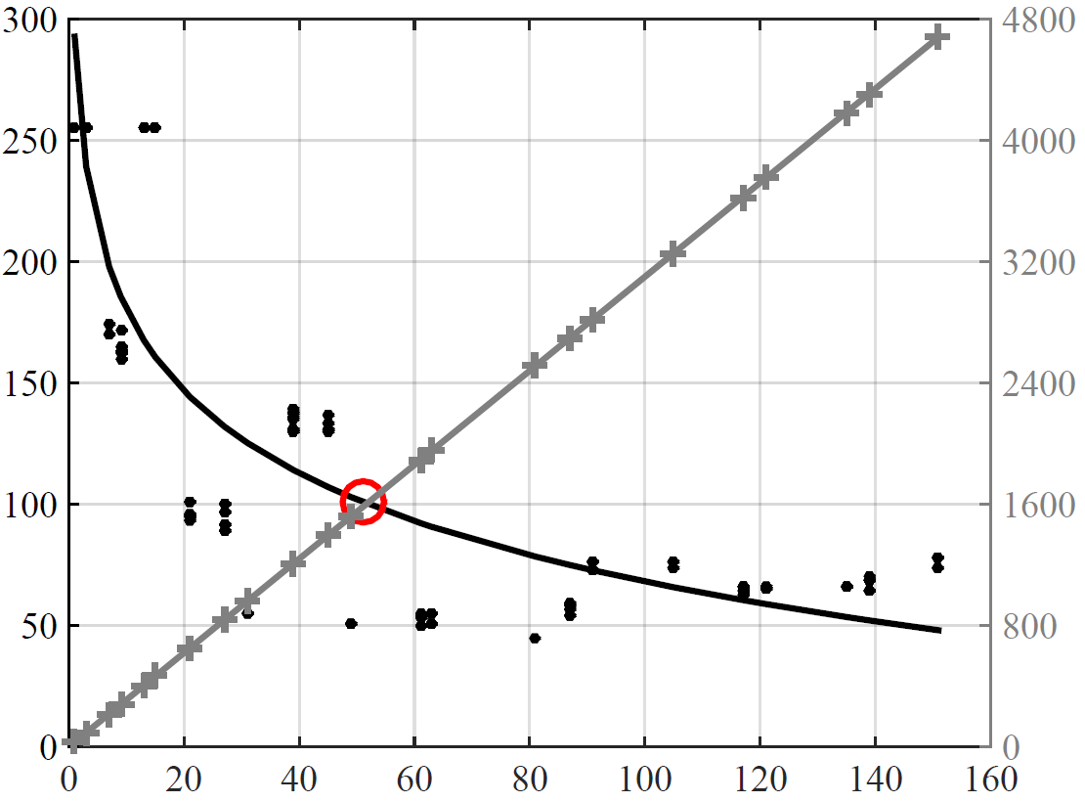




Trade-offs
$$g$$
SAT Attack Execution Time
$$Y$$
# Gates Required for Bypass
$$\overline{g}$$
p value
Varied p-value of Anti-SAT block
SAT resistance $↑$ Bypass overhead$↓$
Notes:
Note that the figure is not experimental. Its just

Slide 22
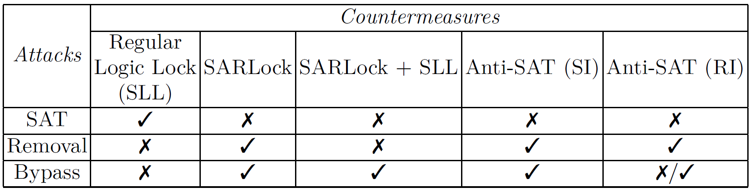
Summary of Attacks
A combination of one or more techniques breaks logic obfuscation
Question: Can resistance against all these attacks be addressed in unison?

Slide 23
Binary Decision Diagrams (BDDs)
f = ab+a’c+bc’d
a
a
c+bd
If reduced and ordered, canonically represent a Boolean circuit
Used in formal verification and logic synthesis
b
c+bd
b
b
c
c+d
c
c
c
d+b
d
d
b
d
b
0
1
0
1
f
f
S
S
1 0
Variable Ordering, Mapping
Reduction Rules
Notes:
BDDs are widely used in verification and model checking problems.
BDDs allow for compact representations of logic that are easy to store, compare, and modify.
One can interpret BDDs as binary trees where nodes are logical variables and edges correspond to a variable being 0 or 1. One can view each node as a MUX that is controlled by the variable value to produce an input to the next MUX controlled by the next variable. By reordering variables it is possible to obtain a very compact representation.

Slide 24
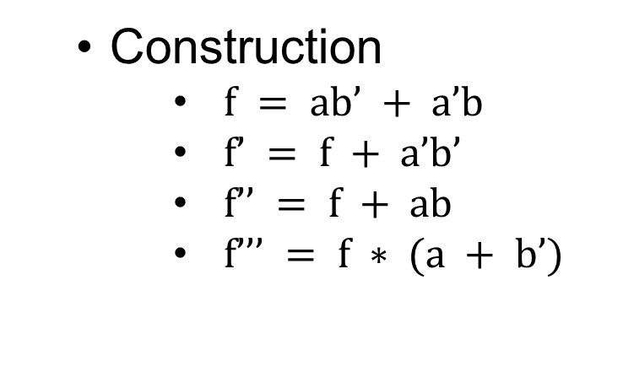

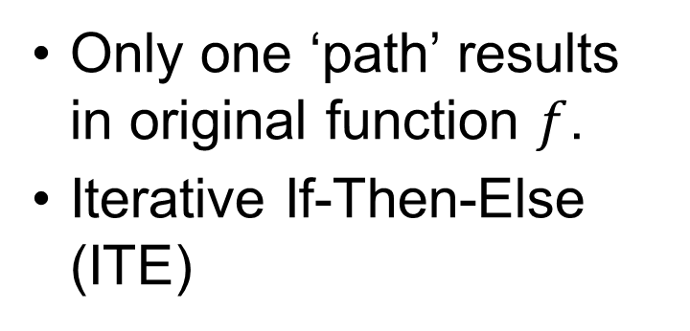
Logic Obfuscation on BDDs
Only one ‘path’ results in original function $f$.
Iterative If-Then-Else (ITE)
K2 = 0
K2
K1
a
K1 = 0
  Construction
          $f = ab’ + a’b$
          $f’ = f + a’b’$
          $f’’ = f + ab$
          $f’’’ = f ∗ (a + b’)$
b
b
f
f’
f’’
f’’’
0
1
0
1
$$f=a ⊕b$$

Slide 25
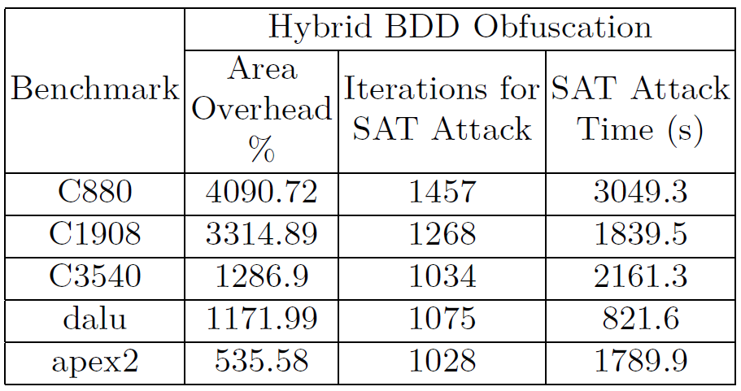
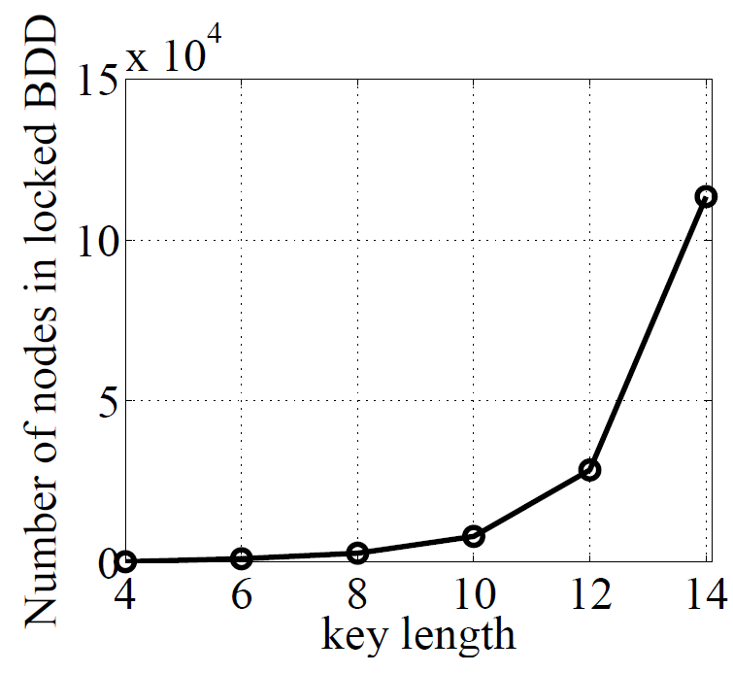
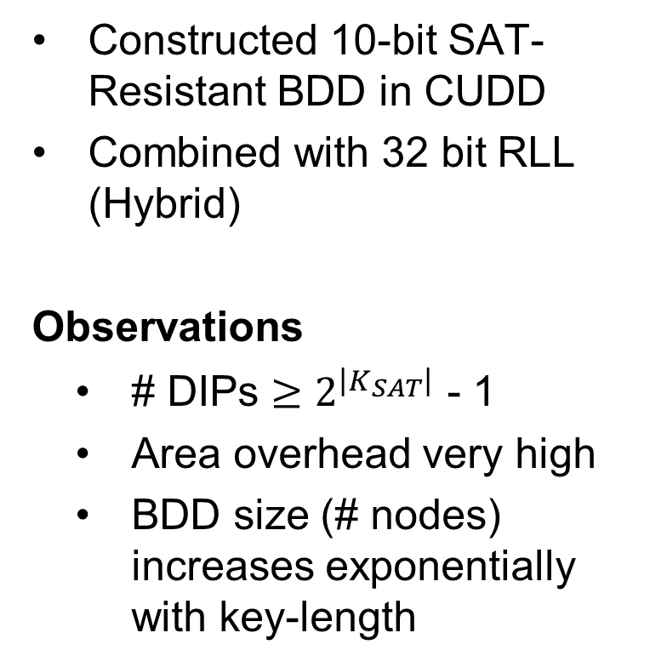
Experimenting with BDDs
Constructed 10-bit SAT-Resistant BDD in CUDD
Combined with 32 bit RLL (Hybrid)
Observations
  # DIPs $≥2^{\left|K_{SAT}\right|}$ - 1
  Area overhead very high
  BDD size (# nodes) increases exponentially with key-length
Notes:
We have developed a preliminary method for obfuscating BDD representations of circuits.
Assume we have a function f represented by the following bdd. We create alternative functions of f (denoted by an apostrophe) that result in flips at the output (the number of which is within our control. These functions get connected be adding key variables to the BDD such that only one corrected key results in the original function f

Slide 26

Logic Encryption on BDDs
Strengths
  Allows for precise Boolean function manipulation
    Control SAT resistance and bypass resistance
    Trade-offs
      Sharing DIPs vs SAT resistance
      Enforcing unique set of DIPs vs overhead
  Inherently resistant to key propagation attacks
  Inherently resistant to removal attacks
Challenges
  Area Overhead
    Apply to N outputs and reduce key length
      $\# DIPs = N ∙(2^{\left|K\right|}+1)$
      Reduced SAT strength
Notes:
Strengths
Point 1
Because we have full control over modifying patterns, we can control how resistant we are to SAT vs. bypass attacks which trade off with each other
Point 2
Key propagation can only be applied when key input can be propagated (like a fault) to the primary output without being masked by another.
In our case, all key gates converge to the same output and therefore share the same output cone. This is clearly understood when considering the fact that each key variable is associated with a MUX and all the MUXes are connected to each other.
Point 3
BDD obfuscation happens before synthesis
Unless the key is known, original function f cannot be separated from f_primes (other minterms) because they are synthesized together. Extra minterms are still there even after removal of key gates.
Challenge Solutions- area overhead
Apply to transitive cones of multiple outputs independently
Optimal key variable insertion in tree (that minimizes number of nodes and synthesized area)
Minimizing graph size based on logic decomposition and BDD variable ordering

Slide 27
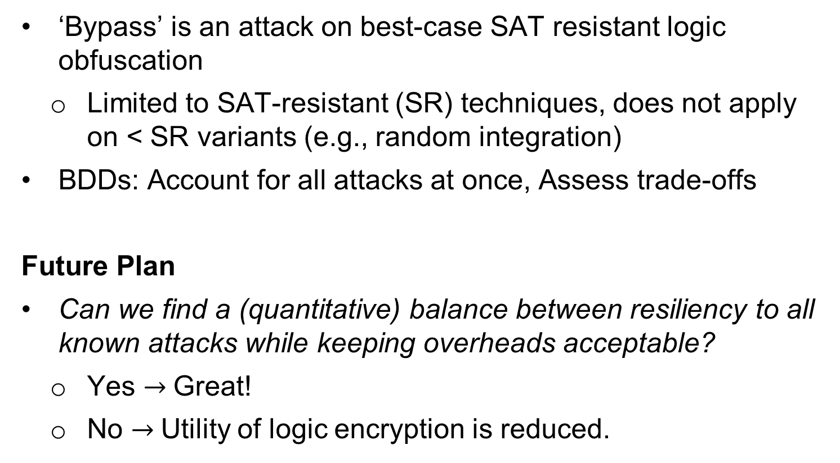
Conclusion
‘Bypass’ is an attack on best-case SAT resistant logic obfuscation
  Limited to SAT-resistant (SR) techniques, does not apply on < SR variants (e.g., random integration)
BDDs: Account for all attacks at once, Assess trade-offs
Future Plan
Can we find a (quantitative) balance between resiliency to all known attacks while keeping overheads acceptable?
  Yes $→$Great!
  No $→$Utility of logic encryption is reduced.
Notes:
To summarize, we have multiple very high impact directions we are exploring for logic obfuscation.

Slide 28

Questions

