Slide 1
Making Password Authenticated Key Exchange Suitable For Resource Constrained Industrial Control Devices
Overcoming the challenges faced when protecting password-based logins in field devices.

Slide 2
Examples for Process industry installations

Slide 3
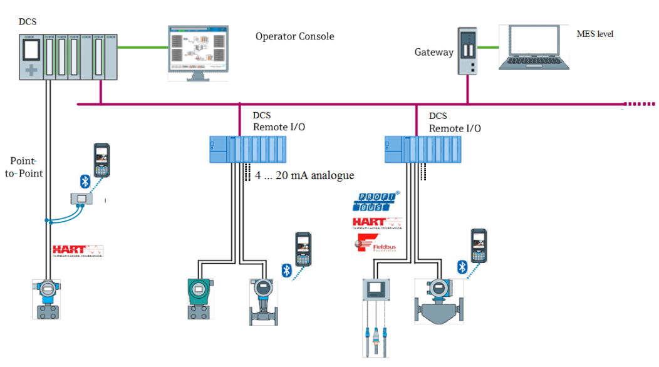
Bigger picture: Field devices in process automation

Slide 4
Bigger picture: Field devices in process automation
Manufactoring execution system (MES)
E.g. SAP

Slide 5
Bigger picture: Field devices in process automation
Distributed Control System (DCS)
E.g. Siemens, Yokogawa, Emerson, …

Slide 6
Bigger picture: Field devices in process automation
Field devices: closest to the process
Harsh environmental conditions
Tight resource constraints
Low computational power
Often: explosion protection required

Slide 7
Bigger picture: Field devices in process automation

Slide 8
Bigger picture: Field devices in process automation
2017: Still most important interface to distributed control system Analog process value encoding (@ ~12V supply voltage) 3.6 mA (error state) 4 … 20 mA (valid process data)

Slide 9
Bigger picture: Field devices in process automation
2017: Still most important interface to distributed control system Analog process value encoding (@ ~12V supply voltage) 3.6 mA (error state) 4 … 20 mA (valid process data)
No digital data exchange between DCS and Field Device!

Slide 10
HMI interfaces of field devices in 2017
2017: Features of Field devices becoming more and more complex
Local HMI still restricted by rough environmental conditions
E.g. two lines of text, 3 Buttons

Slide 11
HMI interfaces of field devices in 2017
Big discrepancy with what we are used to from consumer technology.

Slide 12
HMI interfaces of field devices in 2017
?
Big discrepancy with what we are used to from consumer technology.
Re-Use of Consumer-Technology, such as Bluetooth 4.0 Low-Energy ?

Slide 13
HMI interfaces of field devices in 2017
?
Is Security adequate?

Slide 14
Control industry : Re-use of consumer/office standards
Consumer / office IT security technology not originally designed for control industry threats and constraints
Example: Bluetooth Low-Energy 4.0: Weak challenge response protocol for PIN-based authentication ➔ clearly not adequate for industrial control. “None of the pairing methods provides protection against a passive eavesdropper …“ (Bluetooth 4.0 core spec. page 1964)
Careful threat analysis advisable before using consumer / office IT technology!

Slide 15
Threat analysis → Security requirements
Wireless interfaces and IP-based networks considered vulnerable
HMI handhelds might be easily compromised / stolen
No keys / authentication data stored persistently in smart phone / tablet
Main security target: Plant integrity and availability

Slide 16
Attacker model → Derived key security requirements
Wireless interfaces and IP-based networks considered vulnerable
HMI handhelds might be easily compromised / stolen
No keys / authentication data stored persistently in smart phone / tablet
Main security target: Plant integrity and availability
Confidentiality and forward security essential for update of authentication credentials via vulnerable interfaces (e.g. wireless password changes)

Slide 17
Actual application requirements and constraints
Important markets (e.g. pharma/life science): Regulations impose individual operator authentication
Some, but not all relevant handhelds might have QR code cameras / identification card readers / USB connectors
Only interface available truly everywhere: Keyboard
Today in many industry installations: No certificate authority (CA)
System should be secure even if customer has no CA.

Slide 18
Operator authentication for E+H SmartBlue App
If we cannot avoid use of “passwords” for practical reasons, we should really protect our customer’s installations by adequate technology:
Password Authenticated Key Exchange PAKE

Slide 19
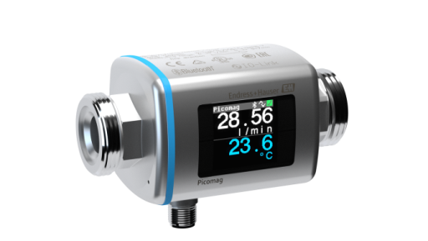
Challenge triangle for actual implementation
A) Security requirements
B) Resource constraints (Power, Memory)
C) Security Patents

Slide 20
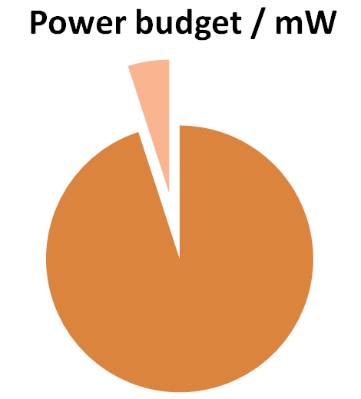
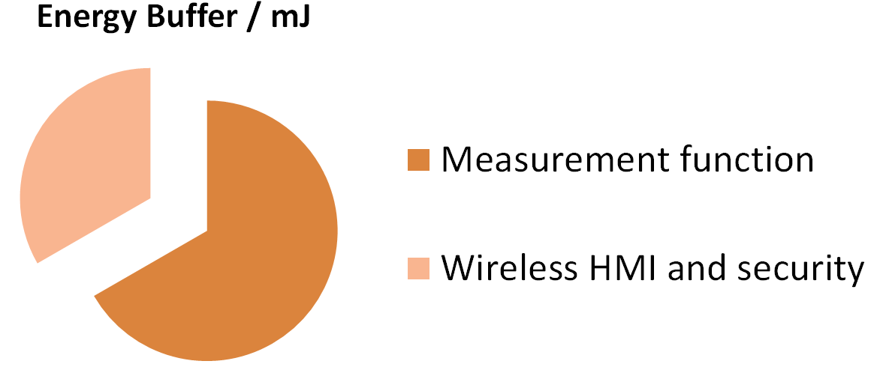
Typical budget constraints for 4 … 20 mA devices
Ignition by hot surfaces → Limit peak supplied electrical power Typical power available: 30 mW
1.5
0,5
1
28

Slide 21
Typical budget constraints for 4 … 20 mA devices
Ignition by hot surfaces → Limit peak supplied electrical power Typical power available: 30 mW For reference: roughly equivalent to driving one LED!
1.5
0,5
1
28

Slide 22
Typical budget constraints for 4 … 20 mA devices
Ignition by hot surfaces → Limit peak supplied electrical power
Ignition by Sparks → Limit size of energy buffers (e.g. capacitors) (e.g. IEC60079-11)
1.5
0,5
1
28

Slide 23
Typical budget constraints for 4 … 20 mA devices
Ignition by hot surfaces → Limit peak supplied electrical power
Ignition by Sparks → Limit size of energy buffers (e.g. capacitors)
Add-on feature “HMI interface and security” will be granted only a small fraction of the available power / transient buffer budget!
1.5
0,5
1
28

Slide 24
Typical budget constraints for 4 … 20 mA devices
Ignition by hot surfaces → Limit peak supplied electrical power
Ignition by Sparks → Limit size of energy buffers (e.g. capacitors)
Add-on feature “HMI interface and security” will be granted only a small fraction of the available power / transient buffer budget!
1.5
0,5
1
28

Slide 25
Wireless HMI: Most important requirements
(Augmented) PAKE scheme
Avoid security patents
Avoid user-perceivable login delay
Power budget ~1.5 mW on average, ~0.5 mJ for short-term transients
~1kByte RAM (static data + stack) / ~32kByte ROM
Our contribution:
Results of implementation research in 2015: Which primitives / protocol choices / implementation techniques might work in our highly constrained setting.

Slide 26
How did we proceed – 1 –
Tested Secure Remote Password (SRP)
Used legacy-level 1024 bit prime field
Login delay for plain C implementation: ~2 minutes

Slide 27
How did we proceed – 2 –
Assessed ECC on Weierstrass Curves (Brainpool / NIST)
Patent Pitfalls! (specifically regarding efficient implementation of PAKE protocols)
Login delays still very long for 128 bit level

Slide 28
How did we proceed – 3 –
Evaluation of Edwards/Montgomery curves
Used AvrNaCl by Schwabe and Hutter as starting point and ported it to the ARM Cortex M0
Password Authenticated Connection Establishment (PACE) suitable
Asymmetric crypto on Curve25519 in ANSI-C was still slow => Development of Curve19119 (~96 bit security parameter)
Significant speedup for X25519 in (Düll et al., 2015) => Switched back to Curve25519 with PACE for our remote HMI solution (E+H SmartBlue App) rollout in 2016 (as building block of our augmented PAKE scheme).

Slide 29
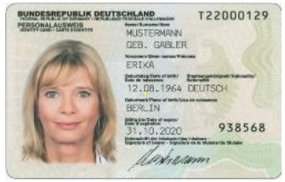
Password Authenticated Connection Establishment
PACE [ˈpaːtʃe] developed by J. Bender, D. Kügler and M. Fischlin
developed for travel documents

Slide 30
Password Authenticated Connection Establishment
PACE [ˈpaːtʃe] developed by J. Bender, D. Kügler and M. Fischlin
PACE: not just a protocol, but rather a tailorable protocol family.
Important design target: Open paths for patent circumvention
developed for travel documents

Slide 31
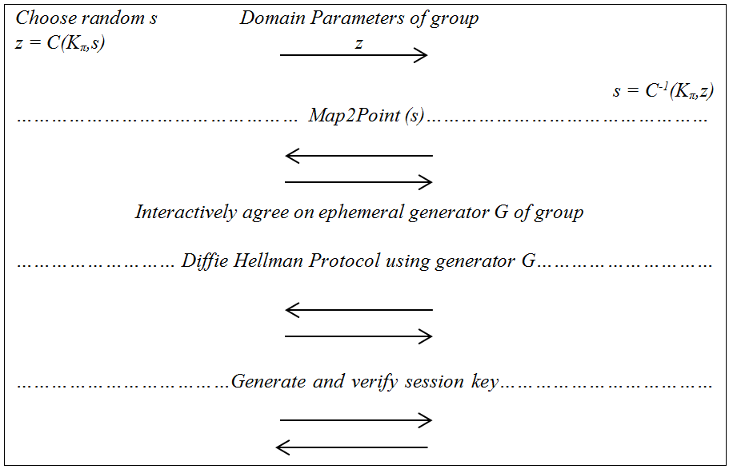
PACE protocol family members : 4 main steps

Slide 32
PACE protocol family members : 4 main steps
1. Key idea: Run DH protocol with an ephemeral generator G of the group and conceal G from attacker

Slide 33
PACE protocol family members : 4 main steps
2. Key idea: If we encrypt a random number s under a password derived key, it still looks like a random number for the attacker

Slide 34
PACE protocol family members : 4 main steps
Most important task for PACE:
Convert secret random s to a generator G of the group
Original PACE paper discusses for four alternative choices.

Slide 35
PACE protocol family members : 4 main steps
German ID-Card: PACE on Weierstrass curves. Inefficient “Generic Mapping” for patent circumvention.
Speed penalty factor ~3 in comparison to “Integrated Mapping”!

Slide 36
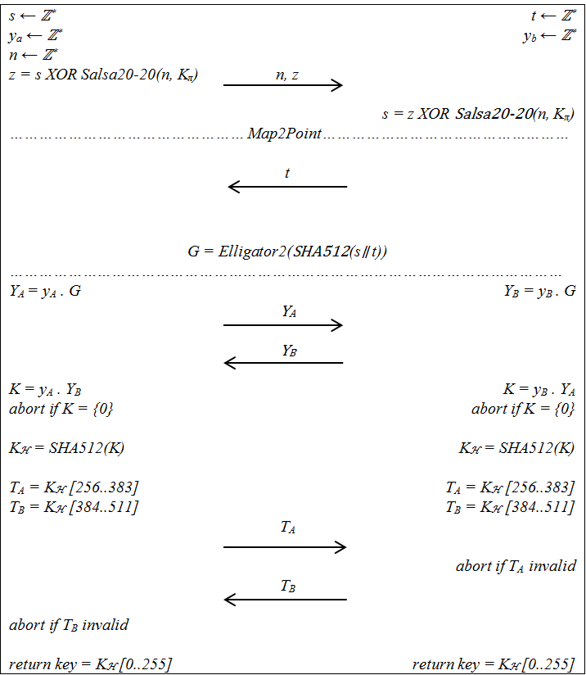
Our choice for balanced PACE sub-step in SmartBlue App

Slide 37
Our choice for balanced PACE sub-step in SmartBlue App
Use Curve25519 for X25519 Diffie-Hellman

Slide 38
Our choice for balanced PACE sub-step in SmartBlue App
Elligator2 for G = Map2Point(s) sub-step
Not covered by patents
Very efficient

Slide 39
Our choice for balanced PACE sub-step in SmartBlue App
Twist security of Curve25519 allows for very simple method for mandatory point verification in PACE
Avoids patent pitfalls regarding point compression and verification.

Slide 40
PACE on Cortex M0+
PACE constant-time run on Curve25519: 474 ms (No secret dependent branches, conditional swaps by logic)
Synchronous execution requires 4 mJ. Energy buffer constraints exceeded!
Nordic nRF51822, 256k Flash 16k RAM, 16 MHz

Slide 41
PACE on Cortex M0+
Asynchronous Crypto Engine (ACE)
Chop calculation into chunks and go to sleep if necessary
Largest transient before returning to sleep: 149 μJ (inversions)
Run-time @ 1.5 mW: ~4s
Nordic nRF51822, 256k Flash 16k RAM, 16 MHz

Slide 42
Our proposal for even smallter targets: ~96 bit security
Curve19119 (a little brother of Curve25519)
Strongly inspired by Curve25519 (http://cr.yp.to/ecdh/curve25519-20060209.pdf)
Field prime p = 2¹⁹¹ – 19 instead of p = 2²⁵⁵ – 19
Montgomery curve y² = x³ + A x² + x .
Parameter A chosen rigidly to be as small as possible given that
Both group orders #E and #E_{quadratic twist} ,co-Factors 4 or 8 (twist security)
#E > 2¹⁸⁸.
New construction requirement: (A+2) shall be square. Allows for most-efficient Hisil-Wong-Carter-Dawson 2008 formulas

Slide 43
Our proposal for even smallter targets: ~96 bit security
Result of construction and suggested base point for x-coordinate-only DH protocol X19119:
A = 529418
#E = 8 (2¹⁸⁸ + 6805822842506810719592233527)
Xbase point = 11

Slide 44
Speed comparison of Curve19119 and Curve25519 on M0
Speed advantage of field multiplication and squaring: Factor ~1.5
Two levels of refined Karatsuba mapping 192→96 bit and 64→32 bit multiplications/squarings
Constant-time conditional negations in Karatsuba using method of Düll et. al. (2015)
Variable base point scalar multiplication: X19119 1.92 times faster

Slide 45
Summary
Explored the design space of PAKE protocols for the constrained setting of a remote HMI interface for field devices: PACE
Asynchronized PACE, Curve25519 with Elligator2: Login delay < 4s
Evaluation of alternative choices:
~96 bit security level (Curve19119): ~ Login factor 1.92 faster (~2s)
Speed penalty for PACE on Weierstrass Curves (e.g. P256) with Coin2Point patent circumvention: factor >> 2 (e.g. >> 8s )
Additional speed penalty for random-prime curves: factor 3
Efficiency matters! Less efficient protocols and implementations might have driven us back to weak Challenge-Response protocols.

Slide 46
Challenge response protocols revisited
Protocol candidate that might actually be beneficial
Björn Haase and Benoît Labrique would like to thank Peter Schwabe, Marc Fischlin, Florian Bachmann, Johann Heyszl and Tanja Lange for inspiring discussions.

