Slide 1
Back to Massey:
Impressively fast, scalable and tight security evaluation tools
Marios O. Choudary and Pantelimon George Popescu
University Politehnica of Bucharest
CHES 2017, Taipei

Slide 2
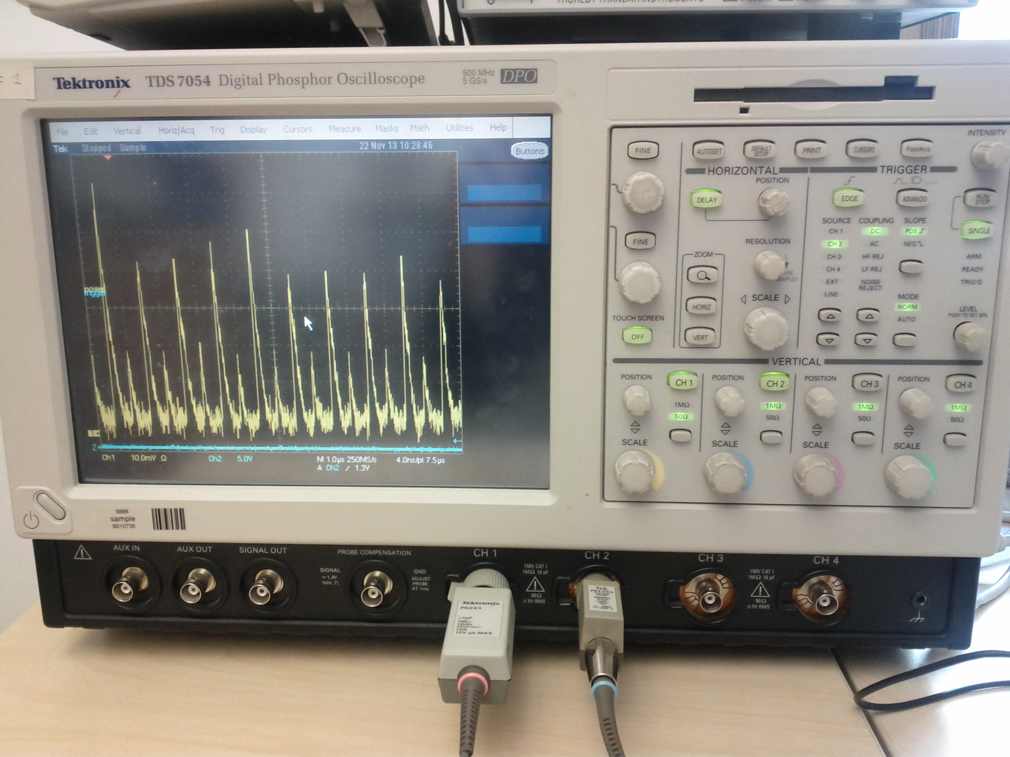
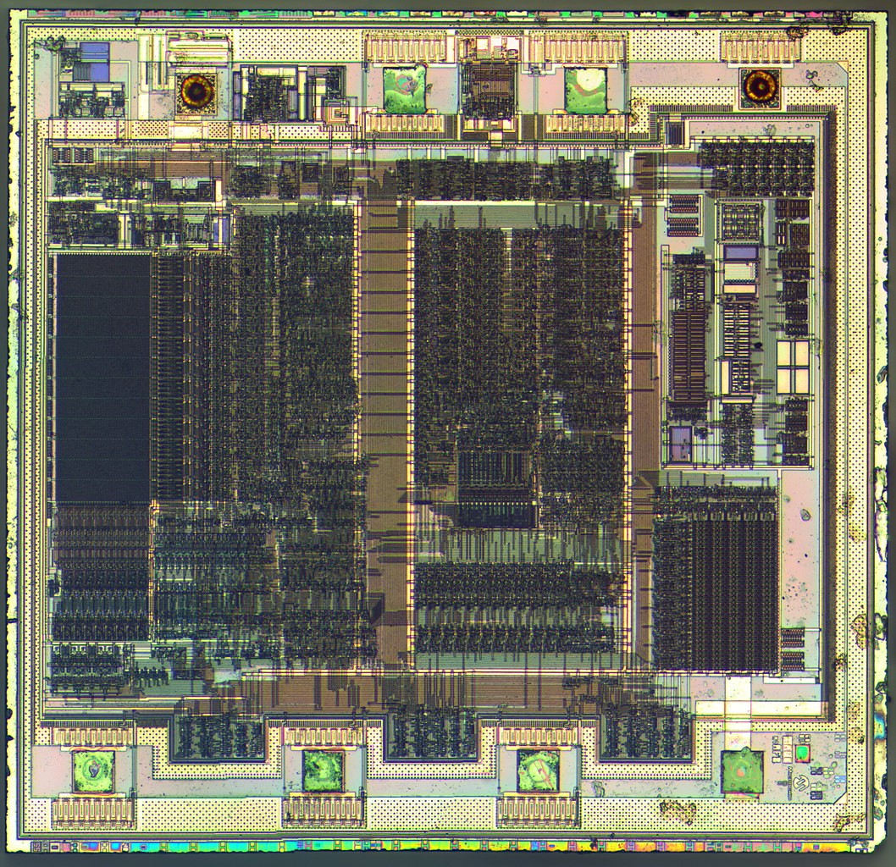


Side Channel Attacks (SCA)
Are powerful tools to extract data (e.g. secret keys) used in cryptographic algorithms
OR during key-loading operations
CRYPTO
SCA
KEY
Choudary and Popescu, Back to Massey
Notes:
Image of PIC12C508, taken from Wikipedia

Slide 3
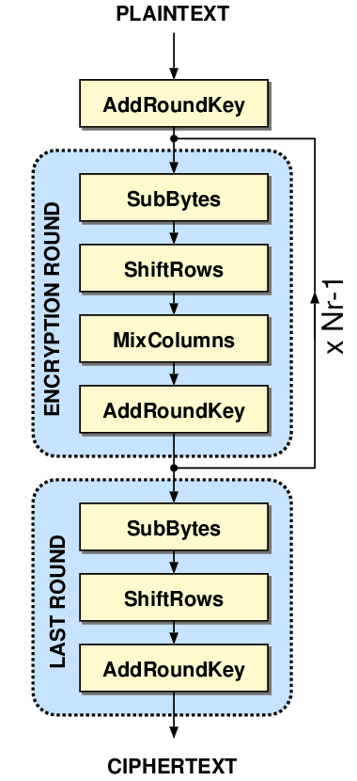
SCA on crypto algorithms
Improved brute-force attacks by Divide and Conquer strategy:
  Target 8-bit subkeys instead of full crypto key (e.g. 128-bit)
Sbox(k₁)
(8-bit)
Sbox(k₂)
(8-bit)
…
AES
SCA
SCA
SCA
Choudary and Popescu, Back to Massey
Notes:
The power of SCA on crypto algorithms comes from the divide et impera strategy. This is also used for key-loading scenarios.

Slide 4
Security Evaluations
Used to determine security of a device against side-channel attacks (as well as other attacks…)
Performed by chip designers as well as specialised evaluation labs (for certification purposes)
Certifications (e.g. Common Criteria, EMV) typically needed for commercial security-critical products (e.g. banking cards)
Choudary and Popescu, Back to Massey

Slide 5
Evaluations on single subkeys
Due to Divide and Conquer strategy, classic evaluation tools apply mostly to single subkeys (bytes, words):
  Guessing entropy (our focus)
  Success rate
  Mutual information
  …
Choudary and Popescu, Back to Massey

Slide 6
Evaluations on single subkeys
These tools require lists of probabilities (or scores) for each value of a subkey:
Sbox(k₁)
(8-bit)
SCA (k₁)
L₁ = [P(k₁=0), P(k₁=1), …, P(k₁=255)]
Sbox(k₂)
(8-bit)
SCA (k₂)
  L₂ = [P(k₂=0), P(k₂=1), …, P(k₂=255)]
…
e.g. Template Attacks
SCA (…)
  …
Choudary and Popescu, Back to Massey

Slide 7
Guessing entropy (GM)
James L. Massey, ’94 (‘guess work’)
|S| is the number of values per subkey
p_{i} are the sorted probabilities after the SCA:
  Statistical expectation of position of correct key value in sorted list of probabilities
  Expected amount of work for optimised brute force attack
Choudary and Popescu, Back to Massey
Notes:
This is the original evaluation tool developed by James Massey in 1994, under the initial name of “guess work”.
The term “guessing entropy” was introduced by Cachin in his PhD thesis.
For GM we need actual probabilities, not scores.

Slide 8
Empirical guessing entropy (GE)
(aka key rank)
Standaert et al., ’06
  GE = position of correct key (k_{good})
  in the sorted list of probabilities:
  e. g. if k_{good} = v₂ => GE = 2 measure
Choudary and Popescu, Back to Massey
Notes:
This is the measure used in practice in many publications of SCA evaluations

Slide 9
Guessing entropy
GE = position of k_{good}
Actual position of correct key for a set of samples
Requires knowledge of k_{good}
Statistical expectation of the position of correct key
Does not require knowledge of k_{good}
=> may be used with unknown key
Our claim: GM can bebetter than GE for security evaluations
(e.g. if we have probabilities)
Choudary and Popescu, Back to Massey

Slide 10
Experimental data sets
Simulated data set
  Target is AES S-box lookup
  Hamming Weight leakage model
  One sample
Real data set:
  Target is AES S-box lookup from AVR XMEGA AES crypto engine
  Template Attack profiling
  LDA compression
Choudary and Popescu, Back to Massey

Slide 11
Guessing entropy
Probabilities for real data with a single attack trace
Very large standard deviation for GE (100 iterations)
Choudary and Popescu, Back to Massey

Slide 12
Guessing entropy
Probabilities for real data with 100 attack traces
Again large standard deviation for GE
Choudary and Popescu, Back to Massey

Slide 13
GM, GE on a single key byte
Large standard deviation for GE in both experiments
Simulated data set
Real data set
Choudary and Popescu, Back to Massey
Notes:
GE has a clearly larger STD => we need to average much more to get a good estimate. With GM there is no such problem.
The only requirement is to get real probabilities, as obtained from template attacks.

Slide 14
Problems for full-key evaluation:
GM, GE do not scale!
n_{s} = 2 bytes => |S|^{ns} = 256² = 65536 probabilities
to compute and sort
Sbox(k₁)
(8-bit)
Sbox(k₂)
(8-bit)
n_{s} = 2 bytes
=> we can still do it
(takes a few min)
SCA
SCA
Choudary and Popescu, Back to Massey

Slide 15
Problems for full-key evaluation:
GM, GE do not scale!
n_{s} = 16 bytes => |S|^{ns} = 256¹⁶ = 3.4… x 10³⁸ probabilities
to compute and sort
Sbox(k₁)
(8-bit)
Sbox(k₂)
(8-bit)
Sbox(k₁₆)
(8-bit)
…
n_{s} = 16 bytes
=> we can not do it
SCA
SCA
SCA
Choudary and Popescu, Back to Massey

Slide 16
Full-key Evaluation tools
Key enumeration: efficient algorithmic combination of lists of probabilities to output the most likely values of the full key (optimised brute force search attack)
f(k_{good}, L₁, L₂, …) => P(k_{full}= v₁) > P(k_{full}= v₂) > …
Rank estimation: algorithmic estimation (bound) of the key rank (empirical guessing entropy)
f(k_{good}, L₁, L₂, …) => {lbound(GE), ubound(GE)}
Choudary and Popescu, Back to Massey
Notes:
Veyrat-Charvillon, FX and his group proposed first practical algorithms for 128-bit keys

Slide 17
Full-key Evaluation tools
Limitations:
  Existing key enumeration and rank estimation algorithms can only practically work with less than 256-byte (2048-bit) keys (i.e. 256 probability lists)
  (due to computation time and memory consumption)
  => existing tools we cannot evaluate the security of a device against a full-key SCA for keys of 512-byte (4096-bit) and larger
  (e.g. key-loading attack on large RSA keys)
Choudary and Popescu, Back to Massey

Slide 18
Our main result: scalable GM bounds for large keys
Mathematical bounds from Massey’s guessing entropy
  Fast: a fraction of a second for a 128-byte key
  Tight: a few bits margin for a 128-byte key
  Scalable: we have computed the bounds for a full-key SCA on 1024-byte (8192-bit) and 8192-byte (65536-bit) keys
  With mathematical proofs
Choudary and Popescu, Back to Massey

Slide 19
Our main result: scalable GM bounds for large keys
n_{s} is number of subkeys (key bytes) in full key
(e.g. n_{s}=16 for AES-128)
|S| is number of possible values per subkey
(e.g. 256 for 8-bit implementation of AES).ween LB_GM -- UB_GM:
From math literature, we arrived at the following bounds:
(LB_GM)
(UB_GM)
Choudary and Popescu, Back to Massey
Notes:
Our LB/UB bounds are easily computable for very large keys.

Slide 20
Our main result: scalable GM bounds for large keys
Complexity:
=> computation increases linearly with number of subkeys
We can compute distance between LB_GM-UB_GM:compute distance between
LB_GM -- UB_GM:
From math literature, we arrived at the following result:
(LB_GM)
(UB_GM)
Choudary and Popescu, Back to Massey
Notes:
Our LB/UB bounds are easily computable for very large keys. Thanks to the reviewer for the LB-UB margin.

Slide 21
Our main result: scalable GM bounds for large keys
Complexity:
=> computation increases linearly with number of subkeys
We can compute distance between LB_GM-UB_GM:compute distance between
LB_GM -- UB_GM:
From math literature, we arrived at the following result:
(LB_GM)
(UB_GM)
VERY SCALABLE!
Choudary and Popescu, Back to Massey
Notes:
Our LB/UB bounds are easily computable for very large keys. Thanks to the reviewer for the LB-UB margin.

Slide 22
GE, GM and GM bounds on two key bytes
Simulated data set
Real data set
(bits)
Choudary and Popescu, Back to Massey
Notes:
In this figure we show log2 (GE, GM, etc.).
Computation time of GM bounds is 0.002s per iteration for all the attack traces lengths (MacBook PRO 2014)

Slide 23
GM bounds vs rank estimation (FSE’15) on 16 key bytes
Could not compare with GE or GM (not computable for full AES key)
FSE’15 (Glowacz et al.) : probably the best (tightness + speed) rank estimation algorithm to date
  Although still not scalable for keys larger than 256 bytes
Choudary and Popescu, Back to Massey
Notes:
Computation time of GM bounds is 0.003s per iteration for all the attack traces lengths (MacBook PRO 2014). Faster than the rank estimation algorithms.

Slide 24
GM bounds vs rank estimation (FSE’15) on 16 key bytes
Simulated data set
Real data set
(bits)
Choudary and Popescu, Back to Massey
Notes:
Computation time of GM bounds is 0.003s per iteration for all the attack traces lengths (MacBook PRO 2014). Faster than the rank estimation algorithms.

Slide 25
GM bounds vs rank estimation (FSE’15) on 16 key bytes
Simulated data set
Computation time
(16 key bytes)
  GM bounds:
  < 10 ms per iteration
  FSE’15 bounds:
  ~300 ms per iteration
(bits)
Choudary and Popescu, Back to Massey
Notes:
Computation time of GM bounds is 0.003s per iteration for all the attack traces lengths (MacBook PRO 2014). Faster than the rank estimation algorithms.

Slide 26
GM bounds on 128 key bytes
Simulated data set
Constant memory
Computation time
(128 key bytes)
  150 ms per iteration
  FSE’15 requires a few seconds for similar tightness.
Choudary and Popescu, Back to Massey
Notes:
FSE’15 requires about 7s for similar tightness.

Slide 27
Our GM bounds for 1024 bytes (8192-bit key)
Based on simulated data set, replicated to obtain 1024 subkeys
(bits)
(bits)
Choudary and Popescu, Back to Massey
Notes:
Computation time of GM bounds is 78s per iteration for all the attack traces lengths (MacBook PRO 2014) due to use of vpa toolbox in MATLAB (in C or Matematica can be done much faster). Compare this to 15s per iteration for FSE on only 128 bytes. No other method could compute this plot. Distance of about 12 bits, as predicted.

Slide 28
Our GM bounds for 1024 bytes (8192-bit key)
Based on simulated data set, replicated to obtain 1024 subkeys
Constant memory
Computation time
(1024 key bytes)
  ~70s per iteration:
  - MATLAB VPA (very slow)
  - no optimisations
(bits)
Choudary and Popescu, Back to Massey
Notes:
Computation time of GM bounds is 78s per iteration for all the attack traces lengths (MacBook PRO 2014) due to use of vpa toolbox in MATLAB (in C or Matematica can be done much faster). Compare this to 15s per iteration for FSE on only 128 bytes. No other method could compute this plot. Distance of about 12 bits, as predicted.

Slide 29
Our GM bounds for 1024 bytes (8192-bit key)
Based on simulated data set, replicated to obtain 1024 subkeys
Constant memory
Computation time
(1024 key bytes)
  ~70s per iteration:
  - MATLAB VPA
  - no optimisations
YES, WE CAN DO IT!
NONE OF THE PREVIOUS ALGORITHMS COULD DO IT!
Choudary and Popescu, Back to Massey
Notes:
Computation time of GM bounds is 78s per iteration for all the attack traces lengths (MacBook PRO 2014) due to use of vpa toolbox in MATLAB (in C or Matematica can be done much faster). Compare this to 15s per iteration for FSE on only 128 bytes. No other method could compute this plot. Distance of about 12 bits, as predicted.

Slide 30
Our GM bounds for 1024 bytes (8192-bit key)
We can even go further: 8192-byte (65536-bit) key
Constant memory
Computation time
(8192 key bytes)
  ~1000s per iteration:
  - MATLAB VPA (very slow)
  - no optimisations
Choudary and Popescu, Back to Massey
Notes:
Computation time of GM bounds is 78s per iteration for all the attack traces lengths (MacBook PRO 2014) due to use of vpa toolbox in MATLAB (in C or Matematica can be done much faster). Compare this to 15s per iteration for FSE on only 128 bytes. No other method could compute this plot. Distance of about 12 bits, as predicted.

Slide 31
Conclusions
GM can be a valuable evaluation tool
Our GM bounds provide the fastest and most scalable
full-key SCA evaluation tool to date
We can evaluate very large keys
  Results shown for 1024-byte (8192-bit)
  and 8192-byte (65536-bit) key
Read the paper for more details and results
Code available: https://gitlab.cs.pub.ro/marios.choudary/gmbounds
Choudary and Popescu, Back to Massey

Slide 32
If you like this, please sponsor us ☺
marios.choudary@cs.pub.ro
pgpopescu@yahoo.com
Choudary and Popescu, Back to Massey

Slide 33
SCA on key-loading operations
We may target individual bytes/words one at a time:
MOV
Mem-to-Reg
…
k₂
k₁
Choudary and Popescu, Back to Massey

Slide 34
GM bounds vs rank estimation methods

