Slide 1
Hardware Masking, Revisited
Maik Ender
Amir Moradi
Thomas De Cnudde
September 11 - CHES 2018 - Amsterdam

Slide 2
The idea is to build a model for the physical characteristics of a device,
and then design masking schemes with provable security in that model
We checked the influence of these parameters on the leakage

Slide 3
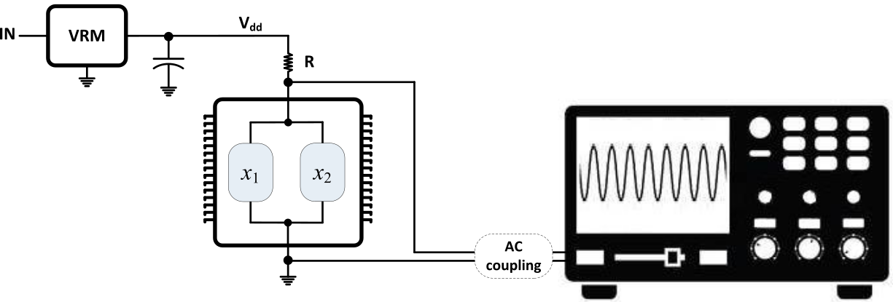
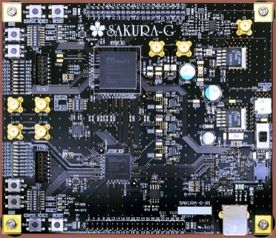
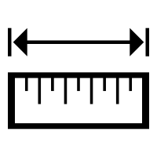
What do we control in the measurement setup and in the implementation?
Supply Voltage
Shunt Resistor
Distance between the shares
Temperature
Circuit Size
Clock Frequency
Number of Shares

Slide 4
Hardware Masking, Revisited
1
2
3
Can we make Masked Implementations leak?
Experiments on
a Toy Example
Conclusions
- Summary
- Implications
to reveal the influence of the various parameters
on the leakage
Notes:
We end with a conclusion where we summarise our findings and discuss the implications of our work

Slide 5
Hardware Masking, Revisited
1
2
3
Can we make Masked Implementations leak?
Experiments on
a Toy Example
Conclusions
revealing the influence on the leakage by
1. the various parameters
2. coupling of FPGA wires

Slide 6
One share in our toy example consists of consecutive MixColumn modules
We can choose between
a lower power consumption from 3 MCs
a higher power consumption from 6 MCs

Slide 7
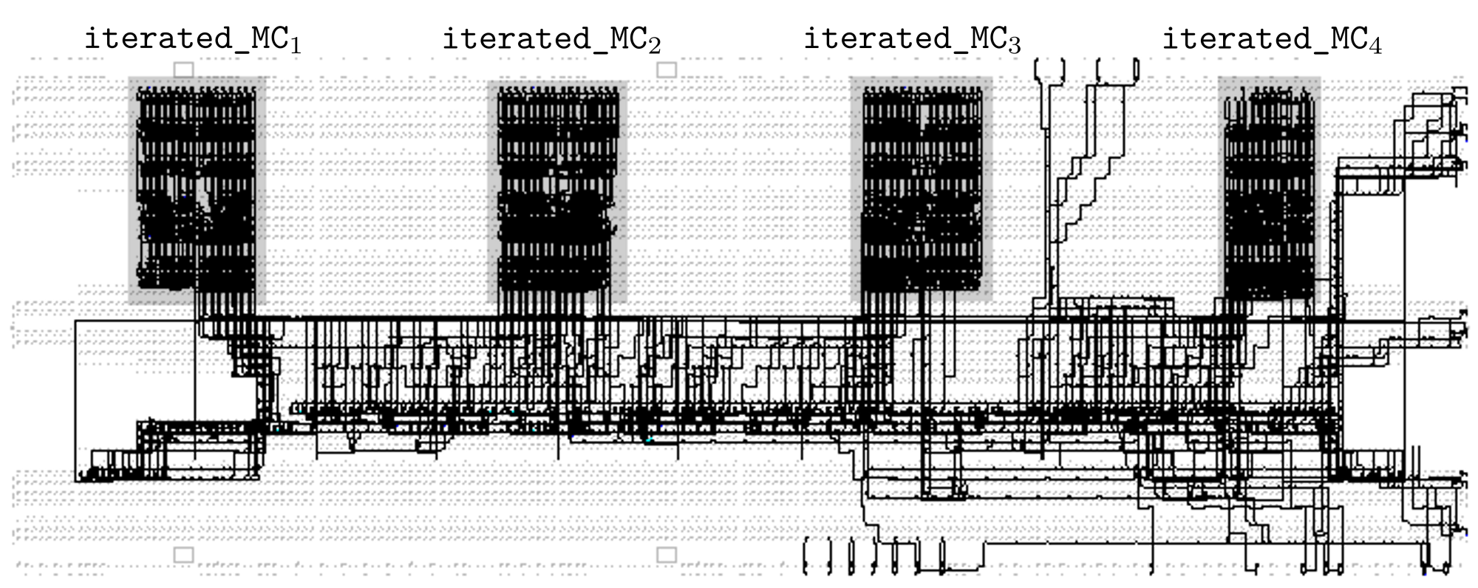
Four iterated MixColumns shares are placed next to each other and in full isolation
We can test the influence of the number of shares
and the distance between the shares on the leakage
Notes:
Using the Isolated Design Flow (IDF) of Xilinx

Slide 8
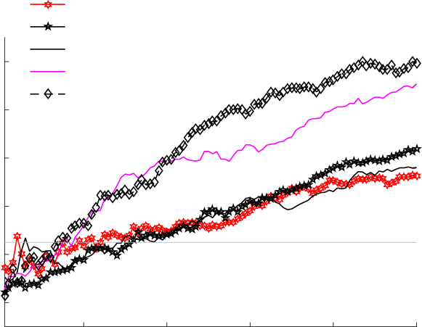
Supply Voltage & Shunt Resistor
V_{dd} 1.0v, 1.0Ω
V_{dd} 1.0v, 0.0Ω
The higher the supply voltage,
the higher the leakage
V_{dd} 1.2v, 1.0Ω (Sakura-G default)
12
V_{dd} 1.2v, 0.0Ω
V_{dd} 1.3v, 0.0Ω
10
The lower the shunt resistor,
the higher the leakage
8
max(|t-statistic|)
6
Fixed-vs-random t-test
iterated_MC1 and iterated_MC4
3 MCs active
6MHz
21°C
4
2
20M
40M
60M
80M
100M
Number of Traces

Slide 9
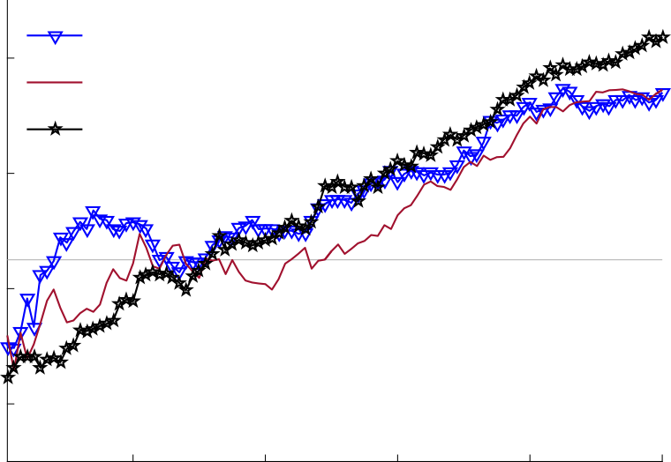
Distance
Iterated_MC_{1↔2}
8
Iterated_MC_{1↔3}
The distance between the shares
does not influence leakage much
Iterated_MC_{1↔4}
6
max(|t-statistic|)
4
Fixed-vs-random t-test
3 MCs active
6MHz
V_{dd} 1.2v, 0.0Ω , 21°C
2
20M
40M
60M
80M
100M
Number of Traces

Slide 10
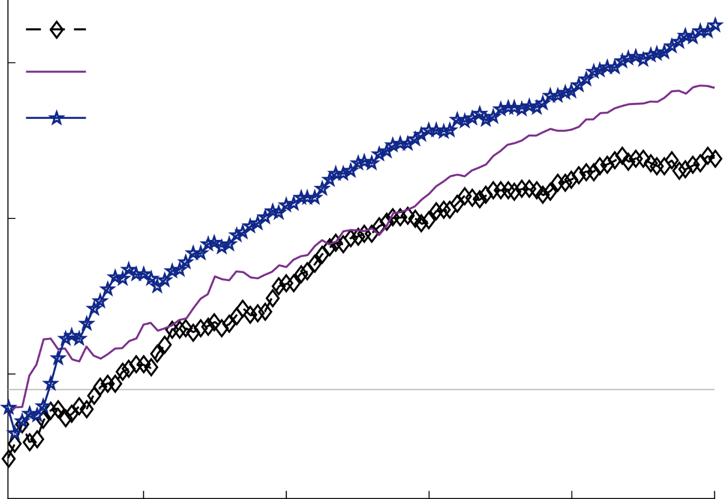
Temperature
21°C
The higher the temperature,
the higher the leakage
15
50°C
70°C
10
max(|t-statistic|)
Fixed-vs-random t-test
iterated_MC1 and iterated_MC4
3 MCs active
6MHz
V_{dd} 1.3v, 0.0Ω
5
20M
40M
60M
80M
100M
Number of Traces
Notes:
Quality of the randomness is not altered by the temperature

Slide 11
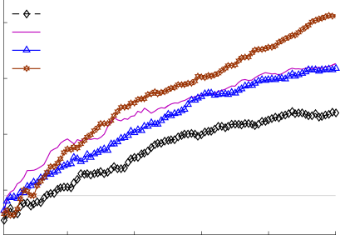
Circuit Size and Clock Frequency
The more MCs active,
the higher the leakage
20
3MC, 6MHz
3MC, 48MHz
6MC, 6MHz
The higher the peak-to-peak
power consumption,
the higher the leakage
15
6MC, 48MHz
The higher the clock frequency, the higher the leakage
max(|t-statistic|)
10
5
Fixed-vs-random t-test
iterated_MC1 and iterated_MC4
V_{dd} 1.3v, 0.0Ω, 21°C
20M
40M
60M
80M
100M
Number of Traces

Slide 12
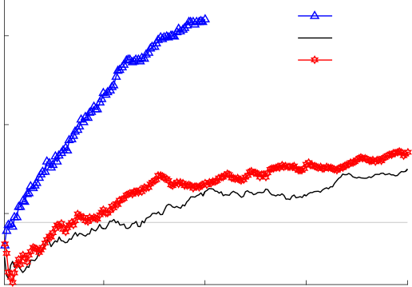
Number of Shares
2 shares 1,2
All linear 1st-, 2^{nd-} and 3rd-order designs leak in the 1st-order!
15
3 shares 1 to 3
4 shares 1 to 4
No 2nd-order leakage in
the 2nd-order secure design
No 2nd- or 3rd-order leakage in
The 3rd-order secure design
10
max(|t-statistic|)
5
Fixed-vs-random t-test
1st-, 2nd- and 3rd-order masking
6 MCs active
6MHz
V_{dd} 1.3v, 0.0Ω, 21°C
50M
100M
150M
200M
Number of Traces

Slide 13
Hardware Masking, Revisited
1
2
3
Can we make Masked Implementations leak?
Experiments on
a Toy Example
Conclusions
revealing the influence on the leakage by
1. the various parameters
2. coupling of FPGA wires

Slide 14
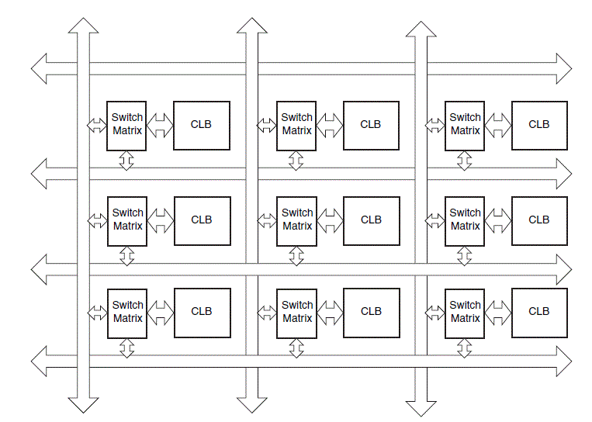
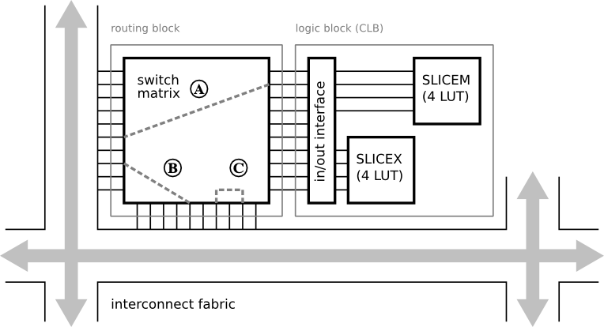
Does leakage current in open switch transistors contribute to the leakage in FPGAs?

Slide 15
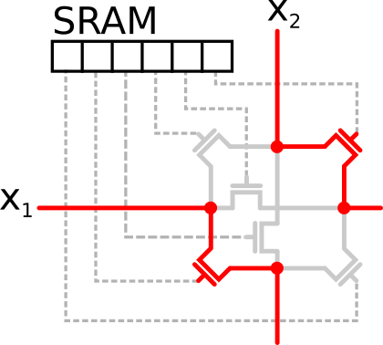
What is the influence of the leakage current?
Open transistors inside a switch matrix could couple wires from two different shares
What is the influence of the number of shared open switches?

Slide 16
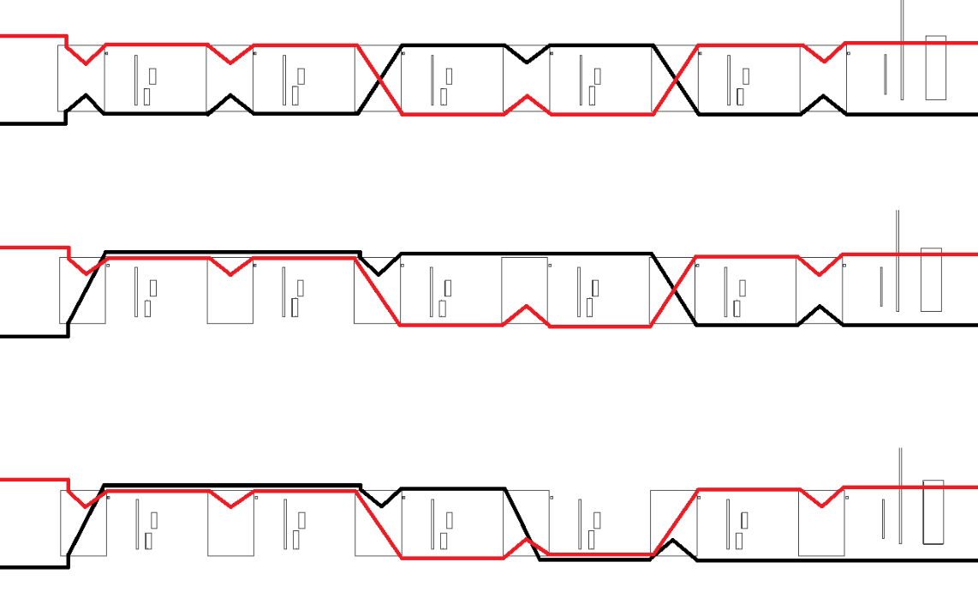
Our experiments are designed with an increasing number of shared open switches
0
0
0
0
0
0
0
0
20
0
0
0
0
0
20
0
16
0

Slide 17
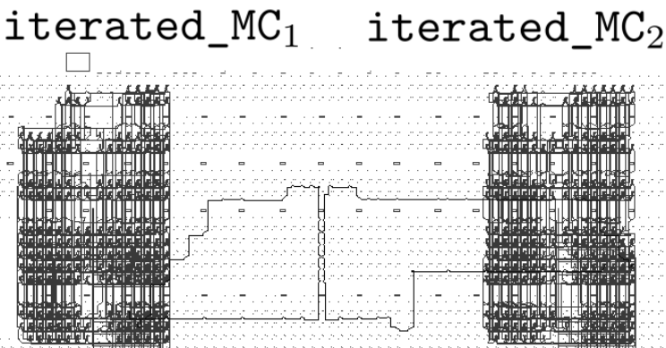
We route two wires close to each other in the middle of two iterated_MC shares

Slide 18
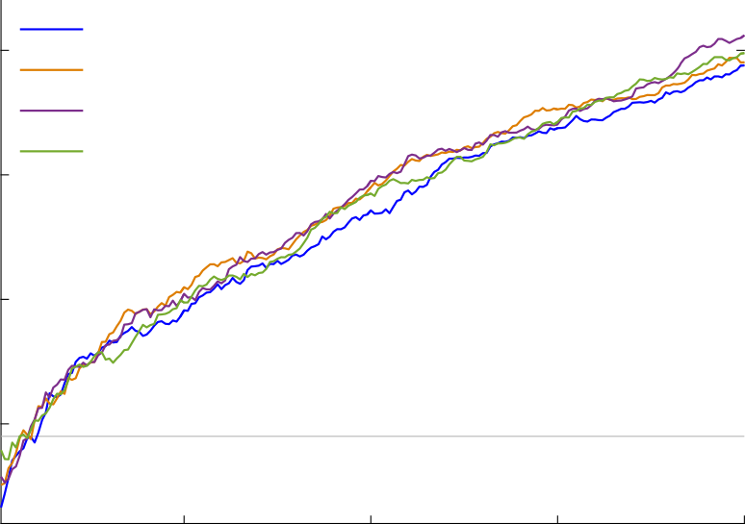
Number of shared open switches
original
20
0 shared open switches
20 shared open switches
20+16 shared
open switches
Routing does not have much eﬀect on the observed leakage
15
max(|t-statistic|)
10
Fixed-vs-random t-test
6 MCs active
V_{dd} 1.3v, 0.0Ω, 6MHz, 21°C
5
50M
100M
150M
200M
Number of Traces

Slide 19
Hardware Masking, Revisited
1
2
3
Can we make Masked Implementations leak?
Experiments on
a Toy Example
Conclusions
- Threshold Implementation of PRESENT
- Domain-Oriented Masking of AES
- d+1 Threshold Implementations of AES

Slide 20
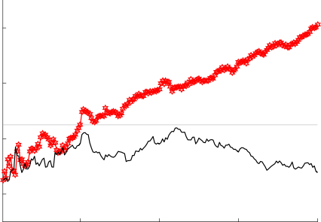
A Threshold Implementation of PRESENT
V_{dd} 1.3v, 0.0Ω
PRESENT-80 TI from [PMK⁺11]
8
V_{dd} 1.0v, 1.0Ω
6
max(|t-statistic|)
1st-order implementation with 3 shares leaks in the 1st order
4
Fixed-vs-random t-test
8 rounds of encryption
12MHz
21°C
2
50M
100M
150M
200M
Number of Traces

Slide 21
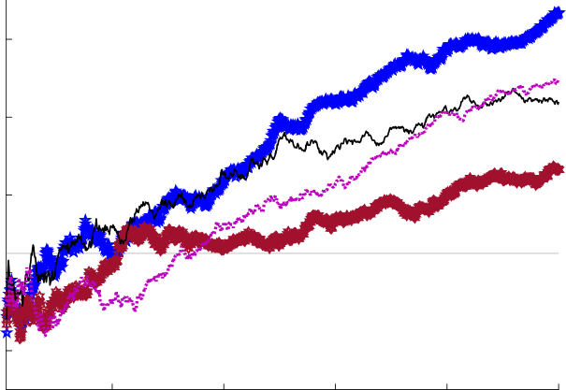
Masked AES implementations with d+1 shares
DOM, 2 shares
10
Domain-Oriented Masking from [GMK16]
d+1 TI from [DRB⁺16]
DOM, 3 shares
d+1 TI, 2 shares
8
d+1 TI, 3 shares
6
All 1st- and 2nd-order designs
leak in the 1st-order!
max(|t-statistic|)
4
2
Fixed-vs-random t-test
full encryption
24MHz
V_{dd} 1.2v, 1.0Ω, 21°C
20M
40M
60M
80M
100M
Number of Traces
Notes:
Second order leakage: t=200 for 2 share implementations
Third order leakage: t=10 for 3 share implementations

Slide 22
Hardware Masking, Revisited
1
2
3
Can we make Masked Implementations leak?
Experiments on
a Toy Example
Conclusions
- Summary
- Implications

Slide 23
Hardware Masking, Revisited
Can we make Masked Implementations leak?
YES!

Slide 24
Summary for the Spartan-6 FPGA
Higher leakage with
higher supply voltages
lower shunt resistors
higher temperatures
higher peak-to-peak power consumption (higher clock frequency or larger circuits)
lower number of shares
Leakage does not depend much on
the distance between the shares
the leakage current from open transistors between the shares

Slide 25
Implications
Assumptions can be violated! Not surprising, e.g. glitches, early signal propagation
Correctly masked implementations leak? Yes, with a high number of traces in a low noise environment
Can this be exploited by an attacker? How?
What about ASICs? Likely more traces needed…

Slide 26
Potential Solutions
Temporal non-completeness?
Don’t process on more than d shares per clock cycle for d^{th}-order security Expensive…
Embedded voltage regulators?
Do EM signals show similar issues?
Sharing the V_{dd} lines? Not clear how to apply nonlinear functions in this setting…
Use the leakage detection in addition to attacks?
Moments-Correlating DPA [MS16]

Slide 27
September 11 - CHES 2018 - Amsterdam

