Slide 1
Rhythmic Keccak:
SCA Security and Low Latency in HW
Victor Arribas, Begül Bilgin, George Petrides,
Svetla Nikova, Vincent Rijmen
10/09/2018
TCHES 2018
Notes:
Last update: 15/03/2016
1

Slide 2
Rhythmic Keccak
Source :https://www.financialexpress.com/industry/
technology/hackers-can-guess-pins-using
-your-smartphones-sensor-data/991535/
Notes:
We have seen registers are important in masking, we try to avoid them22

Slide 3
Rhythmic Keccak
Masking
Input dependencies
Implementations & Evaluation
Unrolled implementations
Speeding up Keccak
Evaluation

Slide 4
Rhythmic Keccak
Masking
Input dependencies
Implementations & Evaluation
Unrolled implementations
Speeding up Keccak
Evaluation

Slide 5
Masking
Threshold Implementations (TI) [NRR06]
x₁
z₁
F₁
x
x₂
z₂
z
F₂
y
F₃
x ₃
z₃
$$s_{in}≥t⋅d+1$$
d^{th}-order Non-Completeness [BGN+14]
[NRR06] S. Nikova, C. Rechberger, and V. Rijmen. Threshold implementations against side-channel attacks and glitches.
In ICICS 2006.
[BGN+14] B. Bilgin, B. Gierlichs, S. Nikova, V. Nikov, and V. Rijmen. A more efficient AES threshold implementation.
In AFRICACRYPT 2014.

Slide 6
Masking
Domain Oriented Masking (DOM) [GMK16]
x₁
z₁
F₁
F₂
x
z
r
y
F₃
F₄
z₂
x₂
Regs.
$$s_{in}=d+1$$
Layer of registers
Indep. inputs
[GMK16] H. Gross, S. Mangard, and T. Korak. Domain-oriented masking: Compact masked hardware implementations with arbitrary protection order. In Cryptology ePrint, Report 2016/486.

Slide 7
Rhythmic Keccak
Masking
Input dependencies
Implementations & Evaluation
Unrolled implementations
Speeding up Keccak
Evaluation

Slide 8
Input dependencies
Example: calculating $xy$
$$x$$
$$⨀$$
$$xy$$
$$y$$
$$x⨀y=\left[\begin{matrix}y_{1}⋅x_{1} & y_{1}⋅x_{2} \\ y_{2}⋅x_{1} & y_{2}⋅x_{2}\end{matrix}\right]$$

Slide 9
Input dependencies
Example: calculating $xy$
$$x$$
$$⨀$$
$$xy$$
$$y$$
$$x⨀y=\left[\begin{matrix}y_{1}⋅x_{1} & y_{1}⋅x_{2} \\ y_{2}⋅x_{1} & y_{2}⋅x_{2}\end{matrix}\right]$$
Non-completeness OK

Slide 10
Input dependencies
Example: calculating $x∙(x≪1)$
$$x$$
<< 1
$$⨀$$
$$x∙(x≪1)$$
$$x=\left(x_{1},x_{2}\right)⟹x≪1=(x_{1}≪1,x_{2}≪1)$$
$$x⨀(x≪1)=\left[\begin{matrix}\left(x_{1}≪1\right)⋅x_{1} & \left(x_{1}≪1\right)⋅x_{2} \\ \left(x_{2}≪1\right)⋅x_{1} & (x_{2}≪1)⋅x_{2}\end{matrix}\right]$$

Slide 11
Input dependencies
Example: calculating $x∙(x≪1)$
$$x$$
<< 1
$$⨀$$
$$x∙(x≪1)$$
$$x=\left(x_{1},x_{2}\right)⟹x≪1=(x_{1}≪1,x_{2}≪1)$$
$$x⨀(x≪1)=\left[\begin{matrix}\left(x_{1}≪1\right)⋅x_{1} & \left(x_{1}≪1\right)⋅x_{2} \\ \left(x_{2}≪1\right)⋅x_{1} & (x_{2}≪1)⋅x_{2}\end{matrix}\right]$$
Non-completeness FAILS

Slide 12
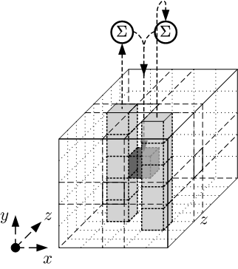
Input deps. In Keccak
Dependencies introduced by θ
Round-based implementations
Non-completeness flaw in
round-based implement. [GMS17]
using DOM
Potentially exploitable leakage
[GMS17] H. Gross, D. Schaffenrath, and S. Mangard. Higher-order side-channel protected implementations of Keccak.
In Euromicro DSD 2017.
Notes:
Intricate

Slide 13
Rhythmic Keccak
Masking
Input dependencies
Implementations & Evaluation
Unrolled implementations
Speeding up Keccak
Evaluation

Slide 14
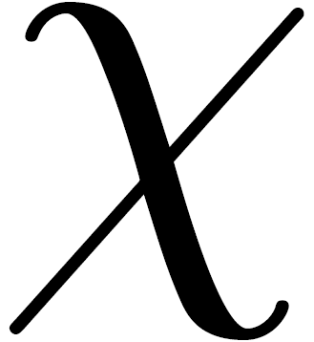
DOM-indep. Keccak
Non-completeness broken when computing
Notes:
Intricate

Slide 15
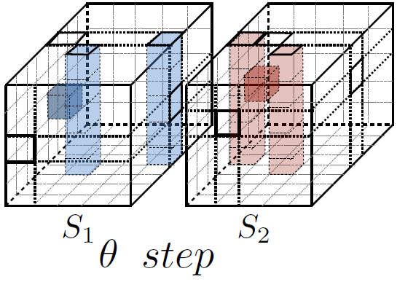
Keccak
2
1
Notes:
Intricate

Slide 16
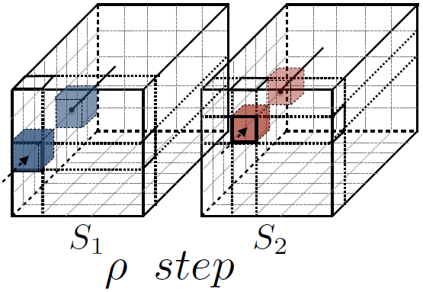
Keccak
2
1
Notes:
Intricate

Slide 17
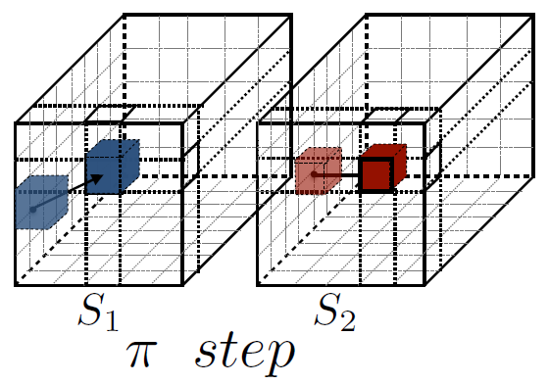
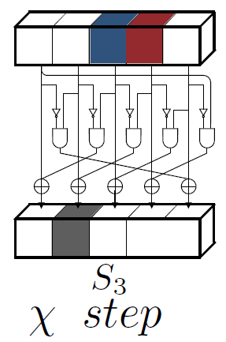
Keccak
Total of 112 bits found
(200 bit state) [ANR17]
2
1
[ANR17] V. Arribas, S. Nikova and Vincent Rijmen. VerMI: Verification Tool for Masked Implementations. In Cryptology ePrint, Report 2017/1227.
Notes:
Intricate

Slide 18
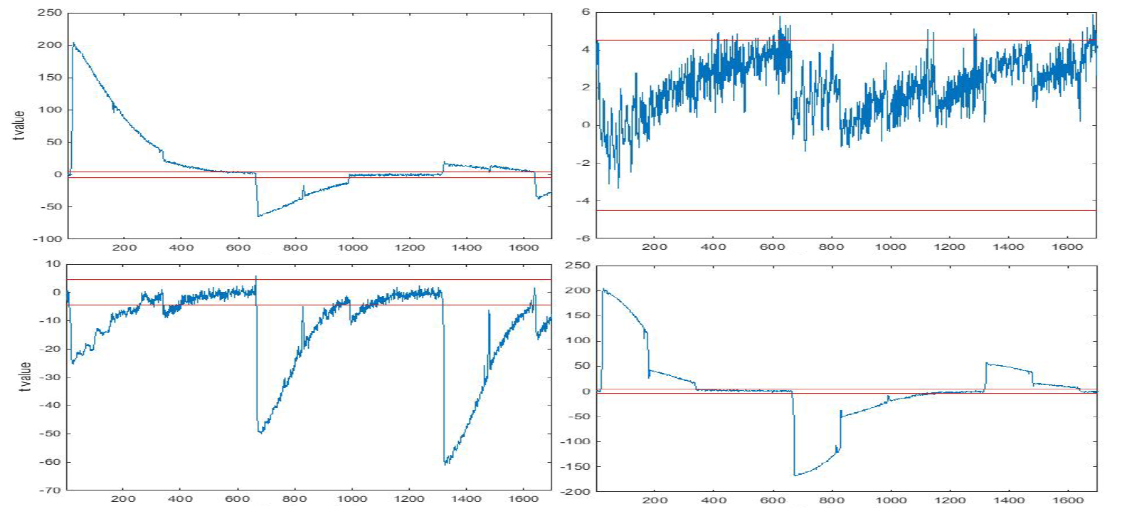
DOM-Keccak
Masks Off
Masks On
1st-order
2nd-order
TVLA
$$t_{value}≤|4.5|$$
55M traces
Notes:
Intricate

Slide 19
NC-Keccak
Non-completeness fulfilled
Notes:
Easy fix once the problem is spot, which is definitely not trivial given the Keccak intricate operations
Verified in the same way with the tool

Slide 20
NC-Keccak
Non-completeness fulfilled
Notes:
Intricate

Slide 21
NC-Keccak
Masks On
1st-order
2nd-order
TVLA
$$t_{value}≤|4.5|$$
55M traces
Notes:
Intricate

Slide 22
Rhythmic Keccak
Masking
Input dependencies
Implementations & Evaluation
Unrolled implementations
Speeding up Keccak
Evaluation

Slide 23
Unrolling
Halve number of cycles on protected implementations
Quartic operation (out of quadratics): $F=R^{2}∘R^{1}$
Notes:
TI condition of NC is violated
AND gate outputs all possible combinations of inputs
You could say: well but if the inputs are 4 different variables what is the matter on mixing three different shares form different variables? That would be correct indeed, but then we need as explained before independent inputs, which means extra registers and for this application we want to avoid registers.
Due to the 2-bit nature of the AND gate the output of the first layer need twice protection that the output of the second one

Slide 24
Unrolling
Extending methodology: $F=R^{N}∘…∘R^{1}$
Sharing scheme to use not specified
Refreshing for multi-variate security not provided
Might not be optimal
Starting point

Slide 25
Rhythmic Keccak
Masking
Input dependencies
Implementations & Evaluation
Unrolled implementations
Speeding up Keccak
Evaluation

Slide 26
Low latency Keccak
$$ℛ^{1}$$
$$ℛ^{2}$$
θ ρ π ꭕ ι
θ ρ π ꭕ ι
$$d_{2}=2$$
$$d_{F}=d_{2}=1$$
1.
$$s_{in}=5;$$
$$s_{out}=10$$
$$s_{in}=10;$$
$$s_{out}=5$$
2.
$$s_{in}=6;$$
$$s_{out}=6$$
$$s_{in}=6;$$
$$s_{out}=6$$
Notes:
Since it is TI and dependencies over inputs do not matter, I focus on the sharing of Chi
What about uniformity?

Slide 27
Low latency Keccak
$$6→6→6$$
$$ℛ^{1}$$
$$ℛ^{2}$$

Slide 28
Rhythmic Keccak
Masking
Input dependencies
Implementations & Evaluation
Unrolled implementations
Speeding up Keccak
Evaluation

Slide 29
$$6→6→6$$
Masks Off
Masks On
1st-order
2nd-order
3rd-order
TVLA
$$t_{value}≤|4.5|$$
55M traces
Notes:
Intricate

Slide 30
Conclusions
A flaw was discovered in previous work round-based implementation of Keccak
Causes are analyzed and fixed, with a practical evaluation
A methodology to secure unwrapped implementations
Faster Keccak implementation with 70,12 kGE and 20,61 ns per computation

Slide 31
Thank you!
Notes:
Explain t-test?

Slide 32
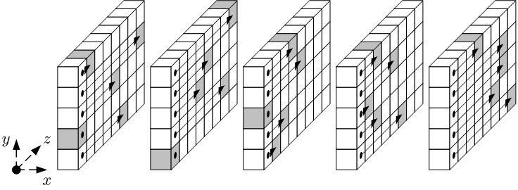
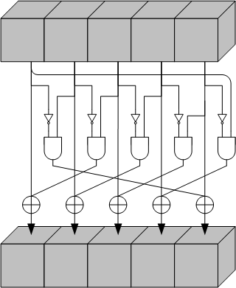
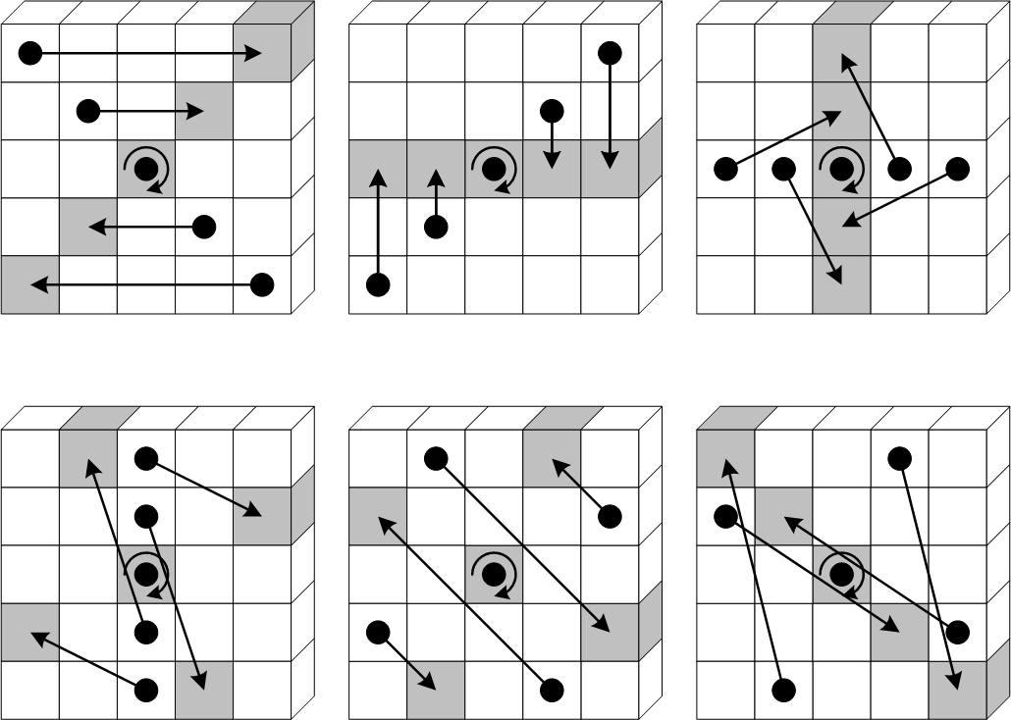
Keccak
θ
ρ
ι
π
ꭕ
Notes:
3 linear permutations: different ops in state bits
Chi: the Sbox and the only non-linear function. Not trivial to secure
Iota just content addition

Slide 33
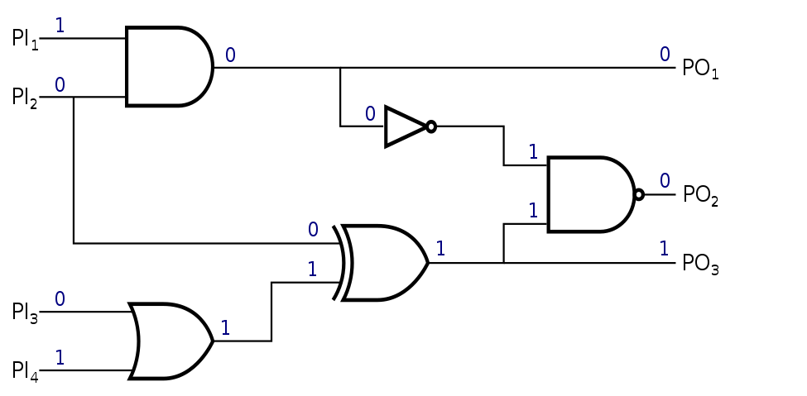
Masking
Based on secret sharing
$x =x_{1} ⊥ x_{2}⊥$ … $⊥ { x}_{s}$
Boolean:
$$⊥ ⇒⨁$$
d-Probing Model [ISW03]
d^{th}-order SCA
Security [DFS15]
[ISW03] Y. Ishai, A. Sahai, and D. Wagner. Private Circuits: Securing Hardware against Probing Attacks. In CRYPTO 2003
[DFS15] A. Duc, S. Faust, and F.-X. Standaert. Making Masking Security Proofs Concrete. In EUROCRYPT 2015

Slide 34
Evaluation
SAKURA board $⇒$ Spartan-6 FPGA
Frequency = 3.072 MHz
Test Vector Leakage Assessment (TVLA) [CMG+13]
Security $⇒t_{value}≤|4.5|$
55 million traces collected
[GMS17] J. Cooper, E. De Mulder, G. Goodwill, J. Jaffe, G. Kenworthy, and P. Rohatgi. Test vector leakage assessment (TVLA) methodology in practice. In ICMC 2013.
Notes:
What if we get a question

Slide 35
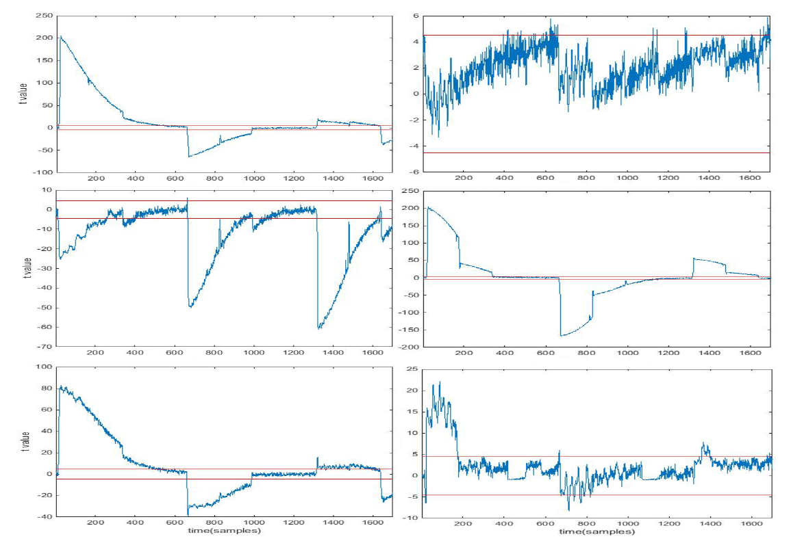
DOM-Keccak
Masks Off
Masks On
1st-order
2nd-order
3rd-order
TVLA
$$t_{value}≤|4.5|$$
55M traces
Notes:
Intricate

Slide 36
NC-Keccak
1st-order Implem.
2nd-order implem.
1st-order
2nd-order
3rd-order
TVLA
$$t_{value}≤|4.5|$$
55M traces
Notes:
Intricate

Slide 37
Performance

