Slide 1
Side-Channel Attacks on Post-Quantum Signature Schemes based on Multivariate Quadratic Equations
Aesun Park¹ , Kyung-Ah Shim²*, Namhun Koo², and Dong-Guk Han¹
¹Department of Financial Information Security, Kookmin University, Seoul, Republic of Korea ²Division of Mathematical Modeling, National Institute for Mathematical Sciences, Daejeon, Republic of Korea
11. Sep. 2018
Notes:
Hi Everyone.
I am Aesun Park from kookmin university.
I’m so glad to talk in CHES.
Today, I’ll talk about the side-channel vulnerability / on UOV variants(베리언스).
This is joint work with NIMS.

Slide 2
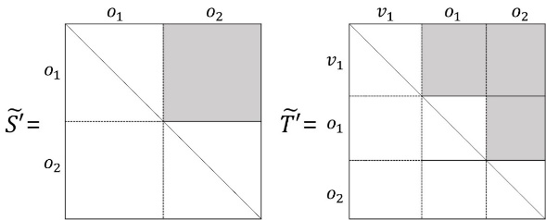
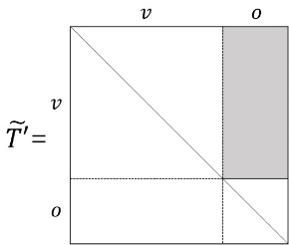
UOV Variants Signature schemes
EUROCRYPT
1999 UOV
Improving efficiency and reducing the key sizes
ACNS
2005 (General) Rainbow : a layered MQ-signature scheme based on UOV
SAC
2006 efficient software implementations
Efficient Implementations in HW/SW
Reduction in the size of the public key
CHES
2012 (Efficient) Rainbow & UOV
Czypek et al.
CHES form
reducing the key space and runtime
removing the constant part
Appling linear maps like the picture
Rainbow
UOV
INDOCRYPT
2017 Lifted UOV
For smaller UOV public keys
Beullens et al.
It uses the linear map T of CHES form
Notes:
In 1999, UOV has been proposed in EUROCRYPT.
And then, In 2005(two thousand five), general Rainbow, which is a layered MQ-signature scheme based on UOV, has been proposed to improve efficiency and reduce the key sizes.
Since the study on efficient software implementations was proposed in 2006,
there have been many studies on efficient implementation in hardware and software.
In CHES 2012(twenty twelve),/ Czypek(씨펙) et al. / demonstrated the feasibility(피~즈빌리티) of MQ-signature schemes / on an 8-bit AVR micro-processor.
They removed the constant part of the linear maps / and applied linear maps like the picture / to reduce the key space and runtime.
We call this shape CHES form.
In 2017, Beullens(비얼렌즈) et al. proposed a Lifted UOV for Smaller UOV Public Keys.
it uses the T of CHES 2012(twenty twelve) form.
(like this, 포인터로 가르키며)

Slide 3
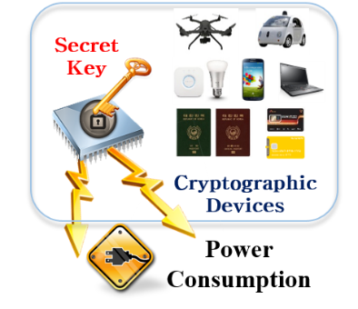
SCA on UOV Variants Signature schemes
Paul Kocher
1996 Timing Attacks
1998 Simple Power Analysis
Differential Power Analysis
2004 Correlation Power Analysis
Implementations of post-quantum algorithms are vulnerable to PA
The studies of PA against UOV variants lack.
The Computer Journal
2017 Semi-invasive Attack on enTTS
Yi et al.
CHES
2018 Ours
Non-invasive Attacks on Rainbow and UOV
Notes:
After Paul Kocher proposed methods of finding keys / using Time and Power and so on,
Power Analysis has been carried out for many crypto algorithms.
It is not surprising / that implementations of post-quantum algorithms are vulnerable to PA.
Therefore, may studies for PA vulnerability of PQC have been studied.
However, the studies of PA against UOV variants lack.
There is only one result except ours.
In 2017(twenty seventeen), / Yi et al. recover the central map F on enTTS / using a fault analysis.
(click)
There is no attack / using only Power Analysis.
Today, I will introduce an non-invasive attack against Rainbow and UOV.

Slide 4
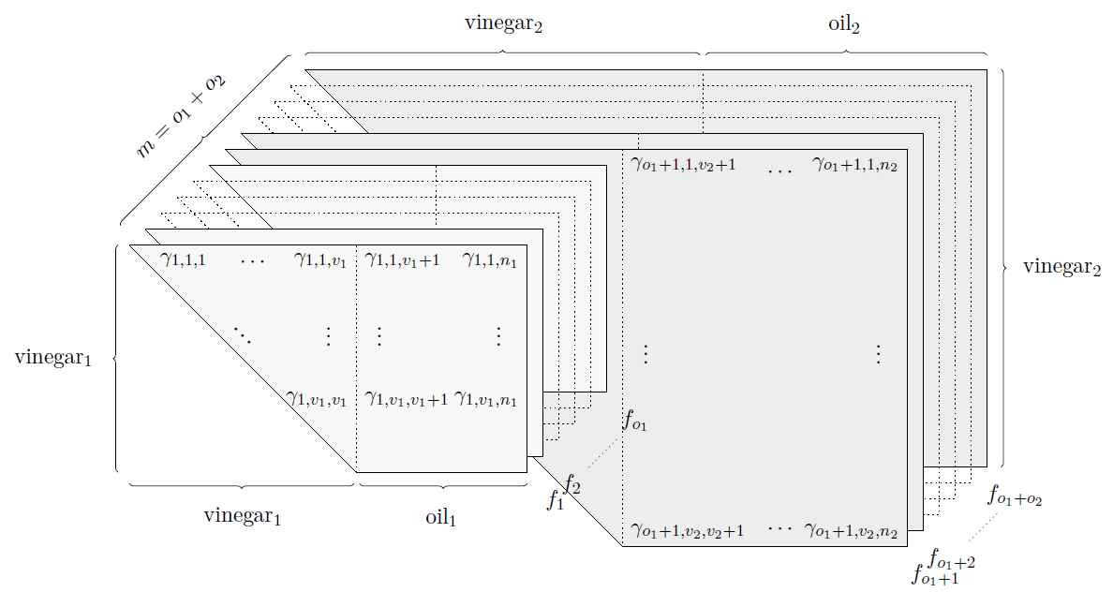
Signature generation on Rainbow
Secret maps : $S, ℱ, T$
Inverse $S$
Inverse $ℱ$
Inverse $T$
message
signature
M
S
8
75
E
S
7
2
S
M
80
12
$$⋮$$
$$⋮$$
$$⋮$$
$$⋮$$
E
A
2
5
Linear map $S$
Random values
Linear map $T$
Matrix-vector product over a field
Solving the linear equations
Matrix-vector product over a field
Field multiplications & additions
Basic operations
Notes:
Here, I’ll briefly explain the signature generation on Rainbow.
There are three secret maps S, F, and T.
signature generation consists of three steps.
(클릭)
The first step is to perform / an inversion linear map of the input message.
At this step, / a matrix-vector product over a field is used(유-즈드).
(클릭)
The second step is to invert / central map F with the transformed message.
At this step, Random values are used and linear equations are solved.
(클릭)
The last one is to apply / an inversion of the(디) other linear map.
It also uses a matrix-vector product over a filed.
(클릭)
Rainbow uses Field Multiplications and additions as the basic operations.

Slide 5
Signature generation on Rainbow
Rainbow generates different signatures for the same message.
Inverse $S$
Inverse $ℱ$
Inverse $T$
message
signature
M
S
9
56
E
S
25
40
S
M
14
8
$$⋮$$
$$⋮$$
$$⋮$$
$$⋮$$
E
A
9
17
Linear map $S$
Random values
Linear map $T$
Matrix-vector product over a field
Solving the equations
Matrix-vector product over a field
Same Input (message) ➔ Different Output (signature)
Notes:
As I mentioned, the second step uses random values.
Because of this, Rainbow generates different signatures for the same message.
This feature leads to difficulty in power analysis.

Slide 6
Signature generation on Rainbow
Applicability of Power Analysis
Power analysis uses the position where the fixed secret value and the random public value are computed.
Inverse $S$
Inverse $ℱ$
Inverse $T$
message
signature
M
S
9
56
E
S
25
40
S
M
14
8
$$⋮$$
$$⋮$$
$$⋮$$
$$⋮$$
E
A
9
17
unknown random values are used
EASY
Difficult
The methods for efficiency can be vulnerable to PA.
Notes:
Power analysis generally uses the position / where the fixed secret value and the random public value are computed.
(클릭) So, in the first step, power analysis is easily applied.
(클릭)
However, in the calculation of F, unknown random values are used.
Therefore, the power analysis cannot be easy / because the intermediate values of T can’t be calculated.
However, the methods for efficiency can be vulnerable to Power analysis.

Slide 7
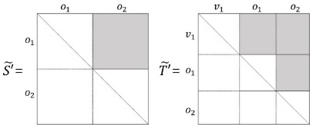
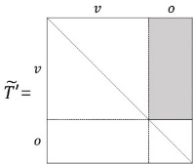
The flow of our proposed attacks
[Goal] Secret maps recovery on Rainbow and UOV
START
CPA on the $S^{−1}$
Sub-attack 1
the general field multiplication vulnerabilities
Sub-attack 2
Sub-attack 3
Does it use the special form linear maps?
CPA on the $T^{−1}$
YES
NO
Recovery $F$ and $T$ using algebraic KRAs
Rainbow
UOV
Recovery $F$
using $S,T$, and $𝓟$
END
Notes:
Our goal / is to recover the secret maps of the Rainbow and UOV / only using CPA and algebraic key recovery attacks.
We propose two attacks.
For easily explain, I describe three sub attacks.
The first sub-attack exploits the general field multiplication vulnerabilities.
The second one is used / when the linear map T has the form / suggested in CHES 2012(twenty twelve) .
This attack can be used(유즈-드) for UOV as well as for Rainbow.
The last one is used to rainbow with random linear map T after S has been recovered.

Slide 8
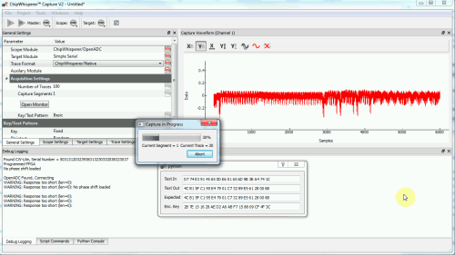
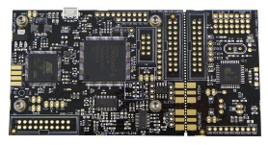
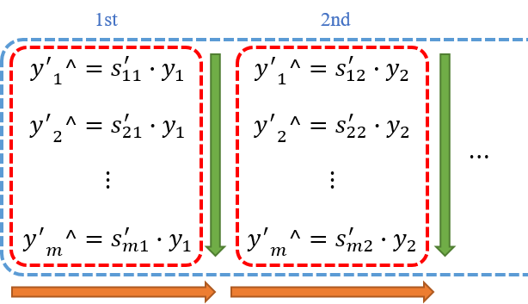
Experimental setup
Environment
Target chip | Atmel AVR XMEGA128
Sampling | 7.38 MS/s
Algorithm | Matrix-vector product over GF($2^{8}$)
Attack system
ChipWhisperer-Lite, 500 traces
Implementation
8-bit implementation
To reduce the number of times y is loaded.
multiplication each loaded y by the i-th column.
Notes:
We implemented(임프리멘티드) the Matrix-vector product on a field GF(two to the power of eight) / and experimented(익스피어리먼티드) with ChipWhisperer-Lite / which is developed(디벨롭티드) for side-channel analysis by collin.
Thanks Collin.
The Algorithm used(유-즈드) in the experiment is (인디 익스페어리먼 이즈) / implemented by multiplying each loaded y / by the i-th (바이 디 아이쓰) column / to reduce the number of times y is loaded.
Power traces were collected using 500 random messages.

Slide 9
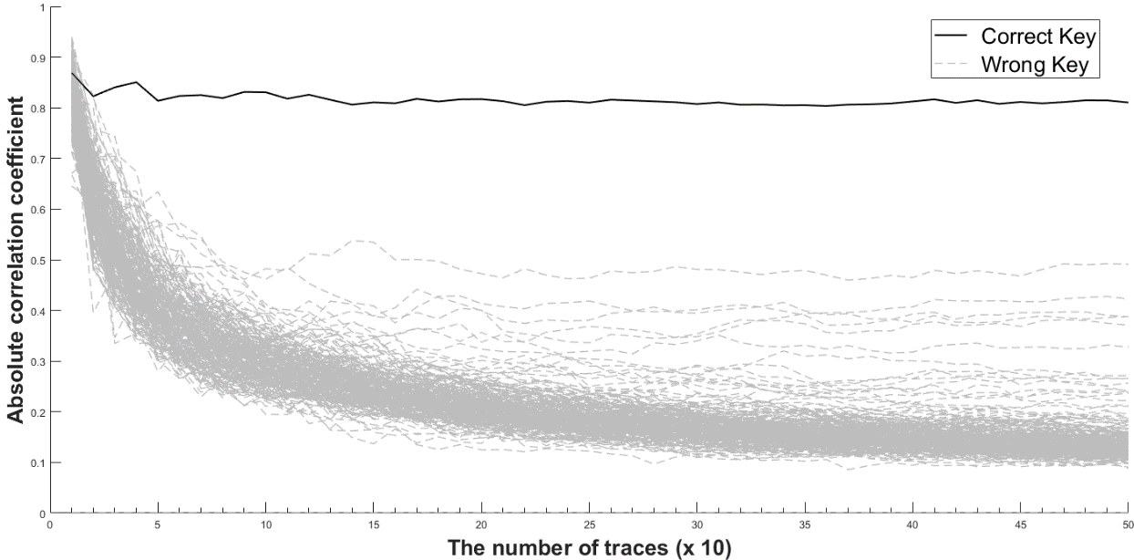
Sub-attack 1
CPA on the $S^{−1}$
Invert $S$
$$\left(\begin{matrix}\begin{matrix}s_{11}^{′} & s_{12}^{′} \\ s_{21}^{′} & ⋱\end{matrix} & \begin{matrix}… & s_{1m}^{′} \\ ⋱ & s_{2m}^{′}\end{matrix} \\ \begin{matrix}⋮ & ⋱ \\ s_{m1}^{′} & s_{m2}^{′}\end{matrix} & \begin{matrix}⋱ & ⋮ \\ … & s_{mm}^{′}\end{matrix}\end{matrix}\right)\left(\begin{matrix}\begin{matrix}y_{1} \\ y_{2}\end{matrix} \\ \begin{matrix}⋮ \\ y_{m}\end{matrix}\end{matrix}\right)$$
the result of CPA for $s_{11}^{′}$
$$s_{11}^{′}∙y_{1}+s_{12}^{′}∙y_{2}+…+s_{1m}^{′}∙y_{m}$$
Intermediate result
Maximum correlation coefficients according to increased number of traces for ${s′}_{11}$
$$guess∙y_{1}$$
$$s_{11}^{′}∙y_{1}+guess∙y_{2}$$
$$⋮$$
$guess$ : hypothetical key
Secret
Known
Notes:
CPA on the S is very easy because the attacker can control the message.
Intermediate results are chosen / as the value / multiplied by each element.
For example, / $guess∙y_{1}$ (guess times y1) can be used as an intermediate result to recover $s_{11}^{′}$(s prime one one).
Here, Guess represents a hypothetical(하이포세티컬) key.
In the same way, after recover $s_{11}^{′}$,/ $s_{11}^{′}∙y_{1}+guess∙y_{2}$ ($s_{11}^{′}$ times y1 plus guess times y2) is used / as an intermediate result to recover $s_{12}^{′}$.
This picture shows the result of CPA for s prime one one.
This represents / the maximum correlation coefficients / according to an increased number of traces.
We experimented(익스피어리먼티드) with traces that increase by 10.

Slide 10
Sub-attack 2
CPA on the $T^{−1}$
Invert $T$
$$\left(\begin{matrix}\begin{matrix}x_{1} \\ x_{2}\end{matrix} \\ \begin{matrix}⋮ \\ x_{n}\end{matrix}\end{matrix}\right)=\left(\begin{matrix}\begin{matrix}{t′}_{11} & {t′}_{12} \\ {t′}_{21} & ⋱\end{matrix} & \begin{matrix}… & {t′}_{1n} \\ ⋱ & {t′}_{2n}\end{matrix} \\ \begin{matrix}⋮ & ⋱ \\ {t′}_{n1} & {t′}_{n2}\end{matrix} & \begin{matrix}⋱ & ⋮ \\ … & {t′}_{nn}\end{matrix}\end{matrix}\right)\left(\begin{matrix}\begin{matrix}{x′}_{1} \\ {x′}_{2}\end{matrix} \\ \begin{matrix}⋮ \\ {x′}_{n}\end{matrix}\end{matrix}\right)$$
Matrix-vector product over a field
It is hard to compute X‘
➔ to compute the intermediate value is difficult
$$x_{1}={t′}_{11}∙{x^{′}}_{1}+{t′}_{12}∙{x^{′}}_{2}+…+{t′}_{1n}∙{x′}_{n}$$
Rainbow
UOV
Notes:
Because the last step also uses(유지즈) a matrix-vector product / this part can also be an attack point.
However, / it is hard to compute X‘ which is calculated with T / because we don’t know F even if S is recovered.
It means / that to compute / the intermediate value (디 인어미디에잇 벨-류) is difficult.
If the Rainbow or UOV is used (이즈 유즈-드) CHES form, it is possible to compute the intermediate value(디 인어미디에잇 벨-류) .
So CPA is possible.

Slide 11
Sub-attack 2
CPA on the $T^{−1}$
(Assume) Special form $T$
Rainbow
UOV
Signature X
$$\left(\begin{matrix}\begin{matrix}\begin{matrix}01 & 00 \\ 00 & 01\end{matrix} & \begin{matrix}{t′}_{13} & {t′}_{14} \\ {t′}_{23} & {t′}_{24}\end{matrix} \\ \begin{matrix}00 & 00 \\ 00 & 00\end{matrix} & \begin{matrix}01 & 00 \\ 00 & 01\end{matrix}\end{matrix} & \begin{matrix}\begin{matrix}{t′}_{15} & {t′}_{16} \\ {t′}_{25} & {t′}_{26}\end{matrix} & \begin{matrix}{t′}_{17} & {t′}_{18} \\ {t′}_{27} & {t′}_{28}\end{matrix} \\ \begin{matrix}{t′}_{35} & {t′}_{36} \\ {t′}_{45} & {t′}_{46}\end{matrix} & \begin{matrix}{t′}_{37} & {t′}_{38} \\ {t′}_{47} & {t′}_{48}\end{matrix}\end{matrix} \\ \begin{matrix}\begin{matrix}00 & 00 \\ 00 & 00 \end{matrix} & \begin{matrix}00 & 00 \\ 00 & 00\end{matrix} \\ \begin{matrix}00 & 00 \\ 00 & 00\end{matrix} & \begin{matrix}00 & 00 \\ 00 & 00\end{matrix}\end{matrix} & \begin{matrix}\begin{matrix}01 & 00 \\ 00 & 01 \end{matrix} & \begin{matrix}00 & 00 \\ 00 & 00\end{matrix} \\ \begin{matrix}00 & 00 \\ 00 & 00 \end{matrix} & \begin{matrix}01 & 00 \\ 00 & 01\end{matrix}\end{matrix}\end{matrix}\right)\left(\begin{matrix}\begin{matrix}\begin{matrix}{x′}_{1} \\ {x′}_{2}\end{matrix} \\ \begin{matrix}{x′}_{3} \\ {x′}_{4}\end{matrix}\end{matrix} \\ \begin{matrix}\begin{matrix}{x′}_{5} \\ {x′}_{6}\end{matrix} \\ \begin{matrix}{x′}_{7} \\ {x′}_{8}\end{matrix}\end{matrix}\end{matrix}\right)=\left(\begin{matrix}\begin{matrix}\begin{matrix}x_{1} \\ x_{2}\end{matrix} \\ \begin{matrix}x_{3} \\ x_{4}\end{matrix}\end{matrix} \\ \begin{matrix}\begin{matrix}x_{5} \\ x_{6}\end{matrix} \\ \begin{matrix}x_{7} \\ x_{8}\end{matrix}\end{matrix}\end{matrix}\right)$$
${x′}_{8}=x_{8}$, ${x′}_{7}=x_{7}$, ${x′}_{6}=x_{6}$, ${x′}_{5}=x_{5}$
Notes:
For example, suppose we use a T that looks like this.
We can know the values from ${x′}_{5}$ to ${x′}_{8}$ because of the blue square.
That is, ${x′}_{8}{,x′}_{7}$, ${x′}_{6}$ and ${x′}_{5}$ equal $x_{8}$, $x_{7}$, $x_{6}$, and $x_{5}$, respectively(리스펙티블리)

Slide 12
Sub-attack 2
CPA on the $T^{−1}$
(Assume) Special form $T$
Rainbow
UOV
Signature X
$$\left(\begin{matrix}\begin{matrix}\begin{matrix}01 & 00 \\ 00 & 01\end{matrix} & \begin{matrix}{t′}_{13} & {t′}_{14} \\ {t′}_{23} & {t′}_{24}\end{matrix} \\ \begin{matrix}00 & 00 \\ 00 & 00\end{matrix} & \begin{matrix}01 & 00 \\ 00 & 01\end{matrix}\end{matrix} & \begin{matrix}\begin{matrix}{t′}_{15} & {t′}_{16} \\ {t′}_{25} & {t′}_{26}\end{matrix} & \begin{matrix}{t′}_{17} & {t′}_{18} \\ {t′}_{27} & {t′}_{28}\end{matrix} \\ \begin{matrix}{t′}_{35} & {t′}_{36} \\ {t′}_{45} & {t′}_{46}\end{matrix} & \begin{matrix}{t′}_{37} & {t′}_{38} \\ {t′}_{47} & {t′}_{48}\end{matrix}\end{matrix} \\ \begin{matrix}\begin{matrix}00 & 00 \\ 00 & 00 \end{matrix} & \begin{matrix}00 & 00 \\ 00 & 00\end{matrix} \\ \begin{matrix}00 & 00 \\ 00 & 00\end{matrix} & \begin{matrix}00 & 00 \\ 00 & 00\end{matrix}\end{matrix} & \begin{matrix}\begin{matrix}01 & 00 \\ 00 & 01 \end{matrix} & \begin{matrix}00 & 00 \\ 00 & 00\end{matrix} \\ \begin{matrix}00 & 00 \\ 00 & 00 \end{matrix} & \begin{matrix}01 & 00 \\ 00 & 01\end{matrix}\end{matrix}\end{matrix}\right)\left(\begin{matrix}\begin{matrix}\begin{matrix}{x′}_{1} \\ {x′}_{2}\end{matrix} \\ \begin{matrix}{x′}_{3} \\ {x′}_{4}\end{matrix}\end{matrix} \\ \begin{matrix}\begin{matrix}{x′}_{5} \\ {x′}_{6}\end{matrix} \\ \begin{matrix}{x′}_{7} \\ {x′}_{8}\end{matrix}\end{matrix}\end{matrix}\right)=\left(\begin{matrix}\begin{matrix}\begin{matrix}x_{1} \\ x_{2}\end{matrix} \\ \begin{matrix}x_{3} \\ x_{4}\end{matrix}\end{matrix} \\ \begin{matrix}\begin{matrix}x_{5} \\ x_{6}\end{matrix} \\ \begin{matrix}x_{7} \\ x_{8}\end{matrix}\end{matrix}\end{matrix}\right)$$
$$0∙{x′}_{1}⊕0∙{x′}_{1}⊕1∙{x^{′}}_{3}⊕0∙{x^{′}}_{4}⊕{t′}_{35}∙{x′}_{5}⊕{t′}_{36}∙{x′}_{6}⊕{t′}_{37}∙{x′}_{7}⊕{t′}_{38}∙{x′}_{8}=x_{3}$$
$$0∙{x′}_{1}⊕0∙{x′}_{1}⊕0∙{x^{′}}_{3}⊕1∙{x^{′}}_{4}⊕{t′}_{45}∙{x′}_{5}⊕{t′}_{46}∙{x′}_{6}⊕{t′}_{47}∙{x′}_{7}⊕{t′}_{48}∙{x′}_{8}=x_{4}$$
Intermediate result: $guess∙{x′}_{5}$, $guess∙{x′}_{6}$, $⋯$
Notes:
So, now we can attack the green part.
Unlike S, / we can not guess the exact value / because we do not know ${x′}_{3}$ and ${x′}_{4}$.
However, there are positions / where ${t′}_{ij}$ and ${x′}_{j}$ are multiplied.
We target these positions as an intermediate result.

Slide 13
Sub-attack 2
CPA on the $T^{−1}$
(Assume) Special form $T$
Rainbow
UOV
Signature X
$$\left(\begin{matrix}\begin{matrix}\begin{matrix}01 & 00 \\ 00 & 01\end{matrix} & \begin{matrix}{t′}_{13} & {t′}_{14} \\ {t′}_{23} & {t′}_{24}\end{matrix} \\ \begin{matrix}00 & 00 \\ 00 & 00\end{matrix} & \begin{matrix}01 & 00 \\ 00 & 01\end{matrix}\end{matrix} & \begin{matrix}\begin{matrix}{t′}_{15} & {t′}_{16} \\ {t′}_{25} & {t′}_{26}\end{matrix} & \begin{matrix}{t′}_{17} & {t′}_{18} \\ {t′}_{27} & {t′}_{28}\end{matrix} \\ \begin{matrix}{t′}_{35} & {t′}_{36} \\ {t′}_{45} & {t′}_{46}\end{matrix} & \begin{matrix}{t′}_{37} & {t′}_{38} \\ {t′}_{47} & {t′}_{48}\end{matrix}\end{matrix} \\ \begin{matrix}\begin{matrix}00 & 00 \\ 00 & 00 \end{matrix} & \begin{matrix}00 & 00 \\ 00 & 00\end{matrix} \\ \begin{matrix}00 & 00 \\ 00 & 00\end{matrix} & \begin{matrix}00 & 00 \\ 00 & 00\end{matrix}\end{matrix} & \begin{matrix}\begin{matrix}01 & 00 \\ 00 & 01 \end{matrix} & \begin{matrix}00 & 00 \\ 00 & 00\end{matrix} \\ \begin{matrix}00 & 00 \\ 00 & 00 \end{matrix} & \begin{matrix}01 & 00 \\ 00 & 01\end{matrix}\end{matrix}\end{matrix}\right)\left(\begin{matrix}\begin{matrix}\begin{matrix}{x′}_{1} \\ {x′}_{2}\end{matrix} \\ \begin{matrix}{x′}_{3} \\ {x′}_{4}\end{matrix}\end{matrix} \\ \begin{matrix}\begin{matrix}{x′}_{5} \\ {x′}_{6}\end{matrix} \\ \begin{matrix}{x′}_{7} \\ {x′}_{8}\end{matrix}\end{matrix}\end{matrix}\right)=\left(\begin{matrix}\begin{matrix}\begin{matrix}x_{1} \\ x_{2}\end{matrix} \\ \begin{matrix}x_{3} \\ x_{4}\end{matrix}\end{matrix} \\ \begin{matrix}\begin{matrix}x_{5} \\ x_{6}\end{matrix} \\ \begin{matrix}x_{7} \\ x_{8}\end{matrix}\end{matrix}\end{matrix}\right)$$
Compute ${x′}_{3}$ and ${x′}_{4}$
$$x_{3}={x′}_{3}⊕{t′}_{35}∙{x′}_{5}⊕{t′}_{36}∙{x′}_{6}⊕{t′}_{37}∙{x′}_{7}⊕{t′}_{38}∙{x′}_{8}$$
$${x′}_{3}=x_{3}⊕{t′}_{35}∙{x′}_{5}⊕{t′}_{36}∙{x′}_{6}⊕{t′}_{37}∙{x′}_{7}⊕{t′}_{38}∙{x′}_{8}$$
Notes:
Now, we have found the green part, / we can compute ${x′}_{3}$ and ${x′}_{4}$.
Therefore, T can be recovered / by finding the blue part as the previous method.
(클릭)
This picture shows the CPA result / for ${t′}_{45}$.
As you can see, we could find ${t′}_{45}$ using 50 traces.

Slide 14
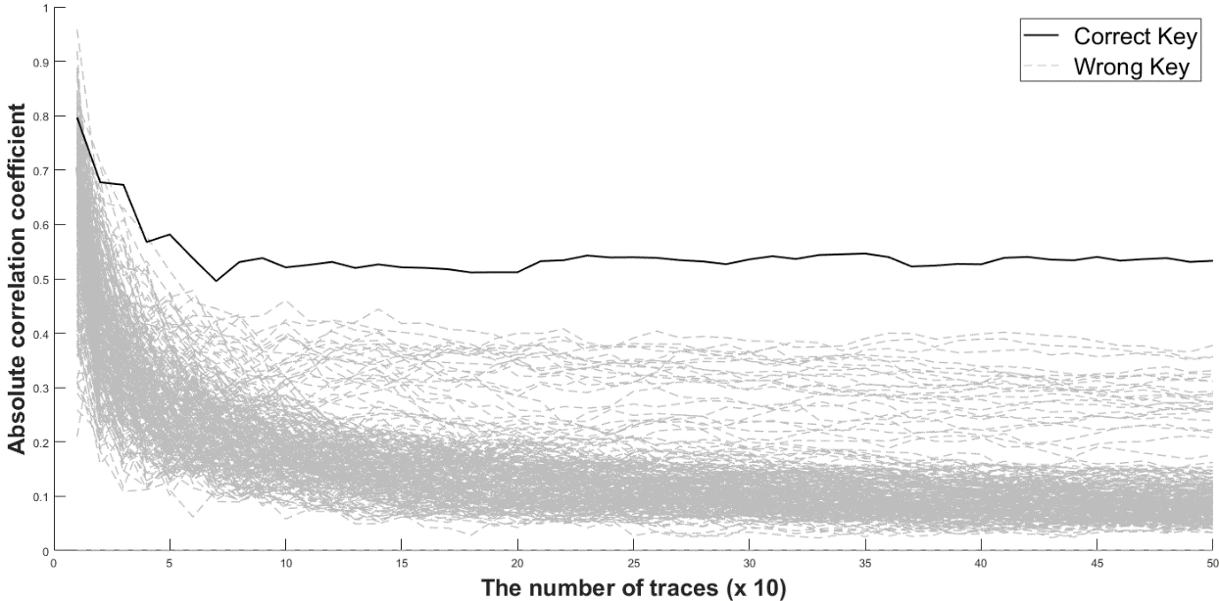
Sub-attack 2
CPA on the $T^{−1}$
(Assume) Special form $T$
Rainbow
UOV
the result of CPA for $t_{45}^{′}$
Maximum correlation coefficients according to increased number of traces for ${t′}_{45}$
Notes:
This picture shows the CPA result / for ${t′}_{45}$.
As you can see, we could find ${t′}_{45}$

Slide 15
Sub-attack 3
Recovery $𝓕$ and $T$ using algebraic KRAs
(Assume) general form $T$, recovery $S$
$S^{−1}∘𝒫=ℱ∘T⟺𝓟∘\tilde{T}=ℱ$; certain places with zero coefficients in $ℱ^{\left(k\right)}$ are known
Let $𝓟=S^{−1}∘𝒫$, $\tilde{T}=T^{−1}$
$$ℱ^{(k)}={\tilde{T}}^{T}⋅P^{\left(k\right)}⋅\tilde{T}$$
$$∀ 1≤k≤m$$
Where $ℱ^{\left(k\right)}$ is the k-th component of the central map $ℱ$.
$$v_{1}$$
$$o_{1}$$
$$o_{2}$$
$$v_{1}$$
$$o_{1}$$
$$o_{2}$$
Find an equivalent key $\left(ℱ′,T′\right)$ s.t $𝒫=ℱ′∘T′$
$$v_{1}$$
$$v_{1}$$
The equivalent key $𝓕′$ and $T′$have the form the figures.
$$o_{1}$$
$$o_{1}$$
${ℱ′}^{\left(k\right)}$=
$\tilde{T′}$=
No. equations | No. variables
$$v_{1}o_{1}o_{2}$$ (linear equations) | $$\left(v_{1}+o_{1}\right)o_{2}$$
$$o_{2}$$
$$o_{2}$$
$$1≤k≤o_{1}$$
Rainbow($𝔽,v_{1},o_{1},o_{2}$) = Rainbow(GF($2^{8}$), 36, 21, 22)
0.46 milliseconds
Intel Xeon E5-2687W CPU 3.1 GHz with 256GB RAM
Notes:
Here, I’ll explain a brief description / about the recovery of F and T / using algebraic key recovery attacks.
We assume that S has been found and T has been used the general form.
Because we find the S and know public key p / we can compute $S^{−1}∘𝓟$.
We let the green p is $S^{−1}∘𝓟$ / and tilde T is inverse T.
green P circle tilde T equals F and certain places with zero coefficients in $ℱ^{\left(k\right)}$ are known because we have found S and Rainbow has different central maps each layer.
So , we obtain the following equality.
we can find an equivalent key T’ with high probability(프로바빌리티) by solving the equations by finding $v_{1}o_{1}o_{2}$ linear equations with $o_{2}\left(v_{1}+o_{1}\right)$ variables.
Therefore we can make a forged signature.
We could find an equivalent key / using this parameter / in less than 0.46(zero point four six) milliseconds / on Intel Xeon CPU.

Slide 16
Attack 1 = sub-attack 1 + sub-attack 2
CPA on Rainbow implementation with Equivalent keys in CHES 2012
Similar attack: CPA on UOV implementation with equivalent key
START
CPA on the $S^{−1}$
YES
Does it use the special form linear maps?
NO
CPA on the $T^{−1}$
Recovery $F$ and $T$ using algebraic KRAs
Recovery $F$
using $S,T$, and $𝓟$
END
Notes:
In summary,
The first attack can be used / when the linear maps have the CHES form.
All of the secret keys S, F, and T can be recovered by a combination of sub-attack 1 and sub-attack 2.
That is, After recovering the two linear maps, S and T, using power analysis / we recover the central map F by simple calculation with the public key P.

Slide 17
Attack 2 = sub-attack 1 + sub-attack 3
Hybrid attack on Rainbow implementation with random linear maps
START
CPA on the $S^{−1}$
YES
Does it use the special form linear maps?
NO
CPA on the $T^{−1}$
Recovery $F$ and $T$ using algebraic KRAs
Recovery $F$
using $S,T$, and $𝓟$
END
Notes:
The second one is a hybrid attack / which uses(유지즈) CPA and algebraic key recovery attacks.
It can attack rainbow-like signature schemes with random linear maps.

Slide 18
Other MQ-signature schemes
UOV-like single layer schemes.
[INDOCRYPT 2017] Lifted UOV (LUOV)
Attack 1
LUOV is submitted to NIST for Post-Quantum Cryptography Standardization.
LUOV uses the form of the equivalent key proposed in CHES 2012.
Rainbow-like multi-layered schemes.
Rainbow and HiMQ-3
affine-substitution (quadratic)-affine (ASA) structure
Attack 2
GF($2^{n}$), $n>1$
Notes:
Our attacks can apply other MQ-signature schemes.
First, LUOV which is submitted(서브밋티드) to NIST, uses CHES form.
So it can be applied to our proposed attack 1.
Rainbow and HiMQ-3, which use ASA structure and are computed over GF(two to the power of n), also are vulnerable to our attack 2.

Slide 19
Countermeasures
UOV-like single layer schemes
Use the $T$ that is removed the relation between the signature value and the intermediate value.
Rainbow-like multi-layered schemes
focus on implementing a secure matrix-vector product against PA
Message randomization
Overhead: $2m$ field multiplications and a field inversion
Notes:
To avoid our attacks, / UOV-like single layer schemes / should not use the form of the linear map / proposed in CHES 2012(twenty twelve).
in other words, we must use the $T$ that is removed the relation between the signature value and the intermediate value.
Rainbow-like multi- layered schemes/ can be recovered all secret maps / if S is recovered.
Therefore, we must focus on implementing(임플리먼팅) a secure matrix-vector product against PA.
we can use message randomization to prevent our in the first step.
That is, multiply all elements of a message by a random number r, / and perform a general matrix-vector product.
And then, we multiply the output of the matrix-vector product / by the inverse r.
We need 2 times m field multiplications and a field inversion.
we also need a random number generation step.
Here, m is the size of the vector.

Slide 20
Conclusion
Our contributions
CPA on Rainbow and UOV implementation with equivalent keys in CHES 2012
Hybrid attack on Rainbow implementation with random linear maps
Our attacks can apply to other MQ-signature schemes.
Countermeasure against first-order CPA
Further work
More efficient countermeasures
Security analysis against high-order and fault injection attacks
Notes:
This is a conclusion.
We proposed CPA on Rainbow and UOV with equivalent keys in CHES 2012.
And we also proposed the Hybrid attack on Rainbow implementation with random linear maps using CPA and algebraic key recovery attacks.
Our attacks can apply to other MQ-signature schemes.
We proposed simple countermeasure against first-order CPA.
We’ll study about More efficient countermeasures and about Security analysis against high-order and fault injection attacks

Slide 21
Notes:
That’s all. Thank you for your attention.
Any questions and comments?

