Slide 1




Reconciling d + 1 Masking in Hardware and Software
Masked
Software
UMA
Masked
Hardware
Hannes Gross, Stefan Mangard
Graz University of Technology
Notes:
Before I’m actually going to start this talk with a brief discussion on why we think that it was about time

Slide 2
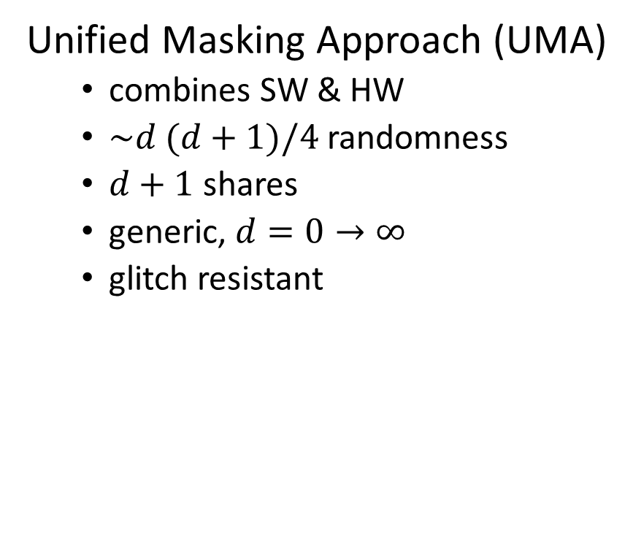
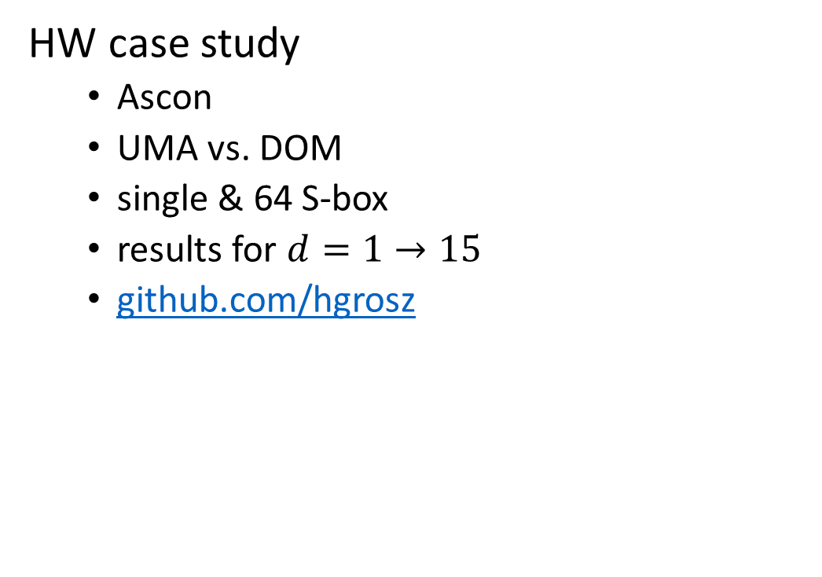
In this work…
Unified Masking Approach (UMA)
  combines SW & HW
  $\sim d (d+1)/4$ randomness
  $d+1$ shares
  generic, $d=0→∞$
  glitch resistant
HW case study
  Ascon
  UMA vs. DOM
  single & 64 S-box
  results for $d=1→15$
  github.com/hgrosz
Q: “Does randomness reduction pay off?”
Notes:
In this work we had a closer look on..
To demonstrate how these properties map..

Slide 3



A Brief History of Boolean Masking
Glitches
MangardPG05
BelaidBPPTV16
Masking
ChariJRR99
GoubinP99
Trichina gate & ISW
Trichina03
IshaiSW03
BartheDFGSS16
… 18
MIND THE GAP
DOM
GrossMK17
CMS
ReparazBNGV15
1 3 5 7 9 11 13 15 17 19
17 18
DPA
1999
(1 AK)
EMA
(QuisquaterS01)
8 … 16
AES d+1 shares
(DeCnuddeRBNNR16)
TI scheme
NikovaRR06
HO TI
BilginGNNR14
Notes:
I want to begin my actual talk with a brief historical overview on…
Anno Domini… Anno Kocher…
Eurocrypt 2016 of Bela-i-d
and the Bounded Moment Leakage Model of Barthe et al.

Slide 4
How big is the randomness gap?
Barthe et al.’s generic algorithm
randomness
Belaïd et al.’s generic algorithm
Belaïd et al.’s optimal solutions
protection order (d)
Notes:
How big is the randomness gap between Software and Hardware Based Masking
Lower bound:
d 1… 2 → d randomness
d 3… → d+1 randomness
tightness??
best SW: best of optimal solutions from Belaid, and generic variants of Belaid and Barthe

Slide 5
How big is the randomness gap?
twice the randomness
randomness
protection order (d)
Notes:
add UMA
DOM
Biggest gap at points where d = integral multiple of 4
were are not only closing this gap, but improve on Barthe\Belaid et al’s algorithms for d = 1 mod 4

Slide 6























Masked Multiplication
$$a_{0}b_{1}$$
$$a_{0}b_{0}$$
$$a_{0}b_{2}$$
$$a_{1}b_{0}$$
$$a_{0}b_{d}$$
$$a_{0}$$
$$b_{0}$$
$$a_{1}$$
$$b_{1}$$
$$a_{1}b_{1}$$
$$a$$
$$×$$
$$b$$
$$a_{2}$$
$$b_{2}$$
(d+1)² terms
$$a_{1}b_{2}$$
$$a_{1}b_{d}$$
$$a_{d}$$
$$b_{d}$$
$$a_{2}b_{0}$$
$$a_{2}b_{d}$$
$$a_{2}b_{1}$$
$$a_{2}b_{2}$$
Notes:
When I talk about randomness requirements I refer to the simplest nonlinear…
Multiplication results in sharing in (d+1)² terms → no randomness, secure when sharing of a and b independent → story could be over here
All resulting terms are not allowed to come together → violation of d-probing model

Slide 7





















































Masked Multiplication
$$a_{0}b_{0}c_{0}$$
$$a_{0}b_{1}c_{0}$$
$$a_{0}b_{2}c_{0}$$
$$a_{0}b_{0}c_{1}$$
$$a_{0}b_{1}c_{1}$$
$$a_{0}b_{2}c_{1}$$
$$a_{0}b_{0}c_{2}$$
$$a_{0}b_{1}c_{2}$$
$$a_{0}b_{2}c_{2}$$
$$a_{0}b_{0}c_{d}$$
$$a_{0}b_{1}c_{d}$$
$$a_{0}b_{2}c_{d}$$
$$a_{1}b_{0}c_{0}$$
$$a_{0}b_{d}c_{0}$$
$$a_{1}b_{0}c_{1}$$
$$a_{0}b_{d}c_{1}$$
$$a_{1}b_{0}c_{2}$$
$$a_{0}b_{d}c_{2}$$
$$a_{1}b_{0}c_{d}$$
$$a_{0}b_{d}c_{d}$$
$$a_{1}b_{1}c_{0}$$
$$a×b×c_{0}$$
$$a_{1}b_{1}c_{1}$$
$$a×b×c_{1}$$
$$a_{1}b_{1}c_{2}$$
$$a×b×c_{2}$$
…
$$a_{1}b_{1}c_{d}$$
$$a×b×c_{d}$$
$$a_{1}b_{2}c_{0}$$
$$a_{1}b_{2}c_{1}$$
$$a_{1}b_{2}c_{2}$$
$$a_{1}b_{2}c_{d}$$
$$a_{1}b_{d}c_{0}$$
$$a_{1}b_{d}c_{1}$$
$$a_{1}b_{d}c_{2}$$
$$a_{1}b_{d}c_{d}$$
$$a_{2}b_{0}c_{0}$$
$$a_{2}b_{0}c_{1}$$
$$a_{2}b_{0}c_{2}$$
$$a_{2}b_{d}c_{2}$$
$$a_{2}b_{0}c_{d}$$
$$a_{2}b_{d}c_{d}$$
$$a_{2}b_{1}c_{0}$$
$$a_{2}b_{2}c_{0}$$
$$a_{2}b_{d}c_{0}$$
$$a_{2}b_{1}c_{1}$$
$$a_{2}b_{2}c_{1}$$
$$a_{2}b_{d}c_{1}$$
$$a_{2}b_{1}c_{2}$$
$$a_{2}b_{2}c_{2}$$
$$a_{2}b_{1}c_{d}$$
$$a_{2}b_{2}c_{d}$$
$$a×b×c …$$
Notes:
Exponential growth in number of terms\shares…. (d+1)² x (d+1) → (d+1)³
→ still no randomness required when inputs

Slide 8




























Compressing
$$a_{0}b_{0}$$
$$⊕$$
$$a_{0}b_{1}$$
$$⊕$$
$$a_{0}b_{2}$$
$$⊕$$
$$…$$
$$⊕$$
$$a_{0}b_{d}$$
$$r_{{?_{?}}_{?}}$$
$$r_{{?_{?}}_{?}}$$
$$r_{{?_{?}}_{?}}$$
$$r_{{?_{?}}_{?}}$$
$$⊕$$
$$⊕$$
$$⊕$$
$$⊕$$
$$a_{1}b_{1}$$
$$⊕$$
$$a_{1}b_{2}$$
$$⊕$$
$$…$$
$$r_{{?_{?}}_{?}}$$
$$r_{{?_{?}}_{?}}$$
$$⊕$$
$$⊕$$
$$a_{2}b_{2}$$
$$…$$
$$\{q_{0}, q_{1}, q_{2}, …, q_{d}\}$$
Notes:
Reduce number of terms to d+1 again by summing up these terms
None of these terms are allowed to come together in a direct manner
Therefore fresh random bits are required. But what is the most efficient way to perform this reduction?
Main difference in SW … how many fresh random bits. in HW, also how much controll over combination sequence is requried?

Slide 9
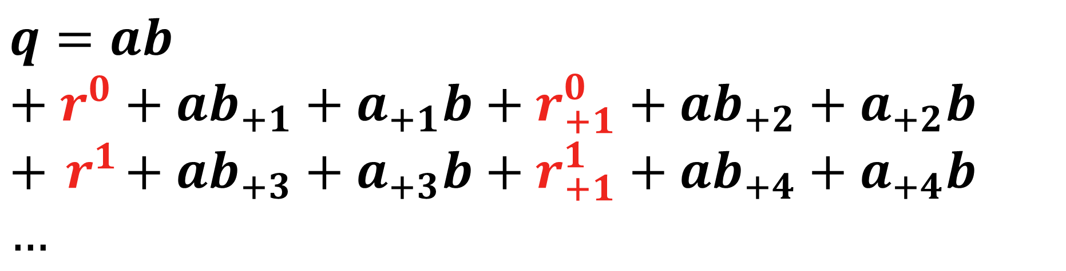
Barthe et al.’s Generic Algorithm
$$q=ab \\ + r^{0}+ab_{+1}+a_{+1}b+r_{+1}^{0}+ab_{+2}+a_{+2}b \\ +{ r}^{1}+ab_{+3}+a_{+3}b+r_{+1}^{1}+ab_{+4}+a_{+4}b \\ …$$
Notes:
Absorbtion of terms as repeating sequence
state that SINE is a symbol for repeating sequence

Slide 10
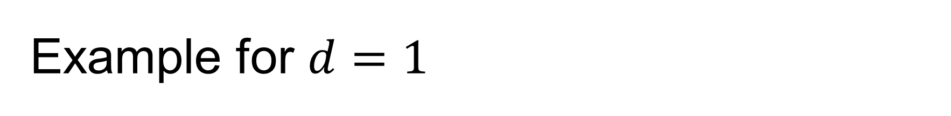
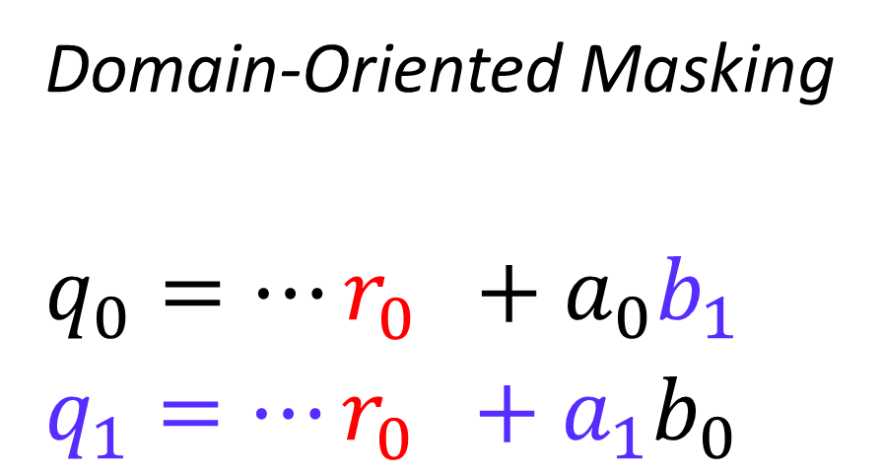
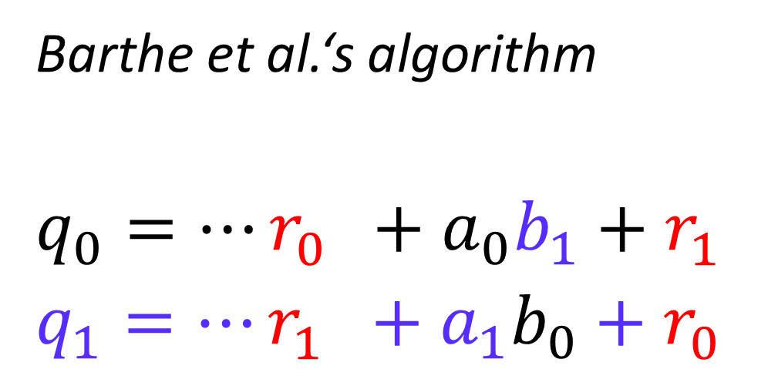
Example for $d=1$
Barthe et al.‘s algorithm
$$q_{0}=…r_{0}^{}+a_{0}b_{1}+r_{1}^{} \\ q_{1}=…r_{1}^{}+a_{1}b_{0}+r_{0}^{}$$
Domain-Oriented Masking
$$q_{0}=…r_{0}^{}+a_{0}b_{1} \\ q_{1}=…r_{0}^{}+a_{1}b_{0}$$
Notes:
Example for first-order
Bathe et al‘s algorithm works quite well for Complete sequences…

Slide 11
Sequence Types
$$…{ r}^{i}+ab_{+2i+1}+a_{+2i+1}b+r_{+1}^{i}+ab_{+2i+2}+a_{+2i+2}$$
Incomplete
Half-Complete
Complete
Pseudo-Complete
Notes:
As it shows, Barthes algorithm is most efficient if 4 terms are absorbed…
Multiple sequences of type „complete“ (four terms per domain absorbed) → Barthe et al‘s algorithm
Psuedo-complete → treat the same as complete sequences
Half-complete → DOM
same randomness as Barthe‘s, but better suitablility in HW
Incomplete → DOM

Slide 12
inner-domain terms
complete sequences
last sequence
pseudo-complete
half-complete
incomplete
Barthe et al.
Belaïd et al.
DOM
Notes:
With this in mind we can begin to implement UMA in Software..

Slide 13

UMA in Hardware
Following DOM paradigm
Split into submodules
Domain separation
Constant latency ($d>3$)
$$a$$
$$×$$
$$b$$
Notes:
For the implementation in Hardware we followed the design principles of DOM…
Construction of a Masked AND gate following the DOM principles

Slide 14
Back to the Randomness Gap
randomness
protection order
Notes:
We not only closed the gap but also improved on SW
d = 5 : UMA 9 vs 12 in SW → save 3 (25%)
d = 9 : UMA 25 vs 30 in SW → save 5
d = 13 : UMA 49 vs 56 in SW → save 7
add UMA
DOM
Biggest gap at points where d = integral multiple of 4
were are not only closing this gap, but improve on Barthe\Belaid et al’s algorithms for d = 1 mod 4

Slide 15
Ascon - Case Study
AE scheme
Round 3 CAESAR candidate
128-bit key & nonce
64 or 128 bit rate
1-64 S-boxes (5-bit)
generic protection
pipelined
Notes:
To have a fair comparison between DOM and UMA under real-world conditions…
Main functionality in State
S-box very compact
Comparison for different amounts of nonlinearity

Slide 16
Area: Ascon-Single Sbox
[kGE]
UMA
DOM
protection order
Notes:
area results are quit similar:
- because UMA → less randomness → less XORs

Slide 17
Area: Ascon-64 S-box
[kGE]
UMA
DOM
protection order
Notes:
One-Sbox variant
64-Sboxes in parallel
Ready & Busy signaling… e.g. AXI4 streaming device
Main functionality in State
S-box very compact
Comparison for different amounts of nonlinearity

Slide 18
Throughput: Ascon-Single Sbox
[Mb/s]
UMA
DOM
protection order
Notes:
Sigle Sbox variants: between 100 and 50 Mbps
402 vs 426 cycles
18 vs 42 cycles

Slide 19
Throughput: Ascon-64 S-box
[Mb/s]
UMA
DOM
Single S-box variants
protection order
Notes:
402 vs 426 cycles
18 vs 42 cycles

Slide 20
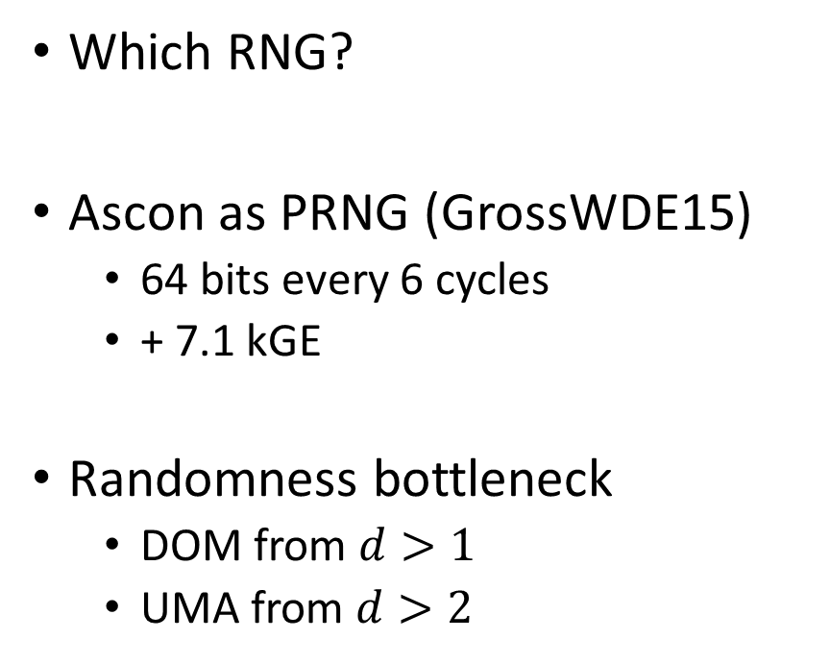
But didn’t we forget something…?
Which RNG?
Ascon as PRNG (GrossWDE15)
  64 bits every 6 cycles
  + 7.1 kGE
Randomness bottleneck
  DOM from $d>1$
  UMA from $d>2$
#PRNGs
UMA
DOM
protection order
Notes:
Numbers from before do not reflect the effort for producing random numbers
Number of PRNGs given for Single- S-box variant
Randomness becomes bottleneck → need more PRNGs

Slide 21
Area with Randomness Costs
[kGE]
UMA
DOM
Single S-box variants
protection order
Notes:
Numbers from before do not reflect the effort for producing random numbers
Number of PRNGs given for Single- S-box variant
→ for 64-bit parallel

Slide 22

Conclusions
Introduction of UMA
  masking in SW and HW
  ~d(d+1)/4 randomness
UMA vs. DOM masked Ascon
  generic protection
  customizable (rate, S-Boxes, rounds, …)
  github.com/hgrosz
  including Ascon, AES, Keccak, RISC-V, …
Randomness reduction does pay off
  randomness = bottleneck
  save randomness → save area → increase throughput
UMA
Notes:
Today I had the great pleasure to introduce UMA…
-closes randomness gap in SW and improves on it
Umkehrschluss → consider the reverse conclusion

Slide 23
Reconciling d + 1 Masking in Hardware and Software
Masked
Software
UMA
Masked
Hardware
Hannes Gross, Stefan Mangard
Graz University of Technology

Slide 24

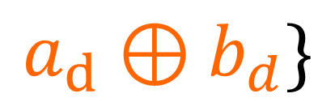
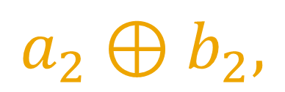
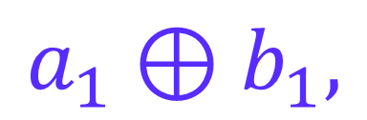


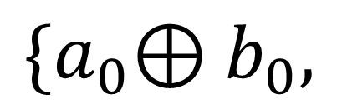
Masking - Linear Operations
$$a_{0}$$
$$b_{0}$$
$$a_{1}$$
$$b_{1}$$
$$a$$
$$⊕$$
$$b$$
$${\{a}_{0}{⊕b}_{0},$$
$$a_{1}⊕b_{1},$$
$$a_{2}⊕b_{2},$$
$$…$$
$$a_{d}{⊕b}_{d}\}$$
$$a_{2}$$
$$b_{2}$$
$$q$$
$$a_{d}$$
$$b_{d}$$
Notes:
Result of linear operation is again a d+1 sharing of the result

Slide 25

Efficiency Comparison
[Mbps/kGE]
UMA
DOM
Single S-box variants
protection order
$$efficiency=\frac{throughput [Mbps]}{area [kGE]}$$
Notes:
Single S-box variants more efficient
UMA more efficient
For high-throughput DOM more efficient, but circuit size is overwhelming

Slide 26
A Brief History of Boolean Masking
Glitches
MangardPG05
BelaidBPPTV16
Masking
ChariJRR99
GoubinP99
Trichina gate & ISW
Trichina03
IshaiSW03
BartheDFGSS16
… 18
MIND
THE
GAP
DOM
GrossMK17
CMS
ReparazBNGV15
1 3 5 7 9 11 13 15 17 19
17 18
DPA
1999
1 AK
EMA
(QuisquaterS01)
8 … 16
AES d+1 shares
(DeCnuddeRBNNR16)
TI scheme
NikovaRR06
HO TI
BilginGNNR14
Notes:
Sonia Bela-i-d
Introducing new time
DPA Kocher 0 AK (1999)
masking (ChariJRR99) & GoubinP99 0 AK (1999)
EMA Quisquatter (QuisquaterS01) 2 AK (2001)
Trichina gate (Trichina03) 4 AK (2003)
ISW scheme (IshaiSW03) 4 AK (2003)
Glitches (MangardPG05) 6 AK (2005)
Hardware branch:
TI scheme (NikovaRR06) 7 AK (2006)
...
Bilgin HO TI (BilginGNNR14) 15AK (2014)
Reparaz note on HO TI (Reparaz15) 16AK (2015)
Consolidating Masking (ReparazBNGV15) 16AK (2015)
AES d+1 (CnuddeRBNNR16) 17AK (2016)
DOM (GrossMK16) 17AK (2016)
Software:
Belaid Randomness Complexity... (BelaidBPPTV16) 17 AK (2016)
Barthe Bounded Moment Leakag... (BartheDFGSS17) 18 AK (2017)

Slide 27
UMA vs. DOM – Area of Masked AND
[GE]
UMA
DOM
protection order
Notes:
For unpipelined AND agtes UMA and DOM requires the same area -> delay for UMA is bigger

Slide 28
UMA vs. DOM – Randomness of Masked AND
random bits
UMA
DOM
protection order
Notes:
UMA requires half the randomness of DOM, in case modulus of d is 1 even more efficient than Barthe algorithm

Slide 29
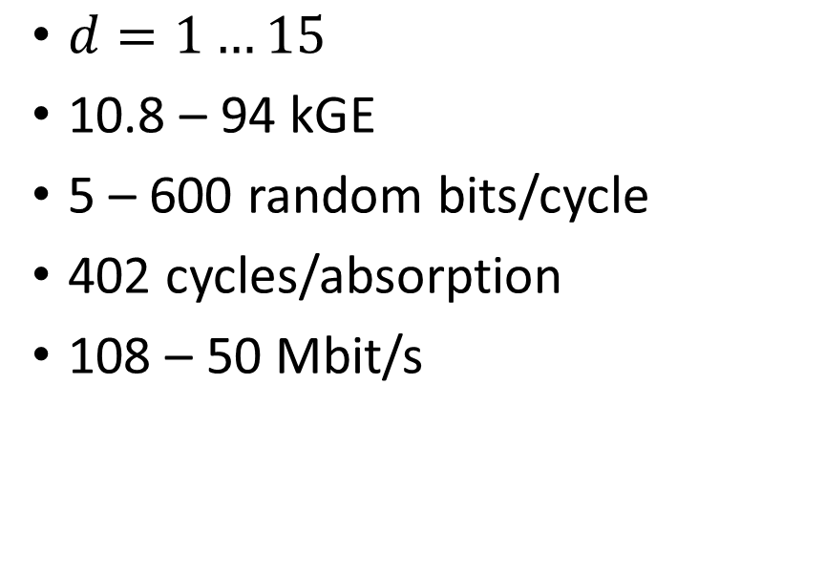
Summary – Single S-Box Variants
DOM Ascon
UMA Ascon
$d=1…15$
10.8 – 94 kGE
5 – 600 random bits/cycle
402 cycles/absorption
108 – 50 Mbit/s
10.8 – 99 kGE
5 – 320 random bits/cycle
402-426 cycles/absorption
108 – 48 Mbit/s
A
B
Z
C
…
Notes:
Ready & Busy signaling… e.g. AXI4 streaming device
Main functionality in State
S-box very compact
Comparison for different amounts of nonlinearity

Slide 30

Summary – 64 S-Boxes Variants
DOM Ascon
UMA Ascon
$d=1…15$
28 – 926 kGE
320 – 38,400 random bits/cycle
18 cycles/absorption
2.25 – 1.48 Gbit/s
28 – 1,252 kGE
320 – 20,480 random bits/cycle
18 – 42 cycles/absorption
2.25 – 0.53 Gbit/s
A
B
Z
C
…
Notes:
Ready & Busy signaling… e.g. AXI4 streaming device
Main functionality in State
S-box very compact
Comparison for different amounts of nonlinearity

