Slide 1
Illusion and Dazzle: Adversarial Optical Channel Exploits against Lidars for Automotive Applications
Hocheol Shin, Dohyun Kim, Yujin Kwon, and Yongdae Kim
System Security Lab.
Korea Advanced Institute of Science and Technology
Notes:
Good morning! I’m Hocheol Shin from KAIST. In this talk, I’ll present a work on lidar hacking. This was a joint work of me and my colleagues, Dohyun, Yujin, and my advisor Yongdae.

Slide 2
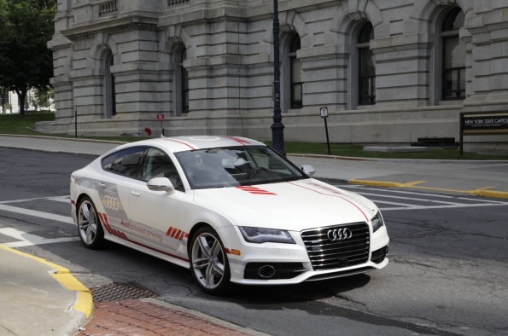
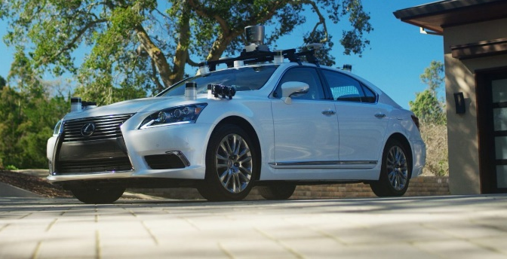
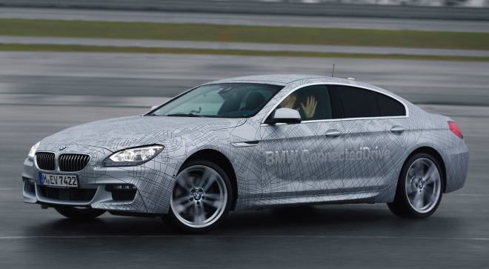
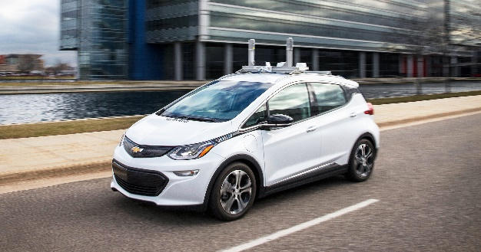
Transition toward Autonomous Cars
And many others….
Notes:
Transition from human-controlled to autonomous vehicle is a general trend. Actually, it’s rather difficult to find companies that is not involved with autonomous driving. All these (point logos) companies and many others are currently developing autonomous driving platforms or their components. Even if completely autonomous cars would not be realized in near future, humans’ role in driving will keep decreasing whereas that of cars will keep increasing.

Slide 3
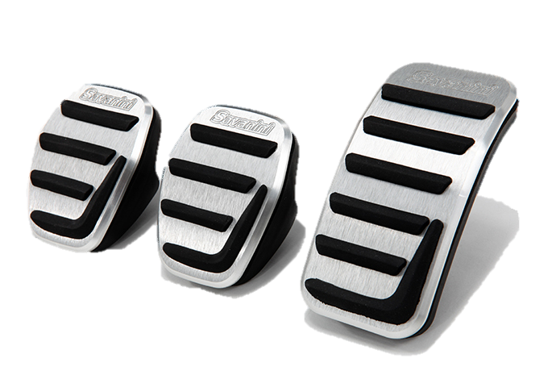
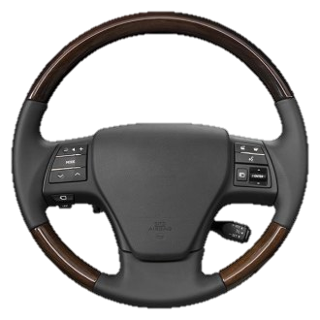
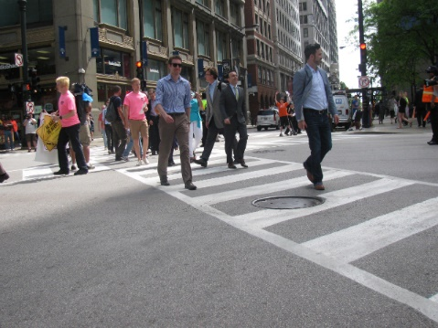
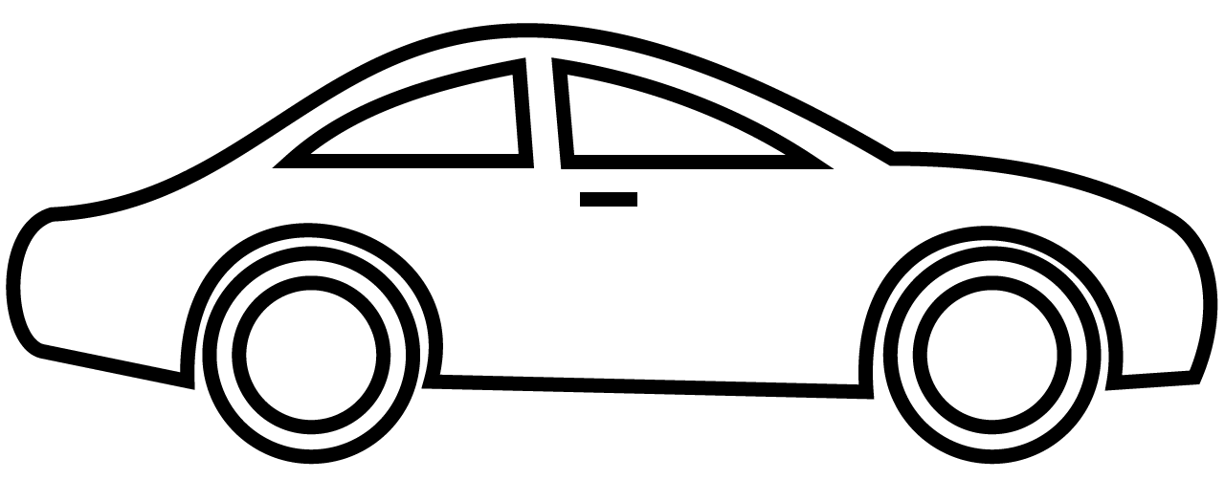
Human Driving
Surroundings
Manual Driving
Notes:
Then, how does autonomous driving differ from past human driving? In human driving, humans took care of every important work for driving, [Click] eyes and ears for perceiving, and [Click] pedals, a gear stick, and steering wheel for controlling.

Slide 4
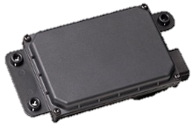
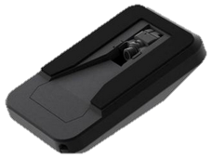
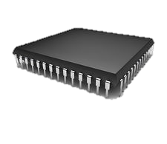
Autonomous Driving: a Sensing & Actuation System
Inter-vehicle Network
Surroundings
GNSS
Intra-vehicle Network
Intra-vehicle Network
Autonomous Driving
Notes:
However, for autonomous driving, humans’ roles are replaced by [Click] ECUs, [Click] telemetries, and [Click] various types of sensors.
애니메이션화!(어디를 말하고 있는지)

Slide 5
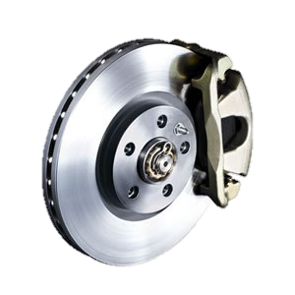
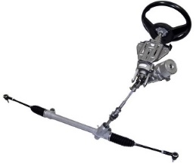
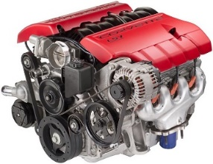
Sensor Attacks against Sensing & Actuation Systems
Surroundings
Sensing & Actuation System
Sensors
Controller
Actuators
Notes:
And it takes the form of sensing and actuation system, [Click] where a feedback loop is established.

Slide 6
Sensor Attacks against Sensing & Actuation Systems
W/O Security Features
Surroundings
Sensing & Actuation System
Sensors
Controller
Actuators
Notes:
We call it sensor attacks that an external attacker injects evil inputs to the sensors, [Click] and without adequate security features, this evil inputs are directly propagated to the actuators without filtering. [Click] And as those actuators are directly connected to the physical world, this can lead to devastating results.
So that’s the motivation of our work. Among various types of sensors mounted on cars [Click] we focused on lidar.

Slide 7
Overview
Explored the possibility of optical-channel sensor attacks against lidars
Notes:
In this work, we explored the possibility of optical-channel sensor attacks.

Slide 8
Overview
Explored the possibility of optical-channel sensor attacks against lidars
How lidar spoofing works in detail
The process of inducing closer fake dots
Saturation attack
Adverse effect of curved reception glasses
Demonstration by experiments
Notes:
We introduce how lidar spoofing works in detail, the process of inducing fake dots closer than the spoofer, saturation attack, and adverse effect of curved reception glasses used in lidars. Besides both type of attacks, spoofing and saturating are demonstrated by experiments against a COTS lidar.
We introduce 뒤에 말을 줄이거나 없애거나

Slide 9
Overview
Explored the possibility of optical-channel sensor attacks against lidars
How lidar spoofing works in detail
The process of inducing closer fake dots
Saturation attack
Adverse effect of curved reception glasses
Demonstration by experiments
Problems of current lidar design
Possible countermeasures and their limitations
Notes:
We will also discuss problems of current lidar design that indirectly made proposed attack possible. Finally, we will show possible countermeasures with their limitations.

Slide 10
Lidar
Light Detection and Ranging
cf) Radio Detection and Ranging → radar
Notes:
Lidar is an acronym of light detection and ranging

Slide 11
Lidar
Light Detection and Ranging
cf) Radio Detection and Ranging → radar
Lots of strengths
Source of highest spatial resolution
Much better than radars / ultrasonic sensors
∵ Superior directivity of laser beam
Highly autonomous platforms tend to have lidars
Notes:
Lidars have lots of strengths. They are sources of highest spatial resolution much better than radars and ultrasonic sensors. This comes from the superior directivity of laser beams. This may be the cause that most highly autonomous driving platforms tend to have lidars.

Slide 12
Lidar
Working principle
Similar to radars / sonars / ultrasonic sensors except media
Multi-layer scanning lidar $≜$ rotating 3D-mapping lidar
Notes:
Lidars’ working principle is basically the same as pulsed radars, sonars, and ultrasonic sensors except the media it uses. And we define a multi-layer scanning lidar as a rotating lidar with 3D-mapping capability.

Slide 13
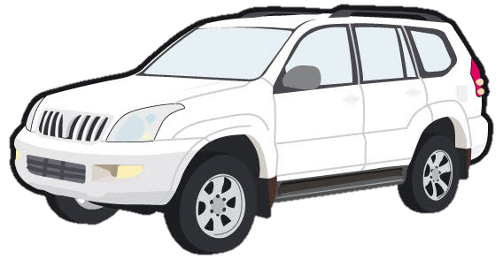
Lidar
Working principle
Similar to radars / sonars / ultrasonic sensors except media
Multi-layer scanning lidar $≜$ rotating 3D-mapping lidar
$$∆t$$
$$l=c{∆t }/2$$
Notes:
Let me briefly illustrate how a multi-layer scanning lidar works. First, [Click] The lidar fires a laser pulse. [Click] When the fired pulse hits an object, a fraction of it reflects back as an echo with a round trip time of delta-t. From this round trip time, the lidar can deduce the distance to the object as c delta-t over 2, [Click] and as the lidar knows the direction to which the pulse fired, a point can be mapped to a virtual space. [Click] Pulses are also fired up and down to map vertically. [Click] For horizontal scanning, the lidar rotates while firing pulses to acquire a new set of points, which together forms a point cloud.

Slide 14
Lidar
Important parameters
Pulse repetition time (PRT, $T$)
$$T$$
$$T$$
$$T$$
Lidar
$$T$$
$$T$$
Time
Notes:
There are a set of important parameters that defines the operation of a scanning lidar. First one is pulse repetition time. In short, PRT. It is the time interval between adjacent pulse firing, and generally, PRT remains constant.

Slide 15
Lidar
Important parameters
Pulse repetition time (PRT, $T$)
Receiving time / dead time (${∆t}_{max}$, $D$)
To limit the ambiguity
Lidar range $l_{max}$ → ${c{∆t}_{max}}/2$
Solely belongs to the last pulse
Ignore all echoes
Possible $∆t$’s
$$T$$
$${∆t}_{max}$$
$$D$$
Pulse
Echo
Next Pulse
Time
Notes:
Next parameter is receiving time and dead time. Here we denote them with delta_t_max and D. When an echo is received, the lidar cannot determine from which it originates, [Click] because it can be any of the previously fired pulses, and thus cannot determine the elapsed time, delta_t. [Click] To limit the ambiguity, each PRT is divided into the receiving time and dead time, and all echoes received during the receiving time are considered as that of just-transmitted pulse, whereas all echoes received during the dead time are ignored. We can deduce the lidar range, l_max, from the receiving time as c delta_max over 2.

Slide 16
Lidar
Important parameters
Pulse repetition time (PRT, $T$)
Receiving time / dead time (${∆t}_{max}$, $D$)
To limit the ambiguity
Lidar range $l_{max}$ → ${c{∆t}_{max}}/2$
Receiving angle
Angle of receiver aperture
If precisely calibrated, covering up to the farthest point is enough
Lidar
Receiving angle
Notes:
The last important parameter is the receiving angle. It is the angle of receiver aperture. [Click] When an echo or external light falls into the receiving angle, the receiver can detect it. [Click] However, when it falls outside the receiving angle, the receiver cannot detect it.
If precisely calibrated, the receiving angle only need to be as wide as it can cover the echo from the farthest point.

Slide 17
Sensor Attacks
Sensor Saturating
Exploiting the transition curve
Output
Silent Region
Linear Region
Saturation Region
Input
Saturation Attack
Notes:
The next thing is sensor attacks. We deal with two types of sensor attacks. First, sensor saturating exploits sensors’ transition curve.
(Point Graph) This is a typical transition curve of a sensor, and the linear region is the region a sensor is intended to operate in. [Click] In this region, input changes are well applied to the output. However this linearity cannot last forever, because its output cannot grow infinitely even if the given input signal does. So, beyond a certain point the output starts being saturated. So the saturation region starts. Saturation attack is to intentionally push the input signal level to fall into the saturation region. [Click] By doing so, the attacker can suppress the size of the output change so that the sensor cannot notice it.

Slide 18
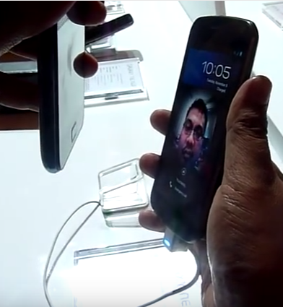
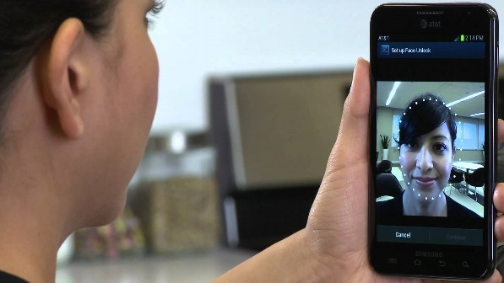
Sensor Attacks
Sensor Saturating
Sensor Spoofing
Exploiting the transition curve
Deceiving sensors
Lidar spoofing: make a lidar see an object that does not exist in fact
Real World
Perception
Output
Silent Region
Linear Region
Saturation Region
Input
Semantic Gap
Saturation Attack
Notes:
And sensor spoofing is to deceive sensors. It exploits the semantic gap between what the world really is and what the sensor perceives it to be. For example of the face unlock hacking, the smartphone on the left actually is seeing a display, but it thinks it is seeing a real human face. So there’s apparently a gap between two. When it comes to lidars, sensor spoofing becomes the attack that makes the lidar see an object that does not exist in fact.

Slide 19
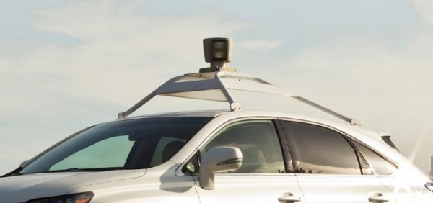
Target System
A scanning lidar system
Exposed to the exterior
Notes:
Let’s get to the main subject. We assume the target systems to be a scanning lidar system that is exposed to the exterior.

Slide 20
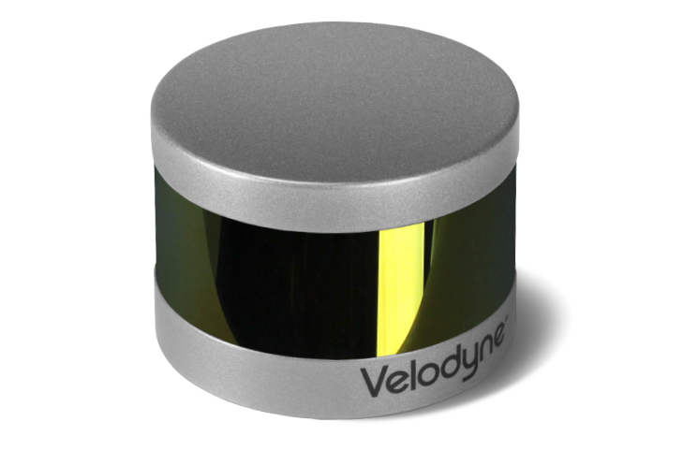
Target System
Velodyne’s VLP-16
Outputs via Ethernet in UDP packets ➔ Used VeloView to visualize sensing outputs
Property of the research sponsor ➔ Non-destructive analysis only
Price | US$7,999
Laser wavelength | 903nm
# of vertical layers | 16
Update rate | 5/10/20Hz (configurable)
Range | 100m
Field Of View | 360° (hor.), -15°~15° (ver.)
Angular Resolution | 0.1/0.2/0.4°(hor., depends on update rate), 2° (ver.)
Notes:
To experimentally confirm the attack methods working well against COTS lidar, we chose our target system as Velodyne’s VLP-16. It’s a 16 layer scanning lidar system which uses 903nm IR laser. It outputs its sensing result via Ethernet in UDP packets, and those output data can be easily visualized with the official viewer software, VeloView. One notable thing is that we could not be able to perform any destructive analysis of it because VLP-16 was not ours but the property of our research sponsor.

Slide 21
Attack Model
Saturating
Can inject light → includes aim & focus capability
Attacking light with the same wavelength as the target
Attacking light strong enough to saturate
Notes:
For the attack model, we assume two different models for each attack. For saturating attack, the attacker can remotely inject attacking light to the target sensor. The attacking light is assumed to have the same wavelength as the target, and is strong enough to saturate it.
슬라이드 나누기 + 말 줄이기

Slide 22
Attack Model
Saturating
Can inject light → includes aim & focus capability
Attacking light with the same wavelength as the target
Attacking light strong enough to saturate
Spoofing
Injection capability
Can receive pinging pulses from the target lidar
For inducing closer objects
Consistent / predictable ping waveform and PRT
Virtually, all COTS automotive lidars meet this
Notes:
Second, for spoofing attack, in addition to the injection capability, the attacker can receive pinging pulses from the target lidar, and only for the case of inducing closer objects, we assume the lidar has consistent or at least predictable ping waveform and PRT. We’d like to stress that as long as we know, virtually all COTS automotive lidar meet this condition.

Slide 23
Saturation Attack
Illuminating the target lidar with intense light source
Saturation ➔ unable to sense incoming echoes ➔ blinding
Strong attack because saturation itself is inavoidable
Detection is easy, but no COTS lidar has this function
Notes:
Next we’d like to present methodologies for the attacks. First, saturation attack is conducted by illuminating the target lidar with intense light source. The principle is as previously explained. The attacking light source saturates the receiver. The receiver becomes unable to sense incoming echoes, then blinded. This attack is strong because saturation itself is unavoidable. Although, detection is very easy, as long as we know, no COTS lidar has this function.

Slide 24
Saturation Attack
Illuminating the target lidar with intense light source
Saturation ➔ unable to sense incoming echoes ➔ blinding
Strong attack because saturation itself is inavoidable
Detection is easy, but no COTS lidar has this function
Effect and cause speculation
Weak light injection → numerous fake dots
Overall noise level increase → Numerous detection
level crossings
➔ Numerous fake dots
Detection Threshold
Noise Fluctuation
Echo
Time
Exposure to weak light source
Time
Notes:
The attack effect take different forms according to the injected light strength. For the case of relatively weak light source, we could observe numerous fake dots in the sensing result. [Click] Although we do not know how it works exactly, it seems that there is a detection threshold, and if the received signal crosses that threshold during receiving time, dots are determined. [Click] When the lidar is exposed to weak light source, this leads to an overall noise level increase, and numerous crossings of the threshold induces numerous fake dots.

Slide 25
Notes:
So this is how it looks. [Play] When the lidar is exposed to the weak light source, as you can see, it induces numerous fake dots.

Slide 26
Saturation Attack
Illuminating the target lidar with intense light source
Saturation ➔ unable to sense incoming echoes ➔ blinding
Strong attack because saturation itself is inavoidable
Detection is easy, but no COTS lidar has this function
Effect and cause speculation
Weak light injection → numerous fake dots
Strong light injection → blinding of a section
Fully saturated → No crossing of detection threshold ➔ Blinding
Detection Threshold
Exposure to Strong light source
Time
Noise Fluctuation
Echo
Time
Notes:
For the case of strong light source injection, [Click] Because the receiver is fully saturated. There is no crossing of the threshold. Therefore, the lidar is completely blinded toward that direction.

Slide 27
Notes:
And this is how actually it looks. [Play] you can see a plate in the sensing result disappears. Besides there are overall degradation around the blinded region.

Slide 28
Saturation Attack
Adverse effect of curved reception glass
Obliquely illuminating VLP-16 ➔ fake dots not in the direction of the attacking light
Curved reception glass
Curved reception glass
Direct
Lidar inner structure
Attacking light source
Oblique
Lidar inner structure
Attacking light source
Notes:
With the saturation attack, we also found an adverse effect of curved reception glass. By obliquely illuminating VLP-16 with the attacking light source. We could observe fake dots not in the direction of the light source. We infer the cause to be reflections or refractions due to the curved reception glass.

Slide 29
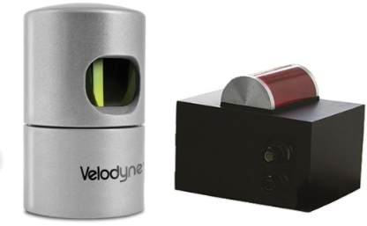
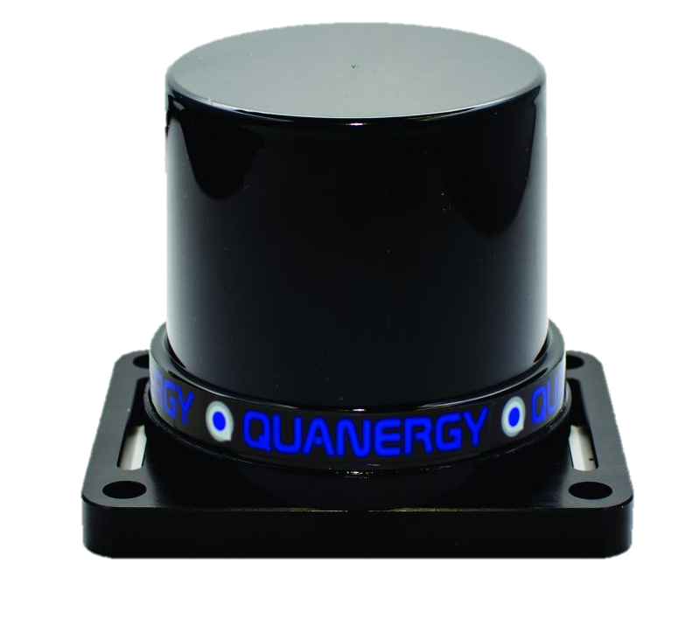
Saturation Attack
Adverse effect of curved reception glass
Obliquely illuminating VLP-16 ➔ fake dots not in the direction of the attacking light
Other lidars also have curved glass (e.g. HDL-32E, LUX mini, M8)
Notes:
And we found lidars other than VLP-16 also have curved reception glasses. Thus they might also have similar problems.

Slide 30
Saturation Attack
Adverse effect of curved reception glass
Obliquely illuminating VLP-16 ➔ fake dots not in the direction of the attacking light
Other lidars also have curved glass (e.g. HDL-32E, LUX mini, M8)
Victim lidar
Victim vehicle
Attacking light source
Attacker vehicle
Notes:
The significance of inducing fake dots other than the direction of the light source is that it can make the attack surface much wider. [Click] For example, the attacker in the lane next to the victim can induce fake dots in front of the victim. This is quite critical because in the adjacent lanes, the attack vehicle can approach much closer to the victim vehicle without alerting it.

Slide 31
Notes:
So, this is how it looks. [Play] Fake dots were induced in directions other than that of the light source.
비디오 다른걸로!

Slide 32
Spoofing by Relaying Attack – Ideal Attack Process
Inducing a farther fake dot
Previous work: Petit et al. - Black Hat Europe 2015
Spoofed fake dots are less important than the spoofer itself
$$l$$
$$Δt={2l/}/c$$
$$l−l_{s}$$
$$l_{s}$$
Receiver
$$+\frac{2\left(l−l_{s}\right)}{c}$$
Delay Component
Transmitter
$$Δt={2l/}/c$$
Petit, Jonathan, et al. "Remote attacks on automated vehicles sensors: Experiments on camera and lidar." Black Hat Europe 11 (2015)
Notes:
For the spoofing by relaying attack. I’d like to introduce the ideal attack process first to understand what’s going on briefly. For the induction of a father fake dot. It is basically the same as the previous work by Petit et al. Its principle is quite simple. It’s just to mimic the process of making echoes.
Let’s assume that the attacker wants to induce a fake dot at a distance of l from the lidar. If there’s a real object is at that distance, [Click] After the lidar fires a pulser, it will receive its echo after delta_t. [Click] To mimic this process with the spoofer located at l_s, [Click] after the receiver receiving the pinging pulse, [Click] it adds a delay of 2(l - l_s)/c to compensate the distance difference. After the added delay, the spoofer retransmits the attacking pulse. So, that retransmitted pulse will be seen as if it were l away.
In the attacker’s point of view, the problem of spoofing farther fake dots is that the importance of fake dots are quite limited as the spoofer itself is closer than the spoofed dots.

Slide 33
Spoofing by Relaying Attack – Ideal Attack Process
Why we cannot induce closer fake dots with this model
Negative delay required → impossible
$$l$$
$$Δt={2l/}/c$$
$$l−l_{s}<0$$
$$l_{s}$$
Delay: $\frac{2\left(l−l_{s}\right)}{c}<0$
Receiver
Delay Component
Transmitter
$$Δt={2l/}/c$$
Notes:
Then, why can’t we induce closer fake dots with this model? The reason is simple. [Click] It’s impossible to add negative delay.

Slide 34
Spoofing by Relaying Attack – Actual Attack Process
$$d_{a}$$
Difference from the ideal case
Laser beam diverges
Receiver-transmitter gap
$$S$$
$$T$$
$$d_{i}+d_{p}$$
① Multiple pulses received due to divergence
①
②
Time
Delay due to receiver-transmitter gap
Ideal Delay: $+d_{i}$
Processing Delay: $+d_{p}$
Receiver
PRT ($T$)
Lidar
Delay Component
② Attacking laser pulse fire
$$S$$
Transmitter
Lidar receiving aperture
Notes:
However, this becomes possible if we understand little more on how actually it works. The main difference from the ideal case is twofold. [Click] First, laser beams from the lidar diverge. [Click] Therefore, receivers with large aperture can detect multiple pulses. [Click] Second, due to receiver-transmitter displacement, there is an additional delay, S, until the lidar actually points to the direction of the transmitter so that it can receive attack pulses. Then finally the ideally requried delay, d_i, is added along with little processing delay, d_p, [Click] and the attack pulse is fired.

Slide 35
Spoofing by Relaying Attack – Actual Attack Process
$$d_{a}$$
Difference from the ideal case
Laser beam diverges
Receiver-transmitter gap
Why this makes closer fake dots possible
$d_{a}=d_{i}+nT+S+d_{p}$
Even if $d_{i}<0$ for closer fake dots, $d_{a}>0$ ($∵T,S≫\left|d_{i}\right|$)
$$S$$
$$T$$
$$d_{i}+d_{p}$$
①
②
Time
Notes:
So the importance of this actual process is that the actual required total delay, d_a, is the sum of various delays. And because S and T are much larger than d_i, even if d_i becomes negative, d_a still remain positive. Thus induction of closer fake dots become feasible.

Slide 36
Spoofing by Relaying Attack – Experimental Setup
Lidar → PD → Receiver Circuit → Function Generator → PLD driver → PLD
Spoofer
Receiver Circuit
Photodiode
Function Generator
Pulse Laser Diode Driver
Pulse Laser Diode
Notes:
For the spoofing attack experiment, we implemented the spoofer as in the diagram below. To spoof, we first aimed the lidar with the spoofer. [Click] When the fired pulses are received by the photodiode, [Click] it passes the raw electric signal to the receiver circuit, [Click] and it converts it into a series of 5V pulses so that the function generator can be triggered upon it. [Click] Based on this input trigger, the function generator [Click] adds some delay then emit pulses to the pulse laser diode driver. [Click] Finally the driver let the pulse laser diode emit attacking pulses.

Slide 37
Spoofing by Relaying Attack – Experimental Setup
Lidar → PD → Receiver Circuit → Function Generator → PLD driver → PLD
Inducing closer fake dots
Induce farther dots
Reduce the delay in function generator
Observer closer dots
Spoofer
Receiver Circuit
Photodiode
Function Generator
Pulse Laser Diode Driver
Pulse Laser Diode
Notes:
To induce the closer fake dots, we first induced farther fake dots, then reduced the delay parameter of the function generator until closer dots are observed.

Slide 38
Notes:
So this is how it looks. [Play] In the video both the spoofer and lidar are located inside the room perimeter. So the fake dots are farther ones. We altered the delay parameter of the function generator so that the induced fake dots move forward and backward.

Slide 39
Notes:
So, this is how it looks. [Play] Here, we set the spoofer to induce closer fake dots. As you can see, induced fake dots are located between the lidar and the spoofer.
왼쪽 영상에서 사실은 먼 Fake Dot을 만들고 있다는 얘기. 스푸퍼는 방안에 있다고 얘기하고

Slide 40
Notes:
In addition, although not mentioned in the paper, we also experimented spoofing attack outside. Although it was little tricky to spoof fake dots due to sunlight, we could observe them.

Slide 41
Details of the experiments & tools
Please refer to the appendices webpage
https://sites.google.com/view/ches17illusionanddazzle
URL is also written on the last page of the paper
Notes:
I want to note that all the details of the experiments can be found on the appendices of the paper. Please refer to it.
다 지우고, appendices 페이지와 논문 마지막 페이지 넣어서 참조하라고 하기.

Slide 42
Discussion
Stealthiness
Proposed attacks use IR ➔ invisible to human drivers & pedestrians
Notes:
Before concluding the presentation, I’d like to discuss a couple of topics on the proposed attack methods. The first one is stealthiness. As the proposed attacks use IR, they are invisible to human drivers & pedestrians.

Slide 43
Discussion
Stealthiness
Proposed attacks use IR ➔ invisible to human drivers & pedestrians
Receiving angle larger than needed
Actual receiving angle $≫$ Minimum required receiving
VLP-16: minimum (0.0048°) vs. actual (2°)
Much wider region affected by the attack
Notes:
The second one is the receiving angle. We found the actual receiving angle was much larget than the minimum required receiving angle. For the case of VLP-16, its minimum required receiving angle to be its specification was just 0.0048 degree. However, its actual receiving angle was measured to be at least 2 degree. This large receiving angle led to much wider region affected by the attack.

Slide 44
Possible Countermeasures and limitations
Saturation
Detection is easy
Multiple sensors + program to abandon compromised sensor output
Minimizing receiving angle → reduce the size of affected region
However, cannot be prevented → none of above is an ultimate solution
Notes:
I’d also like to discuss possible countermeasures and their limitations. First, for the saturation attack, the detection is very easy. So, automakers may adopt multiple sensors, and program the vehicle to abandon the compromised sensor output and to recover with other sensors. Lidar manufacturers can minimize the receiving angle to minimize the size of affected region. However, as the saturation itself cannot be prevented, we want to note that none of these is an ultimate solution for the attack.

Slide 45
Possible Countermeasures and limitations
Saturation
Detection is easy
Multiple sensors + program to abandon compromised sensor output
Minimizing receiving angle → reduce the size of affected region
However, cannot be prevented → none of above is an ultimate solution
Spoofing
Minimizing receiving angle
Adding slight random perturbation to PRTs ∵ Random probing is hard to be adopted for current rotating lidars
However, induction of single, farther fake dot per spoofer is still possible
Notes:
To defend spoofing attacks, first, minimizing receiving angle will also work. Second, by adding slight random perturbation to PRTs, the induction of closer dots would be prevented. We proposed this as a detour, because random probing is hard to be adopted for current rotating lidars due to their rapidly rotating parts. We want to emphasize that even with these countermeasures, induction of single, farther fake dot per spoofer is still possible.

Slide 46
Conclusion
Presented and experimentally verified two types of attacks against a COTS lidar
Notes:
In conclusion, we presented and experimentally verified two types of attacks against a COTS lidar.
현대 ACK을 발표자료에도 넣어야 하는지? → 교수님께

Slide 47
Conclusion
Presented and experimentally verified two types of attacks against a COTS lidar
Results show current lidars are defenseless against presented attacks
Notes:
And the results show that current lidars are defenseless against the presented attacks

Slide 48
Conclusion
Presented and experimentally verified two types of attacks against a COTS lidar
Results show current lidars are defenseless against presented attacks
Some defensive measures exist, but seems not enough to fully trust lidars
Notes:
Although some defensive measures exist, it seems not enough to fully trust lidars.

Slide 49
Conclusion
Presented and experimentally verified two types of attacks against a COTS lidar
Results show current lidars are defenseless against presented attacks
Some defensive measures exist, but seems not enough to fully trust lidars
Other environment perception sensors may have similar vulnerabilities against sensor attacks
Notes:
Because other types of sensors have similar working principle to lidars, they may also have similar vulnerabilities against sensor attacks.

Slide 50
Conclusion
Presented and experimentally verified two types of attacks against a COTS lidar
Results show current lidars are defenseless against presented attacks
Some defensive measures exist, but seems not enough to fully trust lidars
Other environment perception sensors may have similar vulnerabilities against sensor attacks
We do not think we should abandon autonomous driving, but things have to be more robust to be realized
Notes:
Despite the vulnerabilities found, we do not think we should completely abandon autonomous driving. However, we do think things has to be more robust to be realized.

Slide 51
Thank you for listening
E-mail: h.c.shin@kaist.ac.kr
Paper: ia.cr/2017/613
Appendices webpage: sites.google.com/view/ches17illusionanddazzle

Slide 52
Deploying attacks in reality
Aiming problem
main obstacle in deploying attacks in reality
Difficulty can be relieved by
Fixed lidar position on vehicles
Notes:
So, are proposed attacks real threats? One of the biggest obstacle in deploying proposed attacks in reality is the aiming problem. However, we think it is not the matter of possibility but the matter of difficulty. There are several reasons for it. First, lidars have fixed location on vehicles. Like rooftops and corners. With the vehicle database, the attacker can easily know where they should direct the attacking light to.

Slide 53
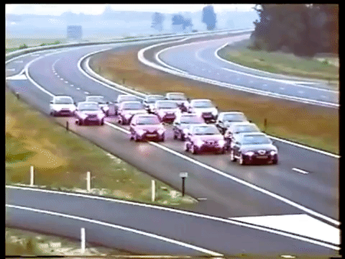
Deploying attacks in reality
Aiming problem
main obstacle in deploying attacks in reality
Difficulty can be relieved by
Exploiting situations where relative velocity is zero
Notes:
Second, it would be possible for the attacker to make the relative velocity close to zero so that it becomes like stationary cases.

Slide 54
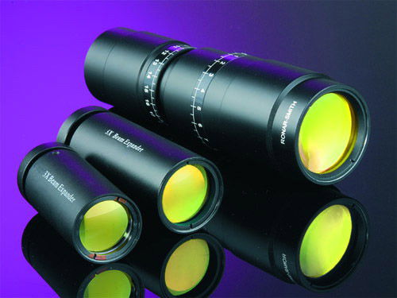
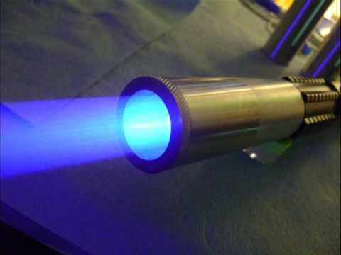
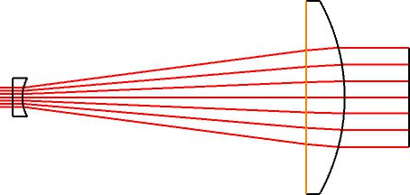
Discussion
Aiming problem: main obstacle in deploying attacks in reality
Difficulty can be relieved by
Fixed lidar position on vehicles
Exploiting situations where relative velocity is zero
Adoption of optical instrument like a beam expander
Notes:
Lastly, there are a lot of optical systems that can help attacker aiming.

Slide 55
Inducing multiple fake dots with one transmitter & receiver
If the lidar has constant PRT ➔ can predict next ping firing
Inducing farther fake dots at the distance of $l$ from the lidar with spoofer at $l_{s}$
$$T$$
$$T$$
$$T$$
: Lidar Ping Instants
: Spoofer Receiving Ping
: Attack Pulse Firing
$${l_{s}}/c$$
Time
PRT == $T$
light speed == $c$
Lidar~Spoofer distance == $l_{s}$
$$l/c$$
$${\left(l−l_{s}\right)}/c$$
$${\left(l−l_{s}\right)}/c+T$$
$${\left(l−l_{s}\right)}/c+2T$$
Notes:
The fundamental reason that a single spoofer can induce multiple fake dots comes from contant PRT. This diagram illustrates how it works. [Click] The spoofer receives the ping signal after l_s over c, and [Click] fires back the first attack pulse with the intentionally added delay of (l – l_s)/c. This will induce one fake dot at l to the victim lidar. [Click] The trick here is, without receiving any incoming ping signals, the attacker can continuously fire following pulses. Thus inducing multiple fake dots.

Slide 56
How randomizing PRT works
Unable to determine these instants
Unable to determine this instant
$$T$$
$$+X$$
$$T$$
$$+X$$
$$T$$
$$+X$$
$$T$$
$$+X$$
$$T$$
$$+X$$
Time
$${l_{s}}/c$$
Time
$${l_{s}}/c$$
$${l_{s}}/c$$
$$l/c$$
$$l/c$$
$${\left(l−l_{s}\right)}/c$$
$${\left(l−l_{s}\right)}/c+T$$
$$T−\frac{\left(l_{s}−l\right)}{c} >0$$
$$+X$$
$$+X$$
$${\left(l−l_{s}\right)}/c+2T$$
$$+2X$$
Notes:
The main reason that the attacker is able to induce closer dots and multiple dots is that the attacker can predict next ping timings based on the fixed PRT. Reviewing how inducing a closer dot work, the attacker first receives the ping signal, then waits for the delay equal to T plus the required negative delay, and fires the attack pulse. Likewise, the induction of multiple fake dots can be prevented. Without the perturbation, if the attacker can spot the attacking pulse firing timing for the first fake dot, subsequent pulse firing timings can be directly deduced.
[Click] These can be fundamentally prevented by adding a random perturbation X to T. Because the attacker cannot predict the true PRT, she cannot determine the firing time for the attack pulse.

